Slide 1
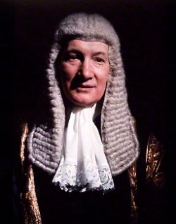
The Right Honourable
The Lord Denning
OM PC DL KC
Master of the Rolls
In office
19 April 1962 – 29 September 1982
But when we come to matters with a European element, the treaty is like an incoming tide. It flows into the estuaries and up the rivers. It cannot be held back. Parliament has decreed that the treaty is henceforward to be part of our law. It is equal in force to any statute.
H P Bulmer Ltd and another v J Bollinger SA and others- [1974] 2 All ER 1226 at 1232-3.

Slide 2
A few years later…
“All this shows that the flowing tide of Community law is coming in fast. It has not stopped at high-water mark. It has broken the dykes and the banks. It has submerged the surrounding land. So much so that we have to learn to become amphibious if we wish to keep our heads above water”
(Shields v E Coomes (Holdings) Ltd [1979] 1 All ER 456, 462).

Slide 3
The Right Honourable
The Lord Denning
OM PC DL KC
Master of the Rolls
In office
19 April 1962 – 29 September 1982
No longer is European law an incoming tide flowing up the estuaries of England. It is now like a tidal wave bringing down our sea walls and flowing inland over our fields and houses—to the dismay of all.
Introduction to The European Court of Justice: Judges or Policy Makers? (London: Bruges Group, 1990).

Slide 4
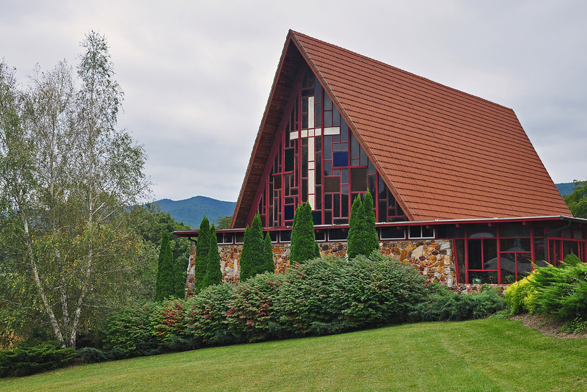
Public Affairs & Religious Liberty Department
Ambassadors / Advocates – BIBLICAL MODEL

Slide 5
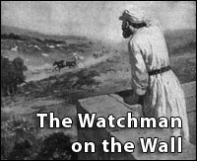

Slide 6
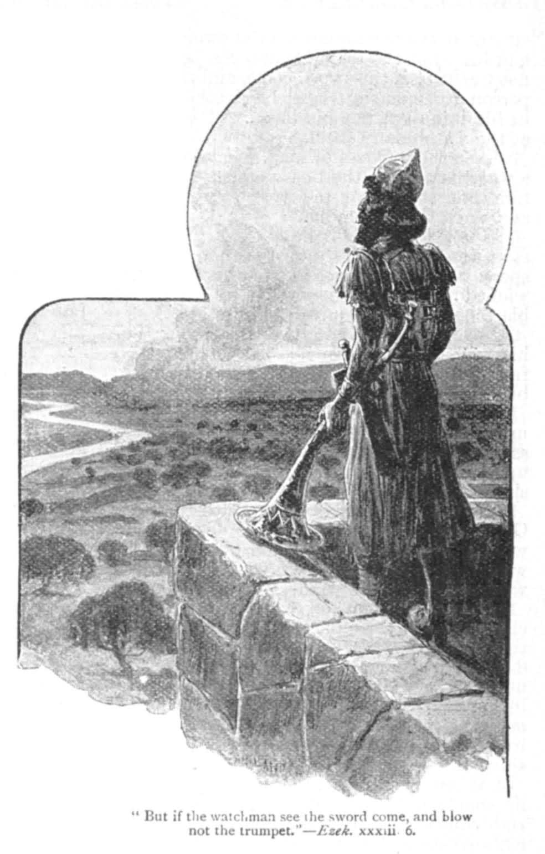
Ezekiel 33:6 KJV
⁶ But if the watchman see the sword come, and blow not the trumpet, and the people be not warned; if the sword come, and take any person from among them, he is taken away in his iniquity; but his blood will I require at the watchman's hand.

Slide 7


Public Affairs & Religious Liberty Training Seminar

Slide 8
GC PARL AIM STATES:
‘We work to position the Seventh-day Adventist Church and its services to a standing of credibility, trust, and relevance in the public realm’
(https://www.adventistliberty.org/quick-overview)

Slide 9
Why?
‘So the Adventist Church can be more effective in its mission…’
What Does PARL Do?
‘For this reason, PARL has a wide mandate. PARL works in cooperation with other church departments to advocate public policy positions on issues in areas as diverse as health, education, peace issues, environmental protection, women’s issues, children’s issues, the rights of prisoners, aid and development.’
https://www.adventistliberty.org/quick-overview

Slide 10
The Need For Church Ambassadors
The need for special religious liberty advocates called “Church Ambassadors” at each level of our church organization has become a priority. As with all religious minorities, we are often victims of prejudice because the authorities and the public do not
Ted N.C. Wilson – General Conference President
know who we are. We try to compensate from time to time by organizing public events; but these are not adequate if no regular contacts are made or relationships established. Unfortunately, the price we pay for this neglect is often very high.
Church Ambassador Manual by John Graz

Slide 11
The Urgency For Church Ambassadors
It is urgent that we equip our churches with talented and committed “Church Ambassadors.” They will become the face of the church in the public life of the city, the county, the state or province and of the country.
Ted N.C. Wilson – General Conference President
There are many church members who have knowledge and experience of public life and who would be willing to serve in this position. We must find and equip them.
Church Ambassador Manual by John Graz

Slide 12
AMBASSADOR
Sent As
High Commissioner, Diplomat & Representative
of the State

Slide 13
General Principles and Purposes of Being An Ambassador
Representing the sending state in the receiving state;
Protecting in the receiving state the interest of the sending state and its nationals, within the limits permitted by international law;
Negotiating with the government of the receiving state;
Ascertaining, by all lawful means, conditions and developments in the receiving state, and reporting thereon to the government of the sending state;
Promoting friendly relations between the sending state and the receiving state, and the developing their economic, cultural, and scientific relations.
1961 Vienna Convention on Diplomatic Relations

Slide 14
Qualification On Being An
Ambassador For Christ
Therefore if any man be in Christ,
he is a new creature: old things are passed away; behold, all things are become new. 2 Cor. 5:17 (KJV)
Anyone who is joined to Christ is a new being; the old is gone, the new has come.
2 Cor. 5:17 (CEB)

Slide 15
On being a Seventh-day Adventist
Ambassador for Christ
Now then we are ambassadors for Christ, as though God did beseech you by us: we pray you in Christ's stead, be ye reconciled to God. - 2 Cor. 5:20 (KJV)
Here we are, then, speaking for Christ, as though God himself were making his appeal through us. We plead on Christ's behalf: let God change you from enemies into his friends! - 2 Cor. 5:20 (GNT)

Slide 16
An Ambassador as
Representative for Christ
So we are ambassadors who represent Christ. God is negotiating with you through us. We beg you as Christ’s representatives.
“Be reconciled to God.”
2 Corinthians 5:20 (CEB)

Slide 17
ROLE OF PARL
IN THE LOCAL CHURCH
AND THE PUBLIC SQUARE
Following the Church Ambassador Biblical Model, a PARL leader is encouraged to serve God and represent the Seventh-day Adventist Church to Governments, International Organizations, Non-Governmental Associations, Religious Bodies and the Public Square

Slide 18
Support, protect and advocate religious freedom and human rights for all people, sharing Adventist Christian values of freedom of worship and belief.
2. Work individually with church members in need of workplace reasonable accommodation (Sabbath work issues) and religious discrimination assistance. Refer these members first to the local pastor and then if needs be involving the local Conference or Union Office of PARL Department.
3. Provide the local Pastor, Church Congregation and the Conference with information on the current events – albeit national, regional and international in which the Seventh-day Adventist Church has vested interest and which affects religious liberty issues. Be accurate in your fact finding and only report on authentic news. Discern between true and false issues. Spotting faulty reasoning and holding one’s tongue when tempted to strike out in retaliation is one necessary attribute of those who are ambassadors for Christ.

Slide 19
4. Monitor closely state legislation actions, clarify them with the Pastor, Conference or Union Office leaders. If needs be, also raise the matter with state officials or legislators to work with them to bring about solutions which uphold individual religious freedom.
5. Mobilise and motivate the Pastor and church members to speak out on serious religious liberty related issues.
6. Provide speakers/seminars to your local church on timely religious liberty topics.

Slide 20
7. Take part in organising events (e.g. health fares) at your church, and invite local politicians/dignitaries to the events as a means of acquainting them with the good work that the church is doing in the community.
8. Periodically attend City/Town and government meetings, even when no religious liberty issues are present, to become more acquainted with elected officials and the issues they deal with. When a civic official in your community takes a strong stand on upholding religious liberty, recognise the official by presenting a plaque or an award at the church or at the official’s office

Slide 21
9. Become acquainted with your Local Councillors, MPs and MEPs, as this makes it easier to write to them when religious liberty issues arise.
10. Develop a file of religious liberty resource materials for your church and be prepared to hand it over to the leader who replaces you. Maintain a Religious Liberty Notice Board and keep it up to date.

Slide 22

SEC PARL
Ambassadors
For Christ
Find,
Train, Equip, Disciple and Send

Slide 23
Compilation By:
Brighton G Kavaloh
SEC Public Affairs and Religious Liberty Director

