Slide 1


Slide 2
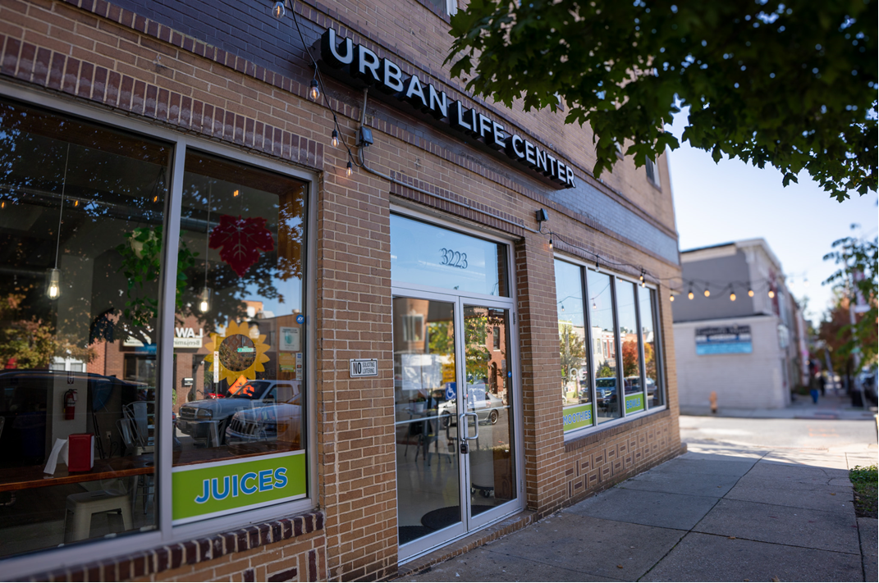
Urban Life Center
Baltimore, MD, USA

Slide 3

Principles of Urban Evangelism
Washington Adventist University
Notes:
1- Do you ever wish you could be a better witness? Wish you could be a better influence. But you are not speaker.
2-- You can live an evangelistic life every day. Maybe not from the pulpit.
3-- The gospel commission can be done without preaching.
4-- There are different forms of "preaching.
5-- Jesus was very effective at meeting people.
6-- We are going to learn His methods. Because Jesus did a lot of "preaching" by actions.
7-- Who is called to share the gospel? Everyone a minister
8- Priesthood of all believers. NT church grew by lay people. They didn't even have paid ministers.
9-- They followed Jesus' example? What was it?

Slide 4
Living An Evangelistic Life Sessions
Session 1: Principles of Personal Evangelism
Session 2: Every Day Opportunities
Session 3: How to Visit People
Session 4: How to have a Bible Study
Session 5: How to have a Daily Devotional Life
Session 6: Getting Decisions and Making Appeals
Notes:
In this session, I want to share the importance of developing relationships in evangelism.
We will look at three principles of soul winning-- of reaching people's hearts. You can apply these principles to your life. If you ignore, you will not reach people.

Slide 5

Session 1:
Principles of Personal Evangelism

Slide 6
Christ’s Way of Personal Evangelism
“Christ’s method alone will give true success in reaching the people. The Savior mingled with men as One who desired their good. He showed His sympathy for them, ministered to their needs, and won their confidence. Then He bade them, ‘Follow Me.’ ”
Ministry of Healing p. 143
Notes:
1- Mingled with men
-- Wedding at Cana
2- Showed sympathy
-- adulterious woman: mercy
--- disfellowship should not be first step
-- don't abuse the Achan story
3- Minister to their needs
-- Jesus and the blind man
4- Won their confidence
-- woman at the well
5-- Then follow Me
Our problem is going right to #5( inviting people to follow Jesus) without doing the other 4. Yes, Jesus' method takes longer. But success.
We will hold evangelistic meetings without having done any personal work in the community. We must incorporate the first 4 steps before going to #5.

Slide 7
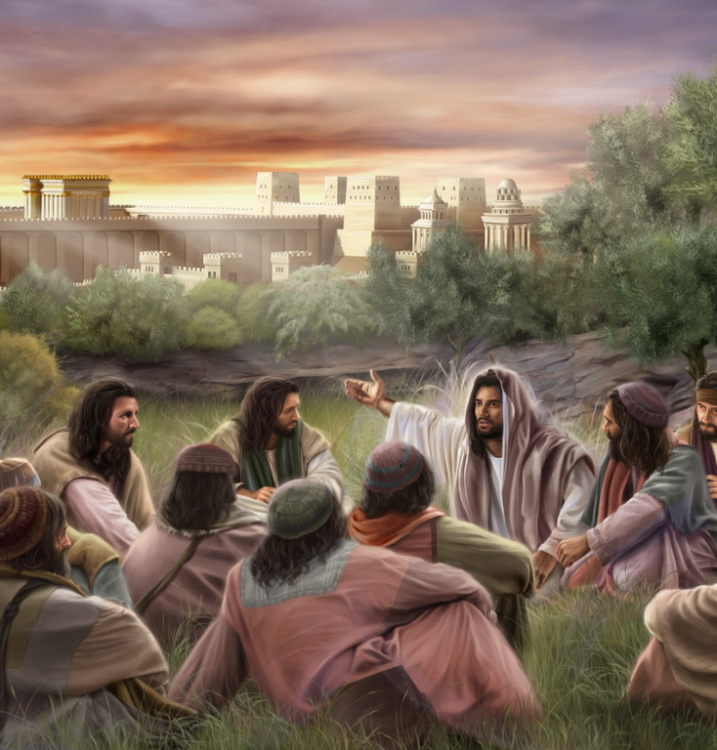
Christ’s Way of Personal Evangelism
Mingled with men
Showed sympathy
Ministered to their needs
Won their confidence and friendship
Invited them to follow Him
Notes:
1- Give some examples of how you can mingle with men?
2- I mingle by playing basketball (story of Paul)
3- Mingling with unbelievers is sometimes uncomfortable
a- improper language and joking
b- dietary habits
4- People misuse the text of "not being of the world"
a- cannot disconnect ourselves from people
b- Jesus came into the world, got dirty
5- Caution: when they have more of an influence on you, then you on them, then back off. Let Spirit guide you.

Slide 8
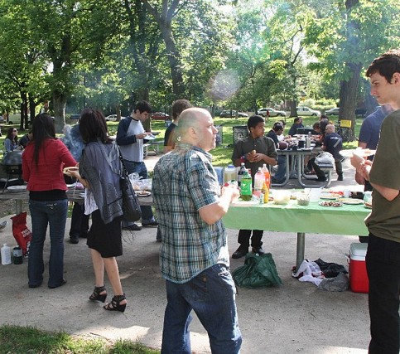
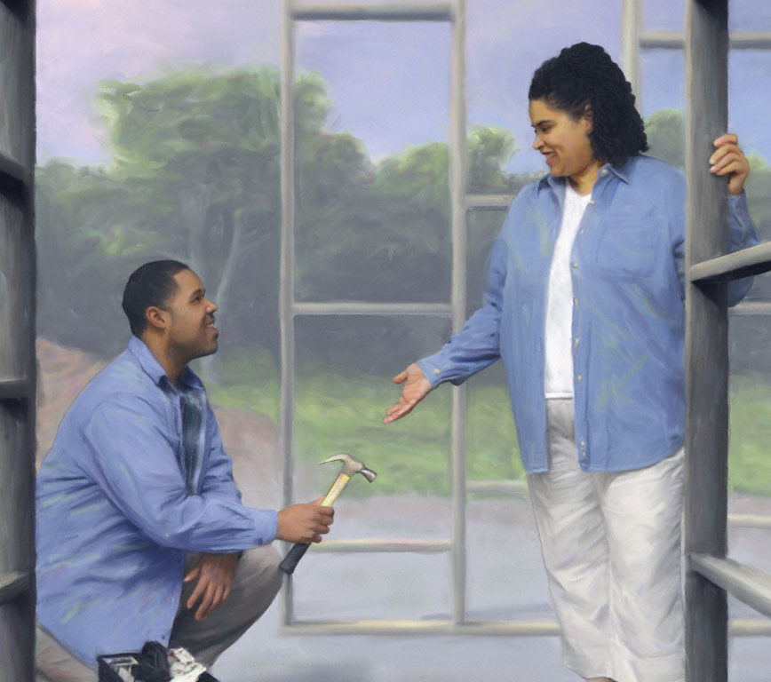
Mingling with People
Going to a barbeque
Playing golf
Shopping
Exercising
Lunch with someone
Notes:
1- When you take time to build friendships, it opens doors. When they trust you, they will ask you spiritual questions when the need arises. Pray to God asking that the person will ask you quesitons.
2. A true friend is rare. People will value it.
3. Story of Paul. Started asking me questions.
4. They will ask, if you live your faith.

Slide 9
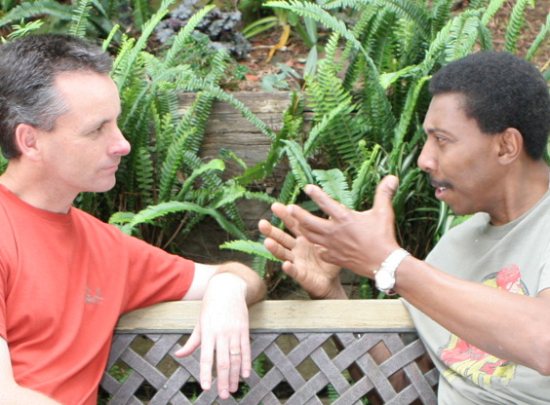
As you build a friendship, you will be the one they come to for their spiritual questions
Notes:
1- When you take time to build friendships, it opens doors. When they trust you, they will ask you spiritual questions when the need arises. Pray to God asking that the person will ask you quesitons.
2. A true friend is rare. People will value it.
3. Story of Paul. Started asking me questions.
4. They will ask, if you live your faith.

Slide 10
In every person’s life, there will be a window of opportunity where they will be interested in spiritual things.
Notes:
1- When you take time to build friendships, it opens doors. When they trust you, they will ask you spiritual questions when the need arises. Pray to God asking that the person will ask you quesitons.
2. A true friend is rare. People will value it.
3. Story of Paul. Started asking me questions.
4. They will ask, if you live your faith.

Slide 11
Flavel Yeakly Study
Flavel Yeakly Study
First Group
Second Group
Those who did not make a decision
Third Group
Those who became active members
Those who dropped out of the church
Notes:
1. Flavel Yeakley did a study of three groups of people. The three groups are listed below.
I'd like you to notice what approaches were used with each of these groups.

Slide 12
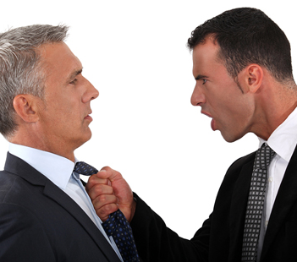


Those who dropped out of church
71% were approached with truth by someone exerting pressure
Notes:
1. This is not Jesus method. He never pressured.
2. Pressured decisions do not last. They give up during times of trial. Why? Because there is no supportive friendship to lean on. When the "decision" is obtained, the "friend" is gone.
3. I'm not saying a person shouldn't be bold. There is a time for boldness. See Acts 4:23-31.
4. But directness must be done in the context of a relationship. You must earn the right to be direct.
5. If you pressure me, I'll resist you. Example of condo saleman in Florida.
6. Let the Holy Spirit guide you when to be direct. Not always the right time.
7. But first friendship is essential. Give the Holy Spirit time to work.

Slide 13

Those who did not make a decision
84% were approached by someone just presenting information
Notes:
1. This is the lazy man's approach. They didn't take time to develop a relationship. They just presented all the doctrines and said "take it or leave it. It's the truth. It's your choice to follow it. I told you, so the blood is off my hands."
2. You must cultivate the soil by friendship. Takes time.
3. It takes more than one contact to win people. Days of one stop witnessing are over. It happens, but rare.
4. Don't look to win people all at once. Take little steps.
5. Giving a tract usually doesn't convert people right away. That's just one step. It takes friendship to move them farther.
6. Story of Pat and alcohol. (Share your story)

Slide 14

Those who became active members
94% were approached by someone who dialogued with them, showed an interest in them, and gave them friendship
Notes:
1. Some say, "I followed the truth because it was the truth. I didn't need friendship. This friendship evangelism is bologna". Not everyone is like you.
2. The devil can use friendship to keep people from truth. God's people to use friendship to bring them to truth.
4. Unless a person makes friendships they don't stay.
5. This is why small groups are so important. The friendships are a strong influence on people. See Acts 2:41-47.
6. Once a week is not developing relationships. SS not to be a monologue.
7. Jesus didn't just give info. He came to this world and developed friendships. Amen.

Slide 15
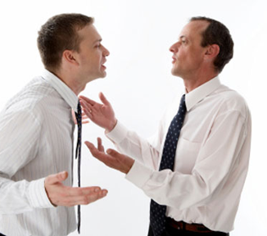
1. Agree with people whenever you can
Three Principles of Personal Evangelism
“Agree with the people on every point where you can consistently do so. Let them see you love their souls and want to be in harmony with them as far as possible.”
Evangelism p. 141
Start with what you have in common
Don’t start with differences
Notes:
1. Start with what you have in common. Never start with differences.
2. Example of Korean man on plane--- he talked about deliverance and speaking in tongues. He believed in the Holy Spirit in a way that was different from me. I talked to him about things we could agree on-- like meditation and having a daily devotional life, spiritual warfare through prayer, being filled with the Spirit. That was our common ground. If I would have started by disagreeing with him, I would have had no further opportunity with him. I gave him a book after the conversation and let the book deal with the difference.
3. Don't be argumentative. There will be no further opportunities. Open door ruined.
4. Don't agree with error. Silence is golden. You can say things like: "I see" "Wow" "That's interesting"

Slide 16
What if your Baptist friend says, “I can’t wait for the rapture!”
Notes:
Here are some possible areas. You have these things in common.
This is not the time to debate!
Can you think of some other responses?

Slide 17
What Others Have Said
I’m looking forward to meeting Jesus too.
I’m looking forward to heaven too.
I believe the end is very soon.
Notes:
Here are some possible areas. You have these things in common.
This is not the time to debate!
Can you think of some other responses?

Slide 18

What if your co-worker says, “I don’t believe in God. If he exists, why is the world so bad?”
Notes:
Timing is everything. You don't have to give it to them all at once.
Don't make them feel like it's a dumb question. They won't ask you again-- ever.

Slide 19
What Others Have Said
I’ve asked that question too. But then I found the answer.
Yes, it’s easy to feel that way. Would you like to know what I think?
Notes:
Timing is everything. You don't have to give it to them all at once.
Don't make them feel like it's a dumb question. They won't ask you again-- ever.

Slide 20
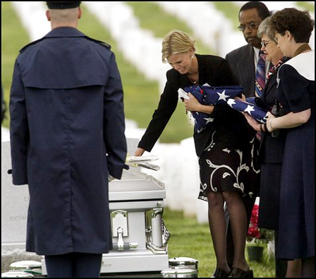
What if your friend says at a funeral, “I’m so happy my husband is walking the streets of gold.”
Notes:
1- Is a funeral a good place to set people straight on death? You will do ten times more harm than good.
2- Smile. Be supportive. The Holy Spirit will bring opportunities later.
3- When they ask a direct question, don't skirt the issue. That's the open door.
A common example-- The Pope is the anti-christ billboard. Will this win a Catholic? No. It's beginning with differences.
Would a billboard saying “Adventists are a cult” win you over?

Slide 21
What Others Have Said
I’m glad death isn’t the end for the Christian.
I’m sure you are looking forward to being reunited one day.
I can understand why you feel that way.
Silence and smile
Notes:
1- Is a funeral a good place to set people straight on death? You will do ten times more harm than good.
2- Smile. Be supportive. The Holy Spirit will bring opportunities later.
3- When they ask a direct question, don't skirt the issue. That's the open door.
A common example-- The Pope is the anti-christ billboard. Will this win a Catholic? No. It's beginning with differences.
Would a billboard saying “Adventists are a cult” win you over?

Slide 22

2. Never condemn or criticize
Three Principles of Personal Evangelism
Build them up
Acknowledge the good in them
Notes:
1- Find the good in the person. Jesus did. He said the good and the potential in Zacchaeus.
2- When you criticize, they'll argue even if they know they're wrong.
3-- How do you respond to criticism? Does it make you submissive? No.
4- Example of Marquita and I.

Slide 23
What should you do if you run into a non-attending member?
What should you do?
What should you not do?
Notes:
1- Smile. It communicates approval. Positive feelings.
2. Say, "We sure miss having you around."
3- "You're welcome to come back anytime"
4- "You know, we should never stop coming to church"
5- "It's a sin to not make time for God"
6- "You know better than this"
1- You don't need a theology degree to win the heart. There are people with PH D's who can't connect with the heart. Have you ever met a doctor whose not personable? He knows his stuff, but you can't talk to him about personal issues.
2- Kindness and warmth will win the heart where logic never could. Sometimes evangelism is not as successful because we rely on information and logic, but don't move the heart and develop relationships.
3- Example-- Sabbath is not about the right day. Sabbath is about spending time with Jesus and developing your relationship with Him.
4- Story of Lincoln barber shop.
5- What do you think it means "to find your way to the heart"?

Slide 24
“Your success will not depend so much upon your knowledge and accomplishments, as upon your ability to find your way to the heart.”
Evangelism p. 141
That means friendship!
Notes:
1- You don't need a theology degree to win the heart. There are people with PH D's who can't connect with the heart. Have you ever met a doctor whose not personable? He knows his stuff, but you can't talk to him about personal issues.
2- Kindness and warmth will win the heart where logic never could. Sometimes evangelism is not as successful because we rely on information and logic, but don't move the heart and develop relationships.
3- Example-- Sabbath is not about the right day. Sabbath is about spending time with Jesus and developing your relationship with Him.
4- Story of Lincoln barber shop.
5- What do you think it means "to find your way to the heart"?

Slide 25

3. Accept people where they are
Three Principles of Personal Evangelism
Never show disgust
Be their friend despite their bad habits
Love them in spite of who they are
Notes:
1- People must feel accepted. You can't shame them into following God. Holier than thou attitude will ruin any opportunity.
2- Example of gay person coming to Washington meetings. I met with him. Can gay people come to church? Can they be welcomed? Yes. As we make friends with them and study the Bible, the opportunity will come to discuss their lifestyle. But they will not listen unless they know you are their friend.
3- Example of critical lady in Leechburg about the Sabbath.
4- Never get mad.
5- Example of Jesus and Zaccheaus. Jesus not repulsed by Zacchaeus. Even went to his house. Read Luke 19.

Slide 26
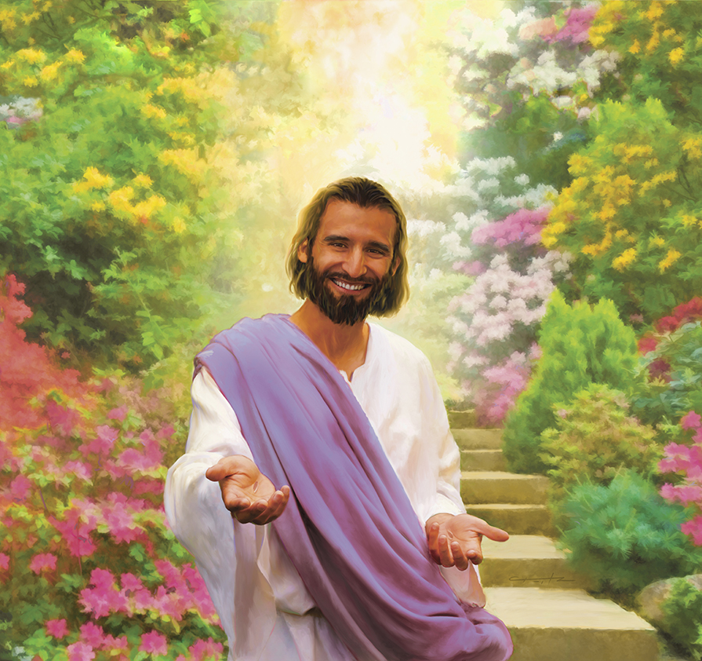
Jesus was a safe person. Are you?
“Come to Me, all you who labor and are heavy laden and I will give you rest…for I am gentle and lowly in heart, and You will find rest for your souls.”
Matthew 11: 28-30
Notes:
1- Are you a safe person to be around?
2- Do people feel comfortable talking to you?
3- Who came to Jesus? The meek. Lowly. Children. Sinners. People struggling in sin are the ones who felt comfortable around Jesus? Would they feel comfortable and accepted around you?
4- Quote from What's So Amazing About Grace book. Why aren't sinners attracted to the church today?

Slide 27
Separate or Mingling with the World
“The example of Christ in linking Himself with the interests of humanity should be followed by all who preach His word, and by all who have received the gospel of His grace. We are not to renounce social communion. We should not seclude ourselves from others. In order to reach all classes, we must meet them where they are. They will seldom seek us of their own accord. Not alone from the pulpit are the hearts of men touched by divine truth.
Notes:
1- Are you a safe person to be around?
2- Do people feel comfortable talking to you?
3- Who came to Jesus? The meek. Lowly. Children. Sinners. People struggling in sin are the ones who felt comfortable around Jesus? Would they feel comfortable and accepted around you?
4- Quote from What's So Amazing About Grace book. Why aren't sinners attracted to the church today?

Slide 28
Separate or Mingling with the World
“There is another field of labor, humbler, it may be, but fully as promising. It is found in the home of the lowly, and in the mansion of the great; at the hospitable board, and in the gatherings for innocent social enjoyment.
As disciples of Christ we shall not mingle with the world from a mere love of pleasure, to unite with them in folly. Such association can result only in harm. We should never give sanction to sin by our words or our deeds, our silence or our presence.
Notes:
1- Are you a safe person to be around?
2- Do people feel comfortable talking to you?
3- Who came to Jesus? The meek. Lowly. Children. Sinners. People struggling in sin are the ones who felt comfortable around Jesus? Would they feel comfortable and accepted around you?
4- Quote from What's So Amazing About Grace book. Why aren't sinners attracted to the church today?

Slide 29
Separate or Mingling with the World
“Wherever we go, we are to carry Jesus with us, and to reveal to others the preciousness of our Saviour. But those who try to preserve their religion by hiding it within stone walls lose precious opportunities of doing good. Through the social relations, Christianity comes in contact with the world. . .
Social power, sanctified by the grace of Christ, must be improved in winning souls to the Saviour. Let the world see that we are not selfishly absorbed in our own interests.”
Desire of Ages, p. 127-128
Notes:
1- Are you a safe person to be around?
2- Do people feel comfortable talking to you?
3- Who came to Jesus? The meek. Lowly. Children. Sinners. People struggling in sin are the ones who felt comfortable around Jesus? Would they feel comfortable and accepted around you?
4- Quote from What's So Amazing About Grace book. Why aren't sinners attracted to the church today?

Slide 30

Seminar Info
Notes:
1. Evangelism doesn't start with the first night of a meeting. It starts by mingling with people.
2. This is how you prepare the soil. Not just by hanging literature on door knobs.
3. It starts with personal work and personal friendships.

Slide 31

Pastor David M. Klinedinst
Church Growth & Evangelism Director
Chesapeake Conference of SDA dklinedinst@ccosda.org DiscoverBibleProphecy.org
402-304-5603 855-744-HOPE davidklinedinst.org
Notes:
1. Evangelism doesn't start with the first night of a meeting. It starts by mingling with people.
2. This is how you prepare the soil. Not just by hanging literature on door knobs.
3. It starts with personal work and personal friendships.

Slide 32
Pastor David M. Klinedinst
Church Growth & Evangelism Director
Chesapeake Conference of SDA ccosda.org/evangelismtraining ccosda.org/pastorevangelistsbootcamp
Notes:
1. Evangelism doesn't start with the first night of a meeting. It starts by mingling with people.
2. This is how you prepare the soil. Not just by hanging literature on door knobs.
3. It starts with personal work and personal friendships.

Slide 33
Pastor David M. Klinedinst
Church Growth & Evangelism Director
Chesapeake Conference of SDA
DiscoverBibleProphecy.org
Notes:
1. Evangelism doesn't start with the first night of a meeting. It starts by mingling with people.
2. This is how you prepare the soil. Not just by hanging literature on door knobs.
3. It starts with personal work and personal friendships.

Slide 34
Living An Evangelistic Life
Columbus Evangelism
Training Weekend
Notes:
1- Do you ever wish you could be a better witness? Wish you could be a better influence. But you are not speaker.
2-- You can live an evangelistic life every day. Maybe not from the pulpit.
3-- The gospel commission can be done without preaching.
4-- There are different forms of "preaching.
5-- Jesus was very effective at meeting people.
6-- We are going to learn His methods. Because Jesus did a lot of "preaching" by actions.
7-- Who is called to share the gospel? Everyone a minister
8- Priesthood of all believers. NT church grew by lay people. They didn't even have paid ministers.
9-- They followed Jesus' example? What was it?

Slide 35

Taffy

Slide 37
Living An Evangelistic Life Sessions
Session 1: Principles of Personal Evangelism
Session 2: Every Day Opportunities
Session 3: How to Visit People
Session 4: How to have a Bible Study
Session 5: How to have a Daily Devotional Life
Session 6: Getting Decisions and Making Appeals
Notes:
In this session, I want to share the importance of developing relationships in evangelism.
We will look at three principles of soul winning-- of reaching people's hearts. You can apply these principles to your life. If you ignore, you will not reach people.

Slide 38

Session 2:
Every Day Opportunities
Notes:
1- Now we want to talk about how to look for opportunities in every day life.
2- Every day we hang around people. These are opportunities to plant seeds for Jesus.
3- How do we get to a point where we can share spiritual things with people?
4- How do we know if they are open?
5- How do we know if we've gone too far?
6. We will learn how to share our personal testimony and how to make a gospel presentation.

Slide 39



Every-Day Evangelism
1. Establish a Relationship
2. Discover their Interests
3. Share Spiritual Tidbits
Notes:
3 STEP PROCESS
1- You must establish a friendship before your spiritual seeds will make a difference. If they don't trust you, you can't move them spiritually.
"You can't win someone to Jesus who hasn't become your friend"
50% of soul-winning is about developing a relationship.
2- You discover their interests-- by asking questions-- spending time together. Learning about them as a person. Listening.
3- Then look for way to share small spiritual tidbits. Notice I said tidbits. The Mark of the Beast is not a small tidbit. You must earn the right to get to that point.

Slide 40

1. Establish a Relationship
Every-Day Evangelism
Spend time together
Play basketball
Play golf
Cookout
Attend pool party
Cross-stitch
Notes:
What are some other activities you can do to establish friendship with people? What can you do to spend time with unbelievers? Break into groups and share suggestions. Be creative.
Is spending time with unbelievers evangelism?

Slide 41
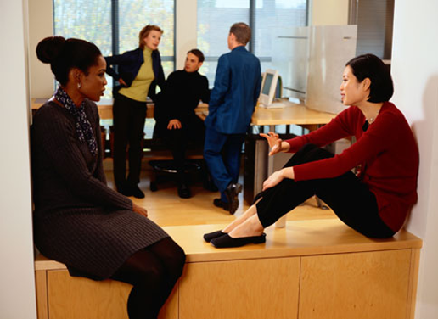
2. Discover their Interests
Every-Day Evangelism
amily
ccupation
ecreation
estimony
Notes:
1- Take an interest in their life. Learn what makes them tick.
2- Find out what's important to them.
3- I have used FORT many times to learn about people.
You're never at a lost what to talk about.
4. FORT -- Each letter represents a subject you can talk about with people.

Slide 42

Family
Tell me about your family.
How long have you been married?
How did you meet?
Tell me about your kids or grandkids.
How long have you lived here?
Notes:
People love to talk about family. Ask. Listen. Remember.
Ask me. I'll show you a picture of Melaney.

Slide 43

Occupation
Where do you work?
What do you do?
What did you do before?
How did you get into that line of work?
What’s your major?
Notes:
1- People spend a lot of time at work. Sometimes they define themselves by their work. You can learn a lot about a person by the type of work they do.
2- Bouncer at a night club. What would that tell you? Secular.
3- Accountant-- Detailed. Introvert.
4- Truck driver-- away from family a lot.

Slide 44
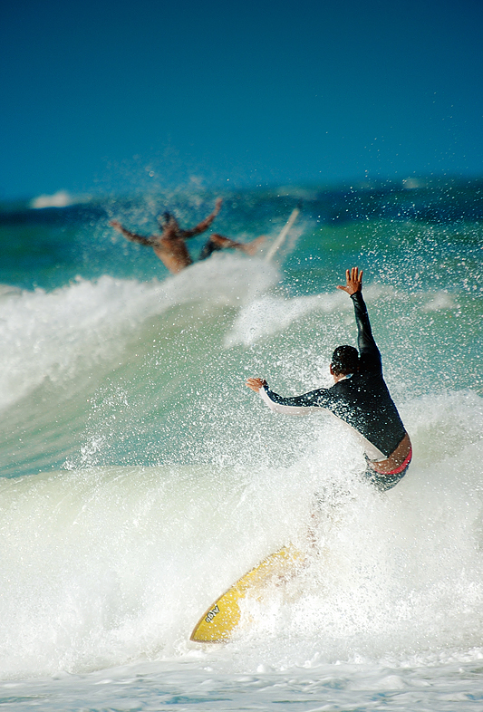
Recreation
What do you do for fun?
What are your hobbies?
What relieves stress?
What is your favorite vacation spot?
What’s your spouse’s hobbies?
Notes:
1- You may discover you have something in common. Then share it together.
2- Washington church had a scrapbooking night.
3- Baseball games with Mike Brach.
4. If they like fishing, then you can invite them with you sometime.

Slide 45
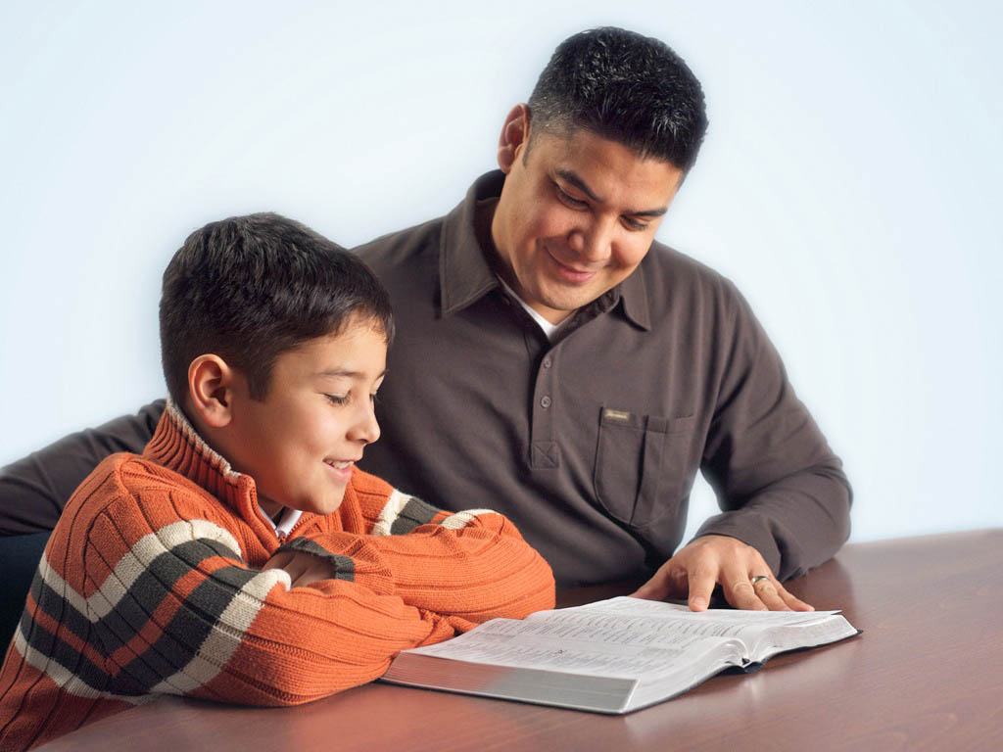
Testimony
Look for an opportunity to share a spiritual tidbit
Plant a small seed
Ask a spiritual question
Notes:
Then you look for an opportunity to plant a small spiritual tidbit in the conversation and see how they respond. We will do this in just a few minutes. But first let me show you how to use FORT.

Slide 46
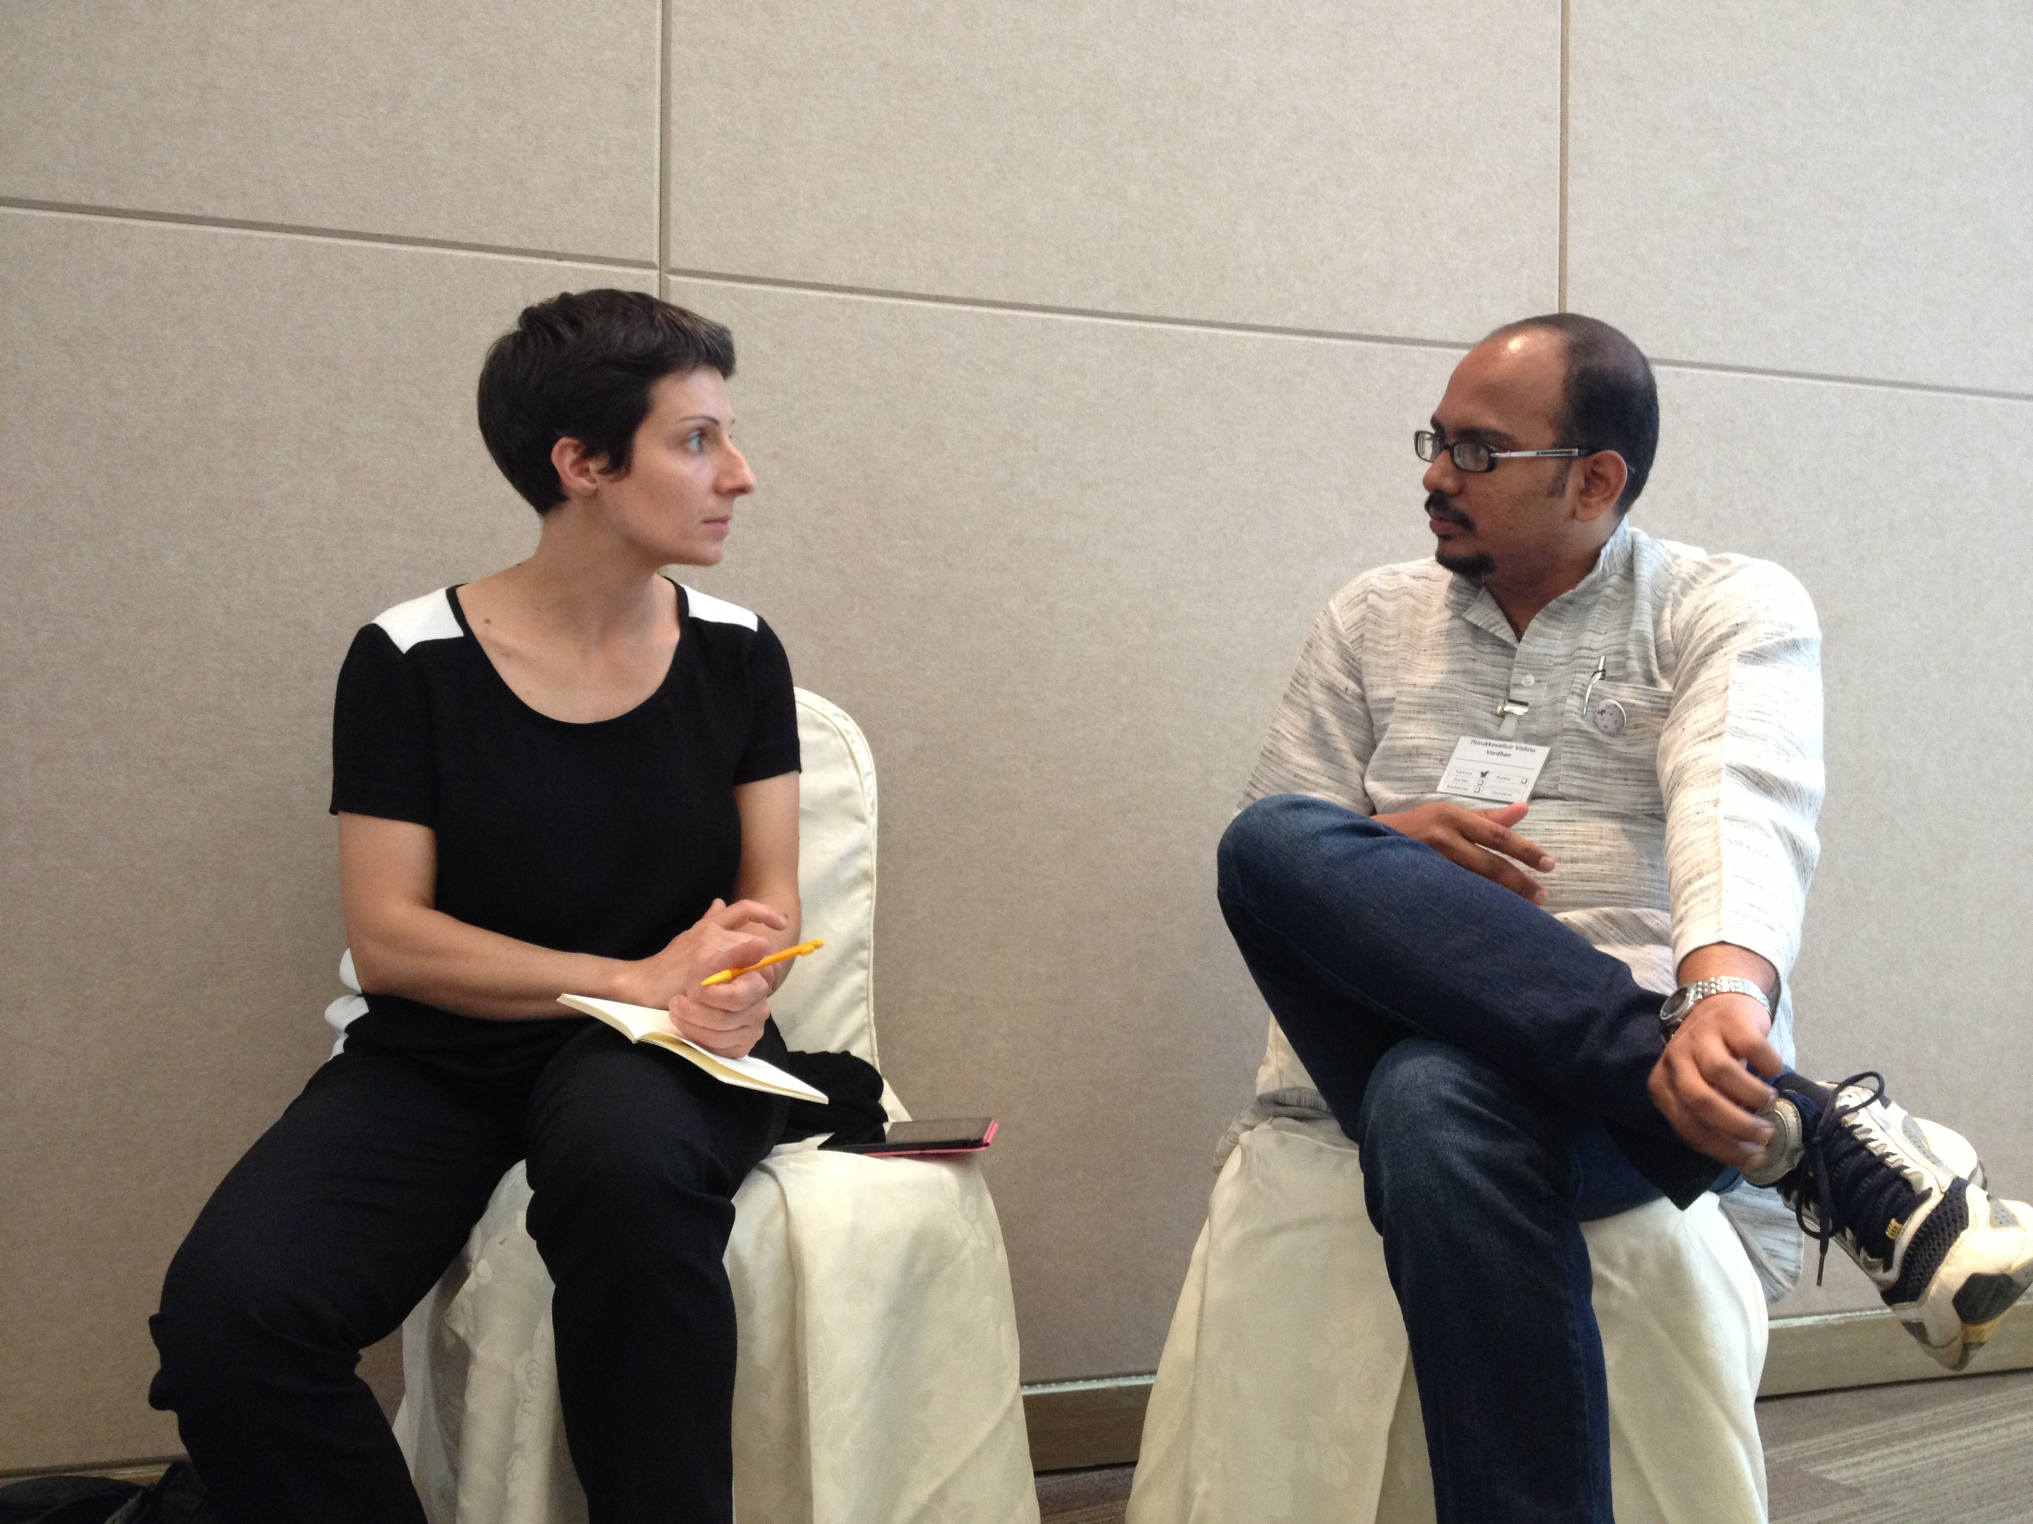
Role Play!
F amily
O ccupation
R ecreation
T estimony
Notes:
1- Role play with someone eating lunch at work (no testimony)
2- Role play with visitor at potluck
3- Some people are natural at this. For others, practice.
4- You won't do FORT all in one visit. Over time.
5- Do a role play with someone from the group. Pretend you are eating lunch with them at work. Go through FORT in a natural way.
6- Activity-- Have group ask FORT questions to person next to them.

Slide 47

3. Sharing a Testimony/Tidbit
Every-Day Evangelism
Look for opportunities to bring up something spiritual and see how they respond.
Notes:
1- This can only be done after a relationship developed.
2- How they respond indicates whether they are open to spiritual things. If no response, time not yet right.
3- I did this with my barber in Washington. When he would mourn about how bad the world is, I would plant a small spiritual tidbit like "Yes I know. The Bible warned us the world would be like this in the last days"-- and see how he responds to that. If he comments on it and asks me questions, then I know the door is open for further conversation. If he ignores my comment, then I know the door isn't open right now. Maybe next time. Keep praying.
4- Testing the waters..........

Slide 48

You are walking with a friend and see a beautiful sunset.
Notes:
Now, I'm going to give you come hypothetical situations. Break into groups and tell me, what could you say that would plant a small spiritual seed in this situation. Something that would not be offensive and would not start with differences. Discuss in groups..
1- Wow! I guess God wants us to see something beautiful today.
2- What a gorgeous sunset. It looks like God outdid Himself on that one.
3- I love sunsets. It reminds me that God still loves this old world.
4- Brainstorm other responses.....

Slide 49
What Others Have Said
I love sunsets. It reminds me that God still loves this old world.
God is a great artist.
God sure can make some beautiful things.
Notes:
Now, I'm going to give you come hypothetical situations. Break into groups and tell me, what could you say that would plant a small spiritual seed in this situation. Something that would not be offensive and would not start with differences. Discuss in groups..
1- Wow! I guess God wants us to see something beautiful today.
2- What a gorgeous sunset. It looks like God outdid Himself on that one.
3- I love sunsets. It reminds me that God still loves this old world.
4- Brainstorm other responses.....

Slide 50

You’re in the car with a friend and hear about more terrorist attacks in the world.
Notes:
1- This world is getting so crazy. I'm glad God is still in control.
2- If I didn't believe it God, I wouldn't have any hope for this world.
3- I'm sure looking forward to a better world.

Slide 51
What Others Have Said
This world is getting so crazy. It must make God weep.
I’m sure looking forward to a better world.
I’m glad there won’t be any of that stuff in heaven.
Notes:
1- This world is getting so crazy. I'm glad God is still in control.
2- If I didn't believe it God, I wouldn't have any hope for this world.
3- I'm sure looking forward to a better world.

Slide 52
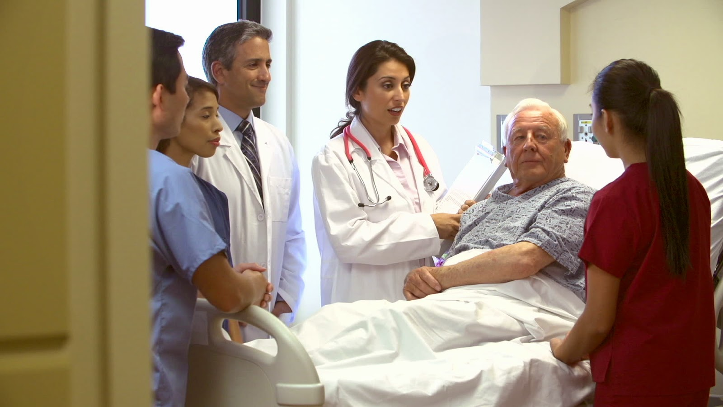
A co-worker has told you that a relative is in the hospital.
Notes:
1- What's your relatives name? I'll pray for him.
2- Would your relative mind if I stopped by and prayed with him?
3- I'll ask my church to pray for him.

Slide 53
What Others Have Said
What’s your relative’s name? I’ll pray for him/her.
Is it OK if I put his/her name on my church’s prayer list?
Would your relative mind if I stopped by and had prayer with him/her?
Notes:
1- What's your relatives name? I'll pray for him.
2- Would your relative mind if I stopped by and prayed with him?
3- I'll ask my church to pray for him.

Slide 54

Tidbits in Conversation
Always try to keep literature handy
Literature goes home with the person when you can’t. It keeps talking.
Notes:
1- Small booklets are best. Things that fit into a purse or coat. (Show some examples)
2- Always keep literature in car.
3- There were many times I wish I had literature to follow up a conversation.
4- Literature goes home with the person when you can't It gives more information. Your conversation may be only 5 minutes. Literature speaks for hours and days, etc.

Slide 55



Types of Literature
Steps to Christ
Amazing Facts tracts
Sharing booklets
Second Coming
Salvation
Sabbath
Death
Discover Cards
Notes:
1- Have booklets to cover basic truths.
2- If you don't have any, you could always bring one another day and say, "Rmemeber that conversation we had about the Sabbath? Here's a book that will answer your questions. It helped me."
3- If you give literature, ask them about it a few days later.
May open door for more conversation. If not, don't push it.
4. Once a quarter, your church could have a special giveaway book. Buy a few boxes and challenge each member to find one person to give the book to that quarter. Every member can reach the goal of once a quarter. It creates an atomosphere of evangelism in the church.

Slide 56

Christian Record Services provides for the visually impaired:
Braille books and lessons
Large print materials
Audio materials
402-488-0981
www.christianrecord.org
info@christianrecord.org
Notes:
1. Keep in mind, if you come in contact with someone who has a vision impairment, Christian Record Services offers many free materials to them. Contact us.

Slide 57

Video/DVD Evangelism
Using videos/DVDs can be an effective way to witness
The church has many Bible studies on video now
“I have some Bible studies on video that have been very helpful for me. I’d be happy to share them with you. Would you like to borrow them?”
Give them 1-2 videos at a time.
Notes:
1- Share example of York church following up LE leads with videos.
2- Some people don't want others in their home. Let them take videos home.
3- Give them 1-2 videos at a time. Switch once a week. People can watch in the privacy of their own homes.
4- Go in order. Do not skip. Example of woman in Uniontown I gave Seven Last Plagues video. Never again.
5- Use these to follow up IIW-VOP-AF leads. Tell them you're a volunteer with IIW and making video Bible studies available.
6- Follow up with people who come to part of evangelistic meetings. Tell them they can watch what they missed. Don't do this during the meetings. They'll stay home.
7- Use these to follow up conversations.

Slide 58

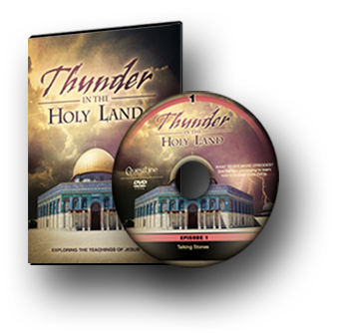
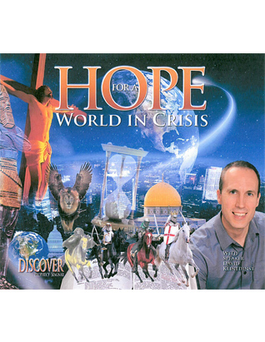
Types of Literature
Revelation of Hope
Revelation Today
Discoveries in Prophecy
Thunder in the Holy Land
Discover Bible Prophecy
Forecasting Hope
Notes:
1- Many videos to choose from. They're cheap. Have your church buy a few sets for people to share.
2- Great way for shy people to share. You make the friendship. Let someone else do the preaching.

Slide 59

DiscoverBibleProphecy.org

Slide 60
Sharing Your Testimony
Be able to share in 3-5 minutes
How did you become a Christian?
Why did you become a Christian?
Why is it a blessing?
Notes:
When the opportunity comes to share you testimony, you need to be able to answer these questions briefly. If they ask questions, then take more time.
2- Some situations allow for deeper sharing. Start briefly. Then if door remains open, go longer.
3- You can tell if someone is interested. Eye contact. Nodding head. Asking questions.
4. It’s OK not to have a dramatic testimony.

Slide 61
Sharing Your Testimony
Be able to share in 3-5 minutes
How did you learn about the Sabbath?
Why do you keep it?
Why is it a blessing?
Notes:
You need to be able to answer in 5 minutes concerning any particular belief.

Slide 62
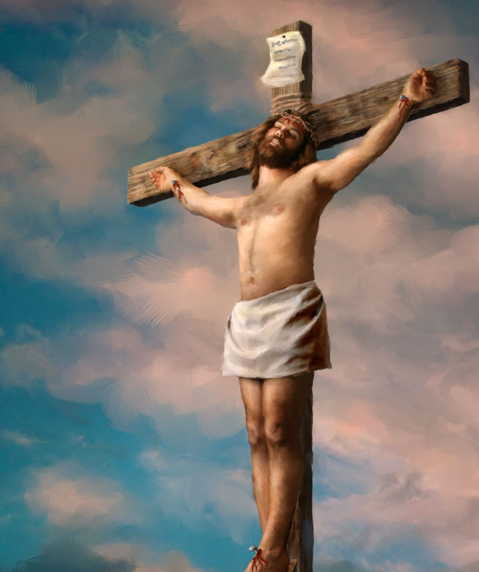
Making a Gospel Presentation
We are born with sin. It’s easy to do wrong. Everyone has made mistakes. Romans 3:23
The penalty of sin is death. Romans 6:23
Jesus paid the penalty. He lived a perfect life in our place. When He becomes your Savior, His perfect life counts for you. John 3:16
We must invite Him. Revelation 3:20
Notes:
Here is a simple way to make a gospel presentation. Just go over these four points.
People don't need big theological words. Make it simple. In the beginning, they just need to understand they are a sinner who needs Jesus and to ask Jesus into their lives. It's that simple.
EXAMPLE-- Do a role play with someone and illustrate how to explain the gospel to someone using these four steps. Invite them to accept Jesus. Have prayer with them.

Slide 63
Taking action with the person
“Would you like to invite Jesus into your life?”
Invite them to pray in their own words
You pray in confirmation
Disciple them to know Jesus better
Get them to church
Start a Bible study
Notes:
When they say yes, pray with them. Invite them to church or to a personal Bible study immediately.

Slide 64
“The one work more precious than any other is the work of soul-saving. The same intensity of desire for the saving of souls that marked the life of the Savior marks the life of His true followers.”
-Australian Union Conference Record Aug. 15, 1902
Notes:
We need to pray for this intensity. This passion.
Maybe it needs to be re-ignited in us.
Ask God to place it in your heart.

Slide 65
Seminar Info
Notes:
1. Evangelism doesn't start with the first night of a meeting. It starts by mingling with people.
2. This is how you prepare the soil. Not just by hanging literature on door knobs.
3. It starts with personal work and personal friendships.

Slide 66
Pastor David M. Klinedinst
Church Growth & Evangelism Director
Chesapeake Conference of SDA dklinedinst@ccosda.org DiscoverBibleProphecy.org
402-304-5603 davidklinedinst.org momentswithjesus.org ccosda.org/evangelismtraining
Notes:
1. Evangelism doesn't start with the first night of a meeting. It starts by mingling with people.
2. This is how you prepare the soil. Not just by hanging literature on door knobs.
3. It starts with personal work and personal friendships.

Slide 67
WEBSITES
DiscoverBibleProphecy.org
Ccosda.org/pastorevangelistsbootcamp
Ccosda.org/evangelismtraining
MomentsWithJesus.org
Notes:
We need to pray for this intensity. This passion.
Maybe it needs to be re-ignited in us.
Ask God to place it in your heart.

Slide 68
Living An Evangelistic Life
Chesapeake Conference
Equipping University
Notes:
1- Do you ever wish you could be a better witness? Wish you could be a better influence. But you are not speaker.
2-- You can live an evangelistic life every day. Maybe not from the pulpit.
3-- The gospel commission can be done without preaching.
4-- There are different forms of "preaching.
5-- Jesus was very effective at meeting people.
6-- We are going to learn His methods. Because Jesus did a lot of "preaching" by actions.
7-- Who is called to share the gospel? Everyone a minister
8- Priesthood of all believers. NT church grew by lay people. They didn't even have paid ministers.
9-- They followed Jesus' example? What was it?

Slide 69
Living An Evangelistic Life Sessions
Session 1: Principles of Personal Evangelism
Session 2: Every Day Opportunities
Session 3: How to Visit People
Session 4: How to have a Bible Study
Session 5: How to have a Daily Devotional Life
Session 6: Getting Decisions and Making Appeals
Notes:
In this session, I want to share the importance of developing relationships in evangelism.
We will look at three principles of soul winning-- of reaching people's hearts. You can apply these principles to your life. If you ignore, you will not reach people.

Slide 70
Session 3:
How to Visit People
Notes:
We are going to learn how to visit different types of people.
-- first time visitors to church
-- former Adventists
-- the sick
We will do some role play.
Observe how to put FORT into practice.

Slide 71
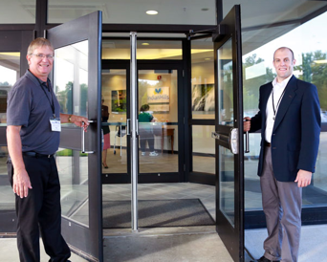
Welcoming Guests
It is essential to have an organized welcoming system.
You must have a plan.
It will not happen automatically.

Slide 72
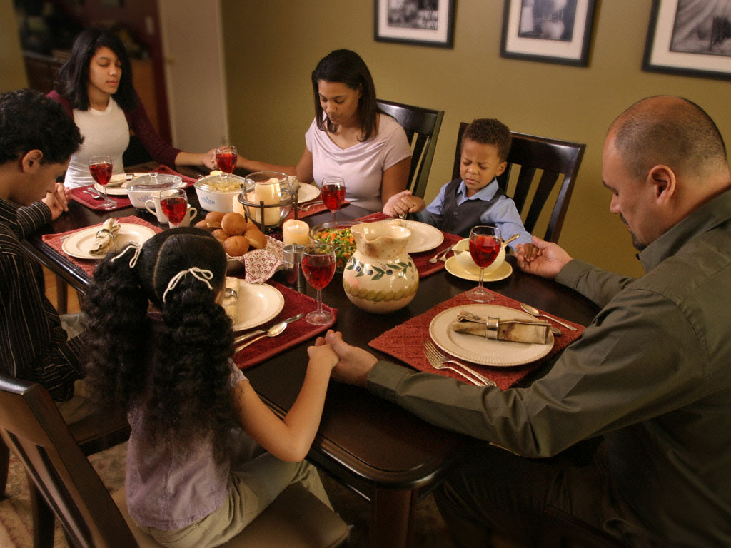
Invite them to your home for a meal
How to Connect With a Visitor
What To Say:
“Jean, I’ve noticed that you’ve been coming to our church and I haven’t gotten a chance to get to know you. I’d like to invite you to our home for a meal this week.”
Notes:
It's as simple as saying this. Or call them in the middle of the week and invite them.

Slide 73
Use the FORT method!
What To Talk About
amily
ccupation
ecreation
estimony
Notes:
When they are at your house, ask them about these things.
Family
Occupation
Recreation
Testimony

Slide 74
More Questions To Ask
How did you find our church?
What brought you here today?
Have you ever been to an Adventist Church
Do you have any questions about our church?
Notes:
These questions are the Testimony stage. It helps you know where they are spiritually.
You can do the same thing in their house or at potluck.
You might even give them SDA's Believe booklet

Slide 75
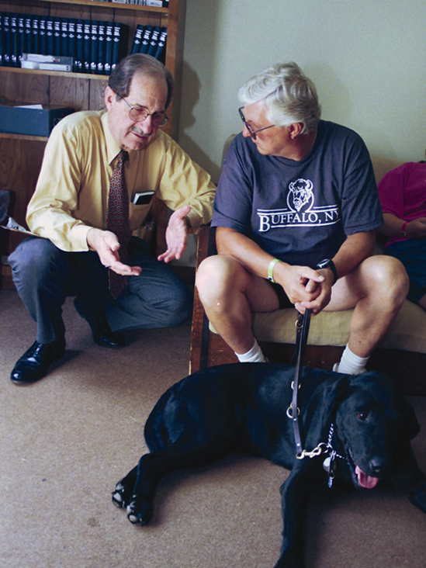
What To Say:
How To Visit a Former Member
“Hi. Is this Jim? I’m David from the Adventist Church. I just stopped by for a minute to visit with you. Would that be OK?”
Notes:
1. Visiting former or non attending members is different. It is a little more challenging. Usually you just have to show up at the door because they don't respond to phone calls. They will always have a reason for you not to come over, unless you personally know them real well.

Slide 76
What To Say:
How To Visit a Former Member
“Jim, I know you used to attend our church at one time. I just wanted to come and invite you back. . .”
Get to the point quickly
Notes:
1- You are smiling when you say this. If you can't smile. Don't visit.
2- Get to the point. The person is already uncomfortable. He knows why you're there.
3- Think about it. Are you comfortable when the doctor is holding a needle in front of you? Be pleasant.....
4. You can have a casual conversation with them inside, if you know them.

Slide 77
How To Visit a Former Member
Listen kindly – let the bitterness come out
Don’t argue
Don’t defend anyone
Be willing to be the scapegoat
Apologize for the church
Don’t betray confidence
Don’t overstay
Invite them back to church
Have prayer
Notes:
If they are angry with the church, kindness and patience will diffuse some of the anger.
And remember, most likely, the anger is not because of you.
They may tell you the story of what the church did to them and how they are never coming back.
1-- Even if the story is not true or exaggerated, apologize anyway.
2- It will do no good to correct him. It will increase hostility.
3- The church probably wasn't perfect anyway.
1- Plan to visit again. It takes more than one visit. Keep in touch by phone and with cards.
2- Example of Glenwood Kraber's birthday ministry.
Ask if you can have prayer with them and bless their family. Do not preach in your prayer. "O Lord, help Bob to realize his mistake in neglecting you. Help to come back to you before he leads his whole family astray...." Get the point (-:
If they’ve been gone a long time and nobody has contacted them, you might not be able to say “We miss you.” It may seem insincere. Just apologize for the church’s neglect and invite them back to church.

Slide 78
Questions To Ask:
How To Visit a Former Member
Invite them to tell their story
How long has it been?
Do you still believe the Adventist way?
Have you ever thought about coming back?
What hinders you?
What about your children?
Notes:
1- If the visit goes well, these are some heart questions that could be asked. They may tell you their story.
2- Be compassionate when they tell their story. They trust you. They need re-assurance and understanding.

Slide 79
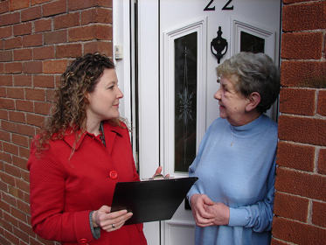
How to Visit Church Members
Choose a visitation team
Divide the membership list to 5-6 families per team
Church needs to keep good records
Call and make appointments, if necessary
Notes:
In this session, I want to share the importance of developing relationships in evangelism.
We will look at three principles of soul winning-- of reaching people's hearts. You can apply these principles to your life. If you ignore, you will not reach people.

Slide 80
What To Talk About:
How to Visit Church Members
Invite them to share their story/testimony
Use FORT!
  F amily
  O ccupation
  R ecreation
  T estimony/Tidbit
Notes:
When they are at your house, ask them about these things.
Family
Occupation
Recreation
Testimony

Slide 81
Questions To Ask:
How to Visit Church Members
How are things going in your spiritual life right now?
How is your relationship with God right now?
What is the greatest spiritual need of your family right now?
How can I pray for you right now?
Notes:
In this session, I want to share the importance of developing relationships in evangelism.
We will look at three principles of soul winning-- of reaching people's hearts. You can apply these principles to your life. If you ignore, you will not reach people.

Slide 82
Ending The Visit:
How to Visit Church Members
Gather the family together. Read a Bible promise and have a special prayer of blessing.
Don’t forget about the children.
Notes:
In this session, I want to share the importance of developing relationships in evangelism.
We will look at three principles of soul winning-- of reaching people's hearts. You can apply these principles to your life. If you ignore, you will not reach people.

Slide 83
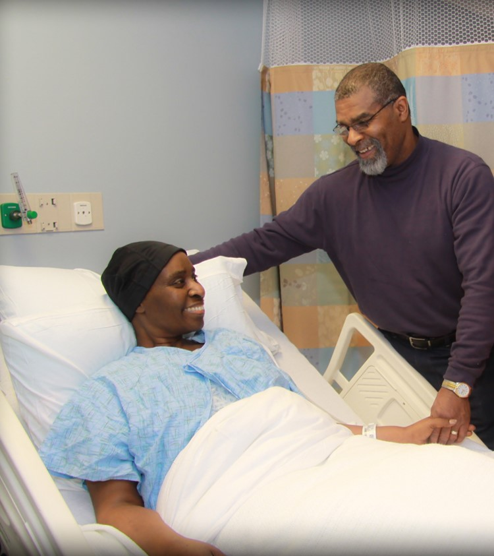
Purpose:
How To Visit The Sick
Give them encouragement
Bring a smile to their face
Give them strength
Point them to Jesus
Notes:
1- This can be a great ministry. Ideal for husband-wife team. I like to use Marquita in hospital visitation.
2- Visit church members, friends, neighbors, co-workers, even strangers.
3. You can visit more than church members. If you speak to the chaplain of a hospital or nursing home, they may allow you to come and visit or pray with people who are alone and have no family.
4. This is not just the pastor’s job. Ephesians 4.
1. Story of visiting Stan. It greatly encouraged him. It's what he needed. Relationships give people something to live for.
2. Remember you want there to be a spiritual component to your visit. Even if it is simply prayer at the end. I always ask "Joe, would you mind if I had a word of prayer with you and ask God to bless your health as you recover?"
99% of people will not refuse this.

Slide 84
What To Say:
How To Visit The Sick
What brought you here?
What have the doctors said?
How do you feel about it?
When can you go home?
What can I do to help?
Use FORT
Notes:
These are just some questions you can ask the person to make conversation.
If you stay longer, you can use FORT.

Slide 85
How To Visit The Sick
Don’t stay long unless they request it
Read a Bible promise and speak an encouraging word
Take their hand and have prayer
Notes:
1- You are there to make a spiritual visit. Not just to have a good time.
2- Have a Bible verse ready.
3- You could make this a ministry. Go to a nursing home or hospital and tell chaplain you want to come regularly to encourage people.
4- Look at admissions registry.
5- Let Marquita add........

Slide 86
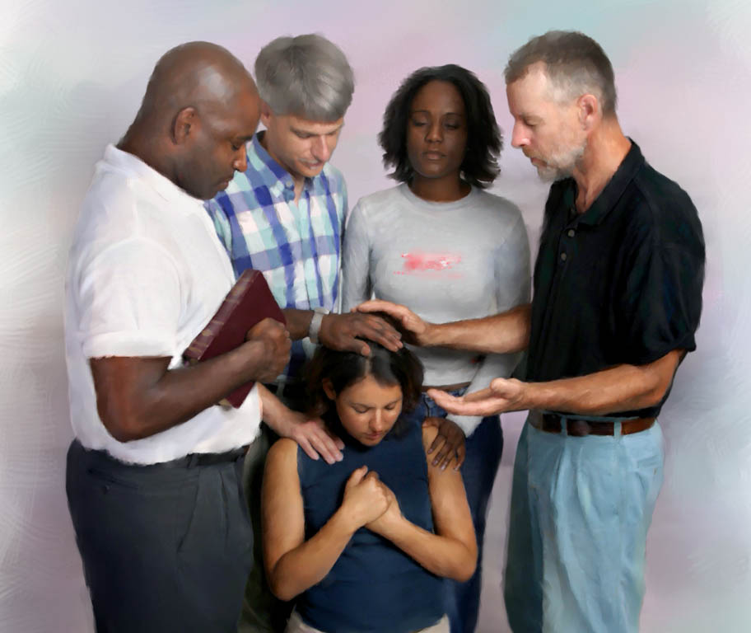
How To Visit During Evangelistic Meetings
Purpose:
To make a personal connection
To develop a friendship that will open hearts
To provide an opportunity to hear their story
Notes:
In this session, I want to share the importance of developing relationships in evangelism.
We will look at three principles of soul winning-- of reaching people's hearts. You can apply these principles to your life. If you ignore, you will not reach people.

Slide 87
How To Visit During Evangelistic Meetings
What To Say:
“Hi Mary! This is David from the Forecasting Hope seminar. I just stopped by for a minute to thank you for coming to the meetings. I wanted to give you this gift as a token of our appreciation.”
Notes:
In this session, I want to share the importance of developing relationships in evangelism.
We will look at three principles of soul winning-- of reaching people's hearts. You can apply these principles to your life. If you ignore, you will not reach people.

Slide 88
How To Visit During Evangelistic Meetings
Questions To Ask:
How did you find out about the meetings?
Why did you decide to attend?
Tell me about your spiritual journey. How did you become a Christian?
Notes:
In this session, I want to share the importance of developing relationships in evangelism.
We will look at three principles of soul winning-- of reaching people's hearts. You can apply these principles to your life. If you ignore, you will not reach people.

Slide 89

Purpose:
How To Make a Sabbath Visit During Evangelistic Meetings
To make a personal connection
To determine if they are open to the Sabbath
To provide an opportunity to answer questions
Notes:
In this session, I want to share the importance of developing relationships in evangelism.
We will look at three principles of soul winning-- of reaching people's hearts. You can apply these principles to your life. If you ignore, you will not reach people.

Slide 90
What To Say:
How To Make a Sabbath Visit During Evangelistic Meetings
“Hi Mary! This is David from the Discover Prophecy Seminar. I just stopped by for a minute to drop off the book you requested.”
Notes:
In this session, I want to share the importance of developing relationships in evangelism.
We will look at three principles of soul winning-- of reaching people's hearts. You can apply these principles to your life. If you ignore, you will not reach people.

Slide 91
Questions To Ask:
How To Make a Sabbath Visit During Evangelistic Meetings
I see you requested the book on the Sabbath? Was that new to you?
What do you think of it?
Do you have any questions?
Have you ever thought about making the Sabbath a part of your life?
Notes:
In this session, I want to share the importance of developing relationships in evangelism.
We will look at three principles of soul winning-- of reaching people's hearts. You can apply these principles to your life. If you ignore, you will not reach people.

Slide 92
Ending The Visit:
How To Make a Sabbath Visit During Evangelistic Meetings
Encourage them to read the book. It will answer their questions.
Have a prayer of blessing upon their family.
If the visit is positive, invite them to visit church and experience Sabbath
Notes:
In this session, I want to share the importance of developing relationships in evangelism.
We will look at three principles of soul winning-- of reaching people's hearts. You can apply these principles to your life. If you ignore, you will not reach people.

Slide 93
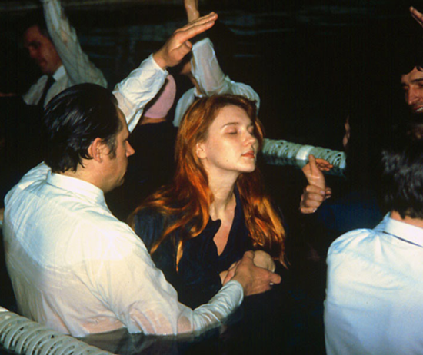
Purpose: To acknowledge and affirm their decision
How To Make a Baptism Visit
Set up an appointment to visit – either at the hall, church, or in the home
Notes:
In this session, I want to share the importance of developing relationships in evangelism.
We will look at three principles of soul winning-- of reaching people's hearts. You can apply these principles to your life. If you ignore, you will not reach people.

Slide 94
Questions To Ask:
How To Make a Baptism Visit
Would you share with me why you decided to check for baptism?
What was going on in your heart?
Is this something you are thinking of doing now?
Notes:
In this session, I want to share the importance of developing relationships in evangelism.
We will look at three principles of soul winning-- of reaching people's hearts. You can apply these principles to your life. If you ignore, you will not reach people.

Slide 95
How To Make a Baptism Visit
Affirm them in their decision and have prayer.
Set up a time to review the baptismal statements.
Review and let them ask questions
Set a date for baptism.
Notes:
In this session, I want to share the importance of developing relationships in evangelism.
We will look at three principles of soul winning-- of reaching people's hearts. You can apply these principles to your life. If you ignore, you will not reach people.

Slide 96
Seminar Info
Notes:
1. Evangelism doesn't start with the first night of a meeting. It starts by mingling with people.
2. This is how you prepare the soil. Not just by hanging literature on door knobs.
3. It starts with personal work and personal friendships.

Slide 97
Pastor David M. Klinedinst
Church Growth & Evangelism Director
Chesapeake Conference of SDA dklinedinst@ccosda.org DiscoverBibleProphecy.org
402-304-5603 855-744-HOPE davidklinedinst.org
Notes:
1. Evangelism doesn't start with the first night of a meeting. It starts by mingling with people.
2. This is how you prepare the soil. Not just by hanging literature on door knobs.
3. It starts with personal work and personal friendships.

Slide 98
WEBSITES
DiscoverBibleProphecy.org
Ccosda.org/evangelismtraining
Momentswithjesus.org
Notes:
We need to pray for this intensity. This passion.
Maybe it needs to be re-ignited in us.
Ask God to place it in your heart.

Slide 99
WEBSITES
ccosda.org/forecastinghope
Notes:
We need to pray for this intensity. This passion.
Maybe it needs to be re-ignited in us.
Ask God to place it in your heart.

Slide 100
Session 4:
How to Find and Give a Bible Study
Notes:
There are some simple ways to find a Bible study if we just keep our eyes open.
It doesn't involve knocking on doors.
Think about people you interact with every day.
People you already have a relationship with.

Slide 101
Ask: “Have you ever had someone study the Bible with you and explain things?”
Ask: “I know of some really good Bible lessons. Would you like to study them together?”
Notes:
As you interact with people, you can give them this simple non threatening invitation.
- If they say yes, set a time right away. Usually once a week is ideal.
2- If they say no, accept their answer and keep the door open. Keep praying.
3- If you sense they don't want you to go to their house, offer your house. Or offer to give them video studies to watch on their own. Personal Bible studies are better, but you have to take what you can get.

Slide 102



What If You Sense They Don’t Want You to Come To Their House?
Dirty house
Unruly kids
Alcoholic spouse
Then offer them video Bible studies
Notes:
As you interact with people, you can give them this simple non threatening invitation.
- If they say yes, set a time right away. Usually once a week is ideal.
2- If they say no, accept their answer and keep the door open. Keep praying.
3- If you sense they don't want you to go to their house, offer your house. Or offer to give them video studies to watch on their own. Personal Bible studies are better, but you have to take what you can get.

Slide 103

What if they say yes? What do you do next?
Set a date and time for the first lesson immediately!
Notes:
As you interact with people, you can give them this simple non threatening invitation.
- If they say yes, set a time right away. Usually once a week is ideal.
2- If they say no, accept their answer and keep the door open. Keep praying.
3- If you sense they don't want you to go to their house, offer your house. Or offer to give them video studies to watch on their own. Personal Bible studies are better, but you have to take what you can get.

Slide 104

Find a Good Set of Lessons
Search for certainty
Storacles
Discover
New It Is Written lessons
Lifting Up Jesus

Slide 105
Following Up Bible Study Cards
Ask – “Hello. I’m looking for Jim. I represent the Discover Bible School. I have the Bible lessons you requested. (Show them the card). Do you have a moment for me to show you how they work?”
Notes:
As you interact with people, you can give them this simple non threatening invitation.
- If they say yes, set a time right away. Usually once a week is ideal.
2- If they say no, accept their answer and keep the door open. Keep praying.
3- If you sense they don't want you to go to their house, offer your house. Or offer to give them video studies to watch on their own. Personal Bible studies are better, but you have to take what you can get.

Slide 106
Following Up Bible Study Cards
Ask – “We have a couple options. Some people like to do the lessons together because it gives them the chance to ask questions. I would be happy to set a time and get together with you once a week to study the lessons. Would you be interested in that?
Notes:
As you interact with people, you can give them this simple non threatening invitation.
- If they say yes, set a time right away. Usually once a week is ideal.
2- If they say no, accept their answer and keep the door open. Keep praying.
3- If you sense they don't want you to go to their house, offer your house. Or offer to give them video studies to watch on their own. Personal Bible studies are better, but you have to take what you can get.

Slide 107
Following Up Bible Study Cards
Ask – “Another option is that I can just give you the first lesson now and you can read through it at home. Then next week I can stop by for a few minutes and give you the second lesson and let you ask any questions. That way you can go at a slower pace and you don’t have to do all the lessons at one time. Would you be interested in that?”
Notes:
As you interact with people, you can give them this simple non threatening invitation.
- If they say yes, set a time right away. Usually once a week is ideal.
2- If they say no, accept their answer and keep the door open. Keep praying.
3- If you sense they don't want you to go to their house, offer your house. Or offer to give them video studies to watch on their own. Personal Bible studies are better, but you have to take what you can get.

Slide 108

Follow the sequence.
Do one lesson at a time.
Have the person do the lesson ahead of time.
Notes:
1- Each lesson is a link in the chain of truth. Skipping lessons will cause them to study a subject they are not ready for. Why study the Sabbath before salvation? Why study the Sabbath before the Law?
2- Don't give the whole set at once. They may look through and get scared. They need background information for some subjects.
3- They need to study themselves and come prepared with questions. Give them the lesson to study in preparation for your appt.
4- Don't study a lesson they haven't looked at.
5- Studying the lesson lets the Holy Spirit work on their heart.

Slide 109
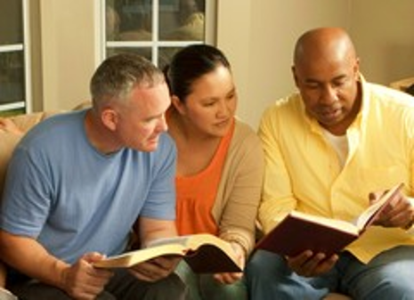
Read the question
Have the person read the text and share their answer
You can make comments
Notes:
1- You want to get them familiar with the Bible. Be willing to go slow.
2- Most lessons are designed in the question and answer format. Have them read the queston and the Bible verse (you can alternate). Then have them share the answer they wrote down. Then you may read the comments below each question--- or give your own. Give opportunity for them to ask questions.
3- You'll probably want your own set of lessons. You need to study lessons and make notes so you are prepared. You will much more comfortable.
1. Make sure they undestand before going on to the next lesson. The reason--- people do not make decisions on things they don't understand. If they don't fully understand the Sabbath or they have a lingering question, they will not make a decision to accept the Sabbath until th issue is resolved. It will be barrier. Give them a chance to ask questions.
2- Don't wait until the end of 26 lessons to ask them to accept the whole package and 28 fundamental beliefs at once. That is way too much to digest at one time.
3. Invite them to make little decisions throughout the lessons.
-- like accepting Christ
-- invite Jesus to be their advocate
-- asking Jesus to write His Law on their hearts and keep his commandments
-- invitation to starting worshipping on Sabbath or visit
-- invitation to consider baptism
--invitation to join the remnant
-- invitation to explore the Spirit of Prophecy books
Take little steps.

Slide 110
Use your own set and make notes
Make sure they understand before going to the next lesson
Let them ask questions
Ask for little decisions along the way
Notes:
1- You want to get them familiar with the Bible. Be willing to go slow.
2- Most lessons are designed in the question and answer format. Have them read the queston and the Bible verse (you can alternate). Then have them share the answer they wrote down. Then you may read the comments below each question--- or give your own. Give opportunity for them to ask questions.
3- You'll probably want your own set of lessons. You need to study lessons and make notes so you are prepared. You will much more comfortable.
1. Make sure they undestand before going on to the next lesson. The reason--- people do not make decisions on things they don't understand. If they don't fully understand the Sabbath or they have a lingering question, they will not make a decision to accept the Sabbath until th issue is resolved. It will be barrier. Give them a chance to ask questions.
2- Don't wait until the end of 26 lessons to ask them to accept the whole package and 28 fundamental beliefs at once. That is way too much to digest at one time.
3. Invite them to make little decisions throughout the lessons.
-- like accepting Christ
-- invite Jesus to be their advocate
-- asking Jesus to write His Law on their hearts and keep his commandments
-- invitation to starting worshipping on Sabbath or visit
-- invitation to consider baptism
--invitation to join the remnant
-- invitation to explore the Spirit of Prophecy books
Take little steps.

Slide 111
Clear and Set Principle
Q – Have you ever studied the Sabbath before? Or is it new to you?
A – Yes, this is new to me. I never knew all of this.
Notes:
1. This what you can do at the end of a lesson.
1. Find out if the subject is new to them.
2. Ask if it is clear. They can't make decisions if it's not clear to them.
3. Give them a small invitation to follow that truth.

Slide 112
Clear and Set Principle
Q – Is it clear to you? Or do you have any questions?
A – Yes, it’s clear. I’m surprised I didn’t see this before.
Q – Would you like to start keeping the Sabbath and experiencing its blessings?

Slide 113
Don’t be afraid of questions. It’s OK to say “I don’t know”.
Search the Scriptures
Don’t act like a know-it-all
Use literature to answer questions
Notes:
1-- When asked a question you don't know the answer to, be honest. Say "I don't know, but I'll find out and get back to you."
2- This makes you study. Gives you a reason to open your Bible.
3- If you can't find the answer, ask your pastor or church leader.
4- You don't know it all, so don't act like it.
5- If it is too soon to answer the question, tell them their question will be covered in a future lesson.
6- Use literature to give them.

Slide 114
Have prayer before and after each lesson
Eventually invite them to pray.
Teach them how to have a daily devotional life.
Notes:
1-- Don't pray fancy prayers. It will intimidate them from praying.
2- Example of my mom.
3- You want them to have an experience with Jesus. Not just memorizing information.
4- If you teach them the truth, but they have failed to know Jesus personally , you haven't taught them the truth.
5. They need to know how to spend time with Jesus apart from the weekly Bible studies. This is how they will transformed and born again.

Slide 115
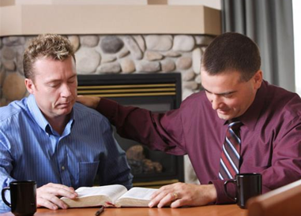
If you teach them the “truth”, but they fail to know Jesus personally, then you haven’t taught them the truth!
Notes:
1-- Don't pray fancy prayers. It will intimidate them from praying.
2- Example of my mom.
3- You want them to have an experience with Jesus. Not just memorizing information.
4- If you teach them the truth, but they have failed to know Jesus personally , you haven't taught them the truth.
5. They need to know how to spend time with Jesus apart from the weekly Bible studies. This is how they will transformed and born again.

Slide 116
Build a friendship. Do things together.
If they don’t make a decision, continue to be their friend.
Spend time praying for them.
Notes:
1- A big part of soul-winning is relationships. Spend time together when you can.
2- You can't win someone who isn't your friend.
3- Even if they don't make a decision, keep the door open. Don't drop them. True friendship means being their friend no matter what.
4- To drop them, is not Christ-like. You might spend more time with better interests, but don't drop them completely. The seed is planted. It may blossom later. Remember, many of Jesus' contacts didn't blossom until after He ascended back to Heaven.

Slide 117
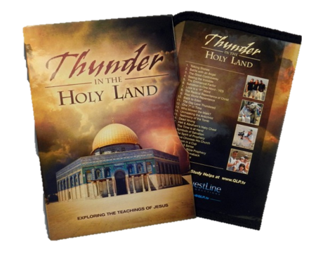
Thunder in the Holy Land
Designed for in-home Bible studies
Small group or one-on-one formats
Based on teachings of Jesus
26 episodes, 30 minutes each
Notes:
1- A big part of soul-winning is relationships. Spend time together when you can.
2- You can't win someone who isn't your friend.
3- Even if they don't make a decision, keep the door open. Don't drop them. True friendship means being their friend no matter what.
4- To drop them, is not Christ-like. You might spend more time with better interests, but don't drop them completely. The seed is planted. It may blossom later. Remember, many of Jesus' contacts didn't blossom until after He ascended back to Heaven.

Slide 118
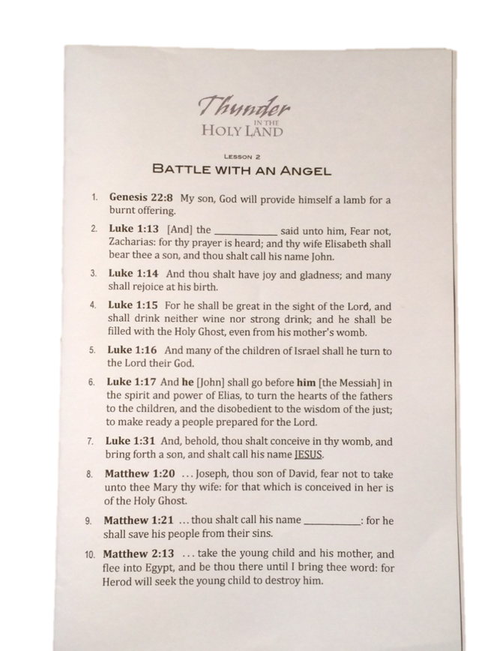
Thunder in the Holy Land
Each lesson has 5 or more heart questions
Elicits people’s responses
Lessons also have blanks to fill in during the video
Notes:
1- A big part of soul-winning is relationships. Spend time together when you can.
2- You can't win someone who isn't your friend.
3- Even if they don't make a decision, keep the door open. Don't drop them. True friendship means being their friend no matter what.
4- To drop them, is not Christ-like. You might spend more time with better interests, but don't drop them completely. The seed is planted. It may blossom later. Remember, many of Jesus' contacts didn't blossom until after He ascended back to Heaven.

Slide 119
One-on-One Format
Prayer and fellowship time
Play the video and let the person fill in the blanks
Go over the heart questions together
Total time = 1 hour
Notes:
1- A big part of soul-winning is relationships. Spend time together when you can.
2- You can't win someone who isn't your friend.
3- Even if they don't make a decision, keep the door open. Don't drop them. True friendship means being their friend no matter what.
4- To drop them, is not Christ-like. You might spend more time with better interests, but don't drop them completely. The seed is planted. It may blossom later. Remember, many of Jesus' contacts didn't blossom until after He ascended back to Heaven.

Slide 120
Small Group Format
Prayer and fellowship (30 min)
Play the video and let people fill in the blanks (30 min)
Discussion time (20-30 min)
Total time = 90 minutes
Notes:
1- A big part of soul-winning is relationships. Spend time together when you can.
2- You can't win someone who isn't your friend.
3- Even if they don't make a decision, keep the door open. Don't drop them. True friendship means being their friend no matter what.
4- To drop them, is not Christ-like. You might spend more time with better interests, but don't drop them completely. The seed is planted. It may blossom later. Remember, many of Jesus' contacts didn't blossom until after He ascended back to Heaven.

Slide 121
Contact Info
Questline Productions
615-448-1037
info@qlp.tv
www.qlp.tv
Notes:
1- A big part of soul-winning is relationships. Spend time together when you can.
2- You can't win someone who isn't your friend.
3- Even if they don't make a decision, keep the door open. Don't drop them. True friendship means being their friend no matter what.
4- To drop them, is not Christ-like. You might spend more time with better interests, but don't drop them completely. The seed is planted. It may blossom later. Remember, many of Jesus' contacts didn't blossom until after He ascended back to Heaven.

Slide 122
Bible Studies on Video
Revelation Speaks Peace – $80 (It Is Written)
www.itiswritten.org
Voice of Prophecy Speaks – $80 (VOP)
www.vop.com
A New Revelation – $90 (Amazing Facts)
www.amazingfacts.org
Thunder in the Holy Land – (Quest Productions)
www.qlp.tv/thunder-in-the-holy-land
Forecasting Hope series – $85
www.DiscoverBibleProphecy.org

Slide 123

“The most significant element necessary for a person to make a true spiritual decision is the element of conviction.”
Gaining Decisions for Christ p. 30
Notes:
1- If a person is not convicted, they are not going to move. You are wasting your time. Conviction is what causes a person to act.
2- They might be convinced, but are they convicted? Convinced is in your head (intellectual). Conviction is in your heart. It leads you to act.

Slide 124
What’s the Difference?
Convinced
Vs
Conviction
Notes:
1- If a person is not convicted, they are not going to move. You are wasting your time. Conviction is what causes a person to act.
2- They might be convinced, but are they convicted? Convinced is in your head (intellectual). Conviction is in your heart. It leads you to act.

Slide 125
“Christ is the source of every right impulse. He is the only One that can implant in the heart enmity against sin. Every desire for truth and purity, every conviction of our own sinfulness, is an evidence that His Spirit is moving upon our hearts.”
Steps to Christ p. 26
Notes:
1- We must pray for the people we work with. Without conviction, it doesn't matter how smooth we--- how smart we are-- how clever---- how many texts we have memorized-- or how many questions we can answer. Nothing is going to happen.
2- Pray they will be convicted by the Holy Spirit. Pray you will recognize it.
3- Story of Don and Renee. She was convicted. He was not. Share your own example.
4. Conviction is the evidence that the Holy Spirit is moving upon the heart and the heart is responding (or at least considering).

Slide 126
Indicators of Conviction
Joy in the face
Sharing with others
Asking questions
Positive attitude
Absolute attention
Tears
Avoidance
Anger
Restlessness
Irritability
Look for multiple signs, not just one.
Notes:
1- Story of Mike Brach. Conviction was there. He was attentive. Very responsive. Positive. Always had lessons done. Applying it to his life. Sharing it with other.
2- Story of Connie Arnone. Three ladies came to Leechburg meetings who were skeptical. They invited us to eat with them to ask questions. Some were asking to prove I was wrong.
I noticed Connie listening intently when I spoke. She wasn't as skeptical. She came to meetings regularly. She was alone in the parking lot after a meeting. Marquita could tell something was wrong. She went over to her. Connie started crying. She was under conviction.
3- Everyone is not alike. Some convictions are obvious. Some are not. We must watch and pray.
4- Just like some conversions are soul rending. Some are quiet and uneventful. The Spirit works in different ways with different people.
5. IMPORTANT-- One of these signs doesn't necessarily indicate conviction. Avoidance may simply mean that have no interest. However, when you see 3 or 4 of these signs that's an indication there's probably conviction going on.

Slide 127
Indicators of Disinterest
No eye contact
Not responsive
Body language
Changing the subject
Notes:
1- If you sense no conviction, maybe you need to ask more heart questions.
What's preventing you from following Jesus?
What's preventing you from turning your words into actions?
Jesus is speaking to your heart, why are you turning away?

Slide 128
Seminar Info
Notes:
1. Evangelism doesn't start with the first night of a meeting. It starts by mingling with people.
2. This is how you prepare the soil. Not just by hanging literature on door knobs.
3. It starts with personal work and personal friendships.

Slide 129
WEBSITES
DiscoverBibleProphecy.org
ccosda.org/forecastinghope
Notes:
We need to pray for this intensity. This passion.
Maybe it needs to be re-ignited in us.
Ask God to place it in your heart.

Slide 130
Pastor David M. Klinedinst
Church Growth & Evangelism Director
Chesapeake Conference of SDA dklinedinst@ccosda.org DiscoverBibleProphecy.org
402-304-5603 855-744-HOPE davidklinedinst.org
Notes:
1. Evangelism doesn't start with the first night of a meeting. It starts by mingling with people.
2. This is how you prepare the soil. Not just by hanging literature on door knobs.
3. It starts with personal work and personal friendships.

Slide 131
Session 5:
Having a Daily Devotional Life
Notes:
1- To be a witness for Jesus, we need to be filled with the Spirit. If we want our life and actions to be an influence, we need to have a close relationship with Jesus.
2- How do you have a relationship with someone? You spend time together. You talk together.
3- If we want to be an influence for Christ, we absolutely must have a daily devotional life. It is imperative that we spend time with Jesus in prayer and Bible study.
Talking to Jesus in prayer. Listening to Him in His Word.
4- The majority of Christians do not have a daily devotional life. This includes Adventists. The only time they pray is at meals or at church. The only time they open their Bible is during the sermon. This is why we lack power. This is why we are not influencing people.
5- As a pastor, there were times when I wasn't spending time with Jesus. My ministry became weaker. I wasn't as much of an influence. I didn't know what to preach about. Being a pastor became a burden. I was tired of people and their problems. I wasn't having a personal experience with Jesus. Can you relate to this?

Slide 132
“Then He came to the disciples and found them sleeping, and said to Peter, “What! Could you not watch with Me one hour? Watch and pray, lest you enter into temptation. The spirit indeed is willing, but the flesh is weak.”
Matthew 26:40-41
Notes:
1- When we commit to spending time with Jesus, it will not be in vain. The Spirit will fil our lives. Change will occur. A supernatural work happens in our hearts over time.
2- Many people don't know how to have a devotional life. They've tried. It's boring. It didn't last.
How many of you have gotten frustrated before?
3-- Here are six principles of having a daily devotional life.

Slide 133
“The creative energy that called the worlds into existence is in the Word of God. The Word imparts power; it begets life…It brings with it the life of the Infinite One. It transforms the nature and recreates the soul in the image of God.”
Education p.126
Notes:
We need that spiritual life in our soul.
1- The power that created the world is in God's Word. We need that power in our lives.
2- If a person is struggling spiritually, many times it's because the person isn't spending regular time with Jesus. When you have a spiritual issue in your life, ask an honest question-- How regular and meaningful is your private time with Jesus? Or is it non-existent?
3-- If you're not being fed at church, it's probably not the church's fault. Maybe it's because you're not having a devotional life. The church and the pastor cannot do that for you.

Slide 134
“A revival in Bible study is needed throughout the world. Attention is to be called, not to the assertions of men, but to the Word of God. As this is done, a mighty work will be wrought. When God declared that His word should not return unto Him void, He meant all that He said.”
Manuscript 139, 1898
Notes:
1- When we commit to spending time with Jesus, it will not be in vain. The Spirit will fil our lives. Change will occur. A supernatural work happens in our hearts over time.
2- Many people don't know how to have a devotional life. They've tried. It's boring. It didn't last.
How many of you have gotten frustrated before?
3-- Here are six principles of having a daily devotional life.

Slide 135

1. Choose the best time of the day and stick to it
Starting a Daily Devotional
Morning
Afternoon
Evening
Notes:
1- Find the best time of day to slow down and get quiet with God. Unrushed. Uninterrupted.
2- For some, early morning is best, before others wake up. For some afternoon, when spouse and kids are gone.
For some, evening, when others are in bed and work day is done.
3- If you miss a day, don't have a guilt trip. Devil wants to beat you up about it. Just don't let it become a pattern.
1- Don't be legalistic about it. "Well, my 30 minutes are up. I've done my duty."
2- The point is quality time. Not quantity.
3- The point is quiet, uninterrupted, and unrushed time.
You are seeking to experience Jesus, not just read a book.
4- If you are saying, "I don't even have time to have a devotional life"-- then something needs to change in your life. If you can't spend time with Jesus, then your life needs to change. Change your schedule. Change your job. Get rid of cable TV.
5- What does it profit a man to gain the whole world, yet lose his own soul?
6-- Sometimes we have to start by praying for the desire to have a devotional life. The carnal nature does not find it interesting.

Slide 136
Starting a Daily Devotional
2. Try to give yourself at least 30 minutes
Unhurried and uninterrupted
Notes:
1- Find the best time of day to slow down and get quiet with God. Unrushed. Uninterrupted.
2- For some, early morning is best, before others wake up. For some afternoon, when spouse and kids are gone.
For some, evening, when others are in bed and work day is done.
3- If you miss a day, don't have a guilt trip. Devil wants to beat you up about it. Just don't let it become a pattern.
1- Don't be legalistic about it. "Well, my 30 minutes are up. I've done my duty."
2- The point is quality time. Not quantity.
3- The point is quiet, uninterrupted, and unrushed time.
You are seeking to experience Jesus, not just read a book.
4- If you are saying, "I don't even have time to have a devotional life"-- then something needs to change in your life. If you can't spend time with Jesus, then your life needs to change. Change your schedule. Change your job. Get rid of cable TV.
5- What does it profit a man to gain the whole world, yet lose his own soul?
6-- Sometimes we have to start by praying for the desire to have a devotional life. The carnal nature does not find it interesting.

Slide 137

3. Choose a book of the Bible that interests you
OR
Find a suitable study guide
Starting a Daily Devotional
Lifting up Jesus
  www.liftingupjesus.net
Search for Certainty
Sabbath School Lessons
Fast Discipleship Lessons
  www.fast.st
Notes:
1- Choose one you'd like to study. Maybe Genesis in the beginning.
Or I Samuel about the kings of Israel.
Or Matthew about the life of Christ.
Or Acts about the spread of the gospel.
2- You can alternate books. You don't have to go in order.
3- Choose a version you understand. It does no good to read a version you can't understand. I'm not a proponent of using only one version.
4- Remember, Jesus made things simple.

Slide 138
4. Read a passage each day and think about the lessons it teaches
Starting a Daily Devotional
Personal Questions To Ask
What spiritual lessons are in this passage?
What is God saying to me personally?
What needs to change in my life?
What principle do I need to understand better?
Use imagination
Put yourself in the characters’ shoes
Look for the lessons
Notes:
1- Read the passage. You may want to use different versions. Think about it. Meditate. If it is a story, use your imagination.
2- Put yourself in the place of the person.
3- Write down the lessons in that passage. Maybe in a journal
4- Ask yourself some questions...
What spiritual lessons are in this passage?
What is God saying to me personally? (Not what is God saying to my wife or kids or pastor)
What needs to change in my life?
What principle in the passage do I need to understand better?
Is there something I need to do?

Slide 139

5. Then pray. Talk to God about the passage.
Starting a Daily Devotional
Praises and requests
Tell Him about your day
Notes:
1- Talk to God about the lessons in the passage. Ask Him what He is saying to you. Ask Him how to apply this to your life. Talk to Him about what's going on in your life.
2- Be quiet and listen.
Ask those questions on previous slide in prayer.
1- You could write down the lessons you learn-- what God is saying to you-- what you are experiencing. Write down your thoughts concerning the personal questions.
2- You could write down praises or prayer requests.

Slide 140
Starting a Daily Devotional
6. Use a spiritual journal to record your thoughts. (Optional)
Notes:
1- Talk to God about the lessons in the passage. Ask Him what He is saying to you. Ask Him how to apply this to your life. Talk to Him about what's going on in your life.
2- Be quiet and listen.
Ask those questions on previous slide in prayer.
1- You could write down the lessons you learn-- what God is saying to you-- what you are experiencing. Write down your thoughts concerning the personal questions.
2- You could write down praises or prayer requests.

Slide 141

Points
The devil will fight you on this
He will put obstacles in your way
Satan knows this is the key to being born again
This is where effort comes in the Christian life
Satan doesn’t care if you try hard to be good
Devotional life goes Jesus access to your life
Notes:
1- The devil does not want you spending time with Jesus. He knows this is where the power and transformation comes from. He doesn't care if you try hard to be good. He knows you'll fail. He is scared if you commit to spending time with Jesus every day. Then power comes into your life over time.
"Greater is He that is in you, then he that is in the world."
I John 4:4
2- He knows your influence will strengthen.
3- He will put obstacles in your way of spending time with Jesus.
Phone will ring.
More work hours.
Kids interrupt.
More homework.
Car will break down. He will try to shift your attentions elsewhere.
1- It will take an effort. Having a consistent devotional life is work. Not trying hard to be good. But seeking to spend time with Jesus.
2- It scares the devil. He wants you to try hard at overcoming sin, not spending time with Jesus. (Ex of rubber hose)
3- At first, devotional time may be boring. You may get nothing out of it. The carnal heart doesn't like the devotional life. It takes time.
4- Story of young man who told Morris Venden he only tried 3 days to have a devotional life and it didn't work. Did you build a meaningful relationship with your spouse in 3 days? It's no different with God.
5- Experience with Leo. Over time, you will develop a stronger desire for God's Word. This is the work of the Holy Spirit.

Slide 142

Read this book in your devotional time and ask Christ to baptize you daily with the Holy Spirit.

Slide 143
The Most Important Witness
A Godly family = Family Worship!
Read a Bible Passage, story book, or devotional
Discuss it together
Talk about your day
Pray together
Keep it brief and interesting
Notes:
1- Your first priority is to be a witness to your family. If you're a witness to everyone else but your family, you've gained nothing.
2- It only needs to be 5-15 minutes together. Read a Bible passage or story book together.
Talk about your day. Pray together.
3- Share what you do with your family.

Slide 144
“A reformation in this respect is needed – a reformation which shall be deep and broad…In too many households, prayer is neglected. Parents feel they have no time for morning and evening worship…They have no time to offer prayer for divine help and guidance and for the abiding presence of Jesus in the household.”
Patriachs and Prophets p.143
Notes:
What needs to reform in your family?
God is calling you to have family worship. What's your response?
If you want your family to know Jesus personally, then have a family worship. Don't just rely on the church or the school to give your children and family a knowledge of Jesus. They cannot make up for what you are not doing in the home.

Slide 145
“Fathers and mothers, however pressing your business, do not fail to gather your family around God’s altar.”
- Ministry of Healing p.393
If the only souls you win is your family, then your life has not been in vain.
Notes:
1- The most powerful witness is a Godly family. If the only souls you win is your family, then your life is not in vain.

Slide 146
“It should be the special object of the heads of the family to make the hour of worship intensely interesting. By a little thought and careful preparation for this season…family worship can be made pleasant and will be fraught with results that eternity alone will reveal.”
Child Guidance p. 521
Notes:
Are we really so busy that we can't have family worship with or families?
How much are the souls of your family worth?

Slide 147
Seminar Info
Notes:
1. Evangelism doesn't start with the first night of a meeting. It starts by mingling with people.
2. This is how you prepare the soil. Not just by hanging literature on door knobs.
3. It starts with personal work and personal friendships.

Slide 148
Pastor David M. Klinedinst
Church Growth & Evangelism Director
Chesapeake Conference of SDA dklinedinst@ccosda.org DiscoverBibleProphecy.org
402-304-5603 855-744-HOPE davidklinedinst.org
Notes:
1. Evangelism doesn't start with the first night of a meeting. It starts by mingling with people.
2. This is how you prepare the soil. Not just by hanging literature on door knobs.
3. It starts with personal work and personal friendships.

Slide 149
Pastor David M. Klinedinst
Church Growth & Evangelism Director
Chesapeake Conference of SDA
DiscoverBibleProphecy.org
Notes:
1. Evangelism doesn't start with the first night of a meeting. It starts by mingling with people.
2. This is how you prepare the soil. Not just by hanging literature on door knobs.
3. It starts with personal work and personal friendships.

Slide 150
WEBSITES
Ccosda.org/pastorevangelistsbootcamp
Ccosda.org/evangelismtraining
MomentsWithJesus.org
Ccosda.org/forecastinghope
Notes:
We need to pray for this intensity. This passion.
Maybe it needs to be re-ignited in us.
Ask God to place it in your heart.

Slide 151
Principles of Urban Evangelism
Washington Adventist University
Notes:
1- Do you ever wish you could be a better witness? Wish you could be a better influence. But you are not speaker.
2-- You can live an evangelistic life every day. Maybe not from the pulpit.
3-- The gospel commission can be done without preaching.
4-- There are different forms of "preaching.
5-- Jesus was very effective at meeting people.
6-- We are going to learn His methods. Because Jesus did a lot of "preaching" by actions.
7-- Who is called to share the gospel? Everyone a minister
8- Priesthood of all believers. NT church grew by lay people. They didn't even have paid ministers.
9-- They followed Jesus' example? What was it?

Slide 153
Living An Evangelistic Life Sessions
Session 1: Principles of Personal Evangelism
Session 2: Every Day Opportunities
Session 3: How to Visit People
Session 4: How to have a Bible Study
Session 5: How to have a Daily Devotional Life
Session 6: Getting Decisions and Making Appeals
Notes:
In this session, I want to share the importance of developing relationships in evangelism.
We will look at three principles of soul winning-- of reaching people's hearts. You can apply these principles to your life. If you ignore, you will not reach people.

Slide 154
Session 6:
Getting Decisions and Making Appeals
Notes:
Let's discuss three things--
1- How do we lead people to make spiritual decisions? How can we influence them to act? There is a way to do this without pressuring or offending. It is quite simple.j
2- It is important to make appeals and give invitations for people to make decisions and act.
3- How do we recognize if conviction is occuring?

Slide 155

Don’t I have to be a Super Spiritual Person to Get Decisions?
Decisions are not just for trained evangelists
Pastors can get decisions
Lay people can get decisions
Notes:
1. You do not have to be a professional evangelist who knows how to sway people.
2. You do not need to be a trained pastor with a eloquent voice.
3. You do not need to be a highly educated person with an extensive vocabulary.
4. Anyone can learn the principles of getting decisions and making appeals.

Slide 156


Three Things You Need
1. Little knowledge of human nature
2. Christ-like love for people
3. The willingness to ask for a decision
Notes:
1. A little knowledge of human nature. No matter where a person lives there are some universal principles of human nature. Just having common sense and understanding how people act and think and respond is very important. You can learn this simply by watching people in daily life.
2. A Christ like love is important. We need to learn to love people the way Jesus did. To understand the value of a soul. To truly care about people. To have a deep desire for them to know Jesus.
If your only desire is to manipulate people or to show how influential you are, you will never be a soul winner.
3. The most important is the willingness to ask. Most people to get decisions because they don't ask. It's that simple.
4.

Slide 157
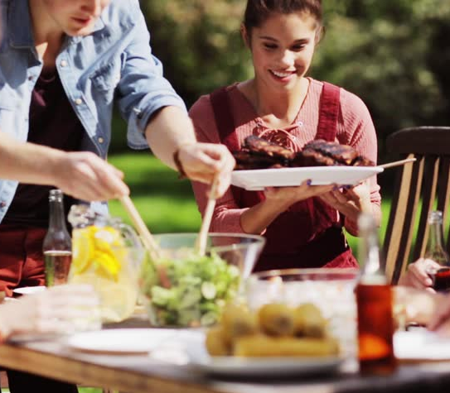
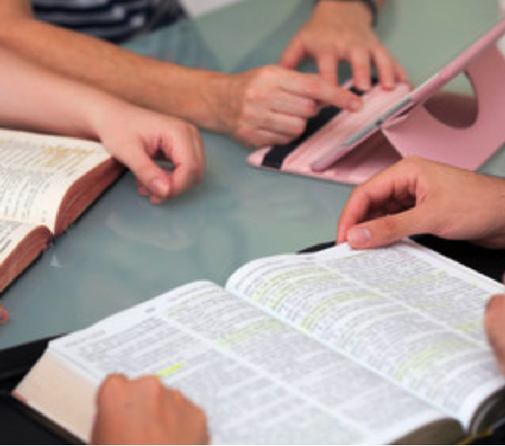
Many Opportunities for Getting Decisions
When preaching
Visiting in the home
Personal Bible study
At potluck
Recreation
Conversation
Anywhere
Notes:
1. There are many opportunities for inviting people to make decisons. Some of them are done publicly like in a sermon. Some are simply done in one on one conversation. Informal.
2. PREACHING--- Every sermon should have an appeal where people are invited to respond. We should always ask people to act on what they heard.
3. VISITING-- When we are visiting people one on one and spiritual subjects come up, this is a time to invite people to make decisions. Ex-- If I justexplained the plan of salvation or why I keep the Sabbath.
4. PERSONAL BIBLE STUDIES-- These are wonderful times to ask for decisions after studying key lessons.
5. POTLUCK-- When I'm sitting with a visitor at potluck and we talk about church things.
6. RECREATION-- In daily life, sometimes we get into significant conversations with people. Look for times to influence people. To ask the to consider things.
4.

Slide 158

Why make Appeals?
People don’t make decisions out of the blue
People need gentle prompting
Appeals plant a seed in people’s minds
To assist the Holy Spirit. The Holy Spirit uses people
Notes:
1. Most people need a gentle push. They need the right question that will make them think. A simple invitation.
EXAMPLE-- People can come to church for years and never join because no one asked them.
Example-- A person can know about the Sabbath for years and never keep it because no one invited them. Gave them a gentle push.
2. Even if the person doesn't make a decision, the seed is planted in the mind. If they hadn't thought of being baptized, they will now that you asked.
Inviting people to make decisions assists the Holy Spirit. The Holy Spirit doesn't work alone. He uses us. That's the way Jesus designed it. The way the Gospel was spread.
1- We can't do the Holy Spirit's work. But we can be used of the Holy Spirit as a tool. Christ gave the gospel work to men. He did not say just stand around and wait for angels to do it.
2-- Getting decisions and making appeals does not involve pressure. It can be done in a gentle and Godly way. You are simply accetuating the voice of the Spirit by making invitations.
3-- That is partly true. We can't rush people. But people need a gentle push sometimes. By asking questions or inviting people we can move them forward step by step. Some people will never move if appeals aren't made.

Slide 159
Objections to Appeals
“We can’t do the work of the Holy Spirit”
“Getting decisions means pressuring people”
“People will make decisions when they are ready”
Notes:
1. Most people need a gentle push. They need the right question that will make them think. A simple invitation.
EXAMPLE-- People can come to church for years and never join because no one asked them.
Example-- A person can know about the Sabbath for years and never keep it because no one invited them. Gave them a gentle push.
2. Even if the person doesn't make a decision, the seed is planted in the mind. If they hadn't thought of being baptized, they will now that you asked.
Inviting people to make decisions assists the Holy Spirit. The Holy Spirit doesn't work alone. He uses us. That's the way Jesus designed it. The way the Gospel was spread.
1- We can't do the Holy Spirit's work. But we can be used of the Holy Spirit as a tool. Christ gave the gospel work to men. He did not say just stand around and wait for angels to do it.
2-- Getting decisions and making appeals does not involve pressure. It can be done in a gentle and Godly way. You are simply accetuating the voice of the Spirit by making invitations.
3-- That is partly true. We can't rush people. But people need a gentle push sometimes. By asking questions or inviting people we can move them forward step by step. Some people will never move if appeals aren't made.

Slide 160
Appeals in the Bible
Exodus 32:19-26: Moses and the Israelites
Joshua 24:15: Joshua and the Israelites
Luke 5:27-32: Jesus to Matthew
Luke 18:22: Jesus to rich young ruler
Acts 26:24-29: Paul’s persuasion to Agrippa
Notes:
LOOK UP THESE VERSES AND COMMENT.
Could break into small groups and have them discover what the appeal is in these verses. What is happening? What decision are they invited to make? What action?
-- Moses invited the Israelites to make a choice after the golden calf incident.
-- Joshua invited the people to choose and make a surrender.
-- Jesus gave a verbal invitation to Matthew to follow Him.
-- Jesus did the same with rich young ruler.
-- Paul intentionally sought to persuade people.

Slide 161
Have you ever considered….

Slide 162
I’d like to invite you to….

Slide 163
Why Ask Them To Take A Step?
Expression deepens impression
  Expressing your decision in an action strengthens the decision
  Decisions of the heart must be acted upon
  We do the same with baptisms, weddings, and communion
Notes:
1. Expressing decisions in tangible ways is crucial.
2. Baptisms (commitment to Jesus), communion (recommitment to Jesus) and wedding (commitment to another person) could all be made in the heart. But we are to express those decisions through actions. It strengthens them.
3. The same applies with cutting up credit cards when we choose to renounce debt. The action strengthens the inner decision.
Or destroying cigarettes or alchohol when we choose to give them up. The action strenghtens the decision.
1. If God knows the heart, why express decisions? Because actions stregthen the decision and influences other people.
2. Jesus wanted the bleeding woman to express her decision.

Slide 164
Why Ask Them To Take A Step?
Jesus made the bleeding woman express her faith in action
  Story of Gladys
Notes:
1. Expressing decisions in tangible ways is crucial.
2. Baptisms (commitment to Jesus), communion (recommitment to Jesus) and wedding (commitment to another person) could all be made in the heart. But we are to express those decisions through actions. It strengthens them.
3. The same applies with cutting up credit cards when we choose to renounce debt. The action strengthens the inner decision.
Or destroying cigarettes or alchohol when we choose to give them up. The action strenghtens the decision.
1. If God knows the heart, why express decisions? Because actions stregthen the decision and influences other people.
2. Jesus wanted the bleeding woman to express her decision.

Slide 165
Information Overload
Obstacles To Making Decisions
Giving No Opportunities to Respond
Lack of Clarity or Understanding
Too much information at one time overwhelms people. It paralyzes them.
Decisions should be made in increments.
Do not ask people to accept the whole package at once.
Appeal for decisions in small steps.
Preaching or studying without asking for a decision/action leads to a negative decision.
It conditions people to listen and not respond.
It lessens the importance of what you are saying. How important can it be if you haven’t asked them to follow it?
When the heart is aroused, if there is no outlet to respond, the heart hardens.
The subject must be made clear. People do not make decisions on what they do not understand.
Ask them if the subject is clear.
Invite them to ask questions.
Help them with their obstacles.
Notes:
1. Too much information prevents people from making decisions. When you have been overwhelmed at work or at home, how did you react? You just wanted to give it all up and forget about it. Run away.
2. Don't go for one big decision. Use smaller decisions to pave the way.
It's like learning English. Don't start with the big words.
1. Not asking for decision leads people to not make a decision. To ignore it. That's negative.
2. You teach people this is only intellectual. No action necesary.
3. Invitiations to respond emphasizes the importance of the subject.

Slide 166
How to Make Personal Appeals
“Is this clear to you?”
“Is there anything that stands in your way?”
“Would you like to tell Jesus you are willing to follow him?”
Invite the person to action
Prayer of commitment together
Notes:
1. I'm asking if it's clear. If it's not, he won't make decision.
2. I'm discovering if there's any obstacles. No decision will be made until obstacle removed.
3. I am now making the appeal and asking for a decision of the heart.
4. I am now asking him to act on that inner decision.
5. Prayer together. This is a spiritual action.

Slide 167
REMEMBER THE MAIN POINT
To Get Decisions,
You Must ASK For Them

Slide 168
“The most significant element necessary for a person to make a true spiritual decision is the element of conviction.”
Gaining Decisions for Christ p. 30
Notes:
1- If a person is not convicted, they are not going to move. You are wasting your time. Conviction is what causes a person to act.
2- They might be convinced, but are they convicted? Convinced is in your head (intellectual). Conviction is in your heart. It leads you to act.

Slide 169
What’s the Difference?
Convinced
Vs
Conviction
Notes:
1- If a person is not convicted, they are not going to move. You are wasting your time. Conviction is what causes a person to act.
2- They might be convinced, but are they convicted? Convinced is in your head (intellectual). Conviction is in your heart. It leads you to act.

Slide 170
“Christ is the source of every right impulse. He is the only One that can implant in the heart enmity against sin. Every desire for truth and purity, every conviction of our own sinfulness, is an evidence that His Spirit is moving upon our hearts.”
Steps to Christ p. 26
Notes:
1- We must pray for the people we work with. Without conviction, it doesn't matter how smooth we--- how smart we are-- how clever---- how many texts we have memorized-- or how many questions we can answer. Nothing is going to happen.
2- Pray they will be convicted by the Holy Spirit. Pray you will recognize it.
3- Story of Don and Renee. She was convicted. He was not. Share your own example.
4. Conviction is the evidence that the Holy Spirit is moving upon the heart and the heart is responding (or at least considering).

Slide 171
Indicators of Conviction
Joy in the face
Sharing with others
Asking questions
Positive attitude
Absolute attention
Tears
Avoidance
Anger
Restlessness
Irritability
Look for multiple signs, not just one.
Notes:
1- Story of Mike Brach. Conviction was there. He was attentive. Very responsive. Positive. Always had lessons done. Applying it to his life. Sharing it with other.
2- Story of Connie Arnone. Three ladies came to Leechburg meetings who were skeptical. They invited us to eat with them to ask questions. Some were asking to prove I was wrong.
I noticed Connie listening intently when I spoke. She wasn't as skeptical. She came to meetings regularly. She was alone in the parking lot after a meeting. Marquita could tell something was wrong. She went over to her. Connie started crying. She was under conviction.
3- Everyone is not alike. Some convictions are obvious. Some are not. We must watch and pray.
4- Just like some conversions are soul rending. Some are quiet and uneventful. The Spirit works in different ways with different people.
5. IMPORTANT-- One of these signs doesn't necessarily indicate conviction. Avoidance may simply mean that have no interest. However, when you see 3 or 4 of these signs that's an indication there's probably conviction going on.

Slide 172
Indicators of Disinterest
No eye contact
Not responsive
Body language
Changing the subject
Notes:
1- If you sense no conviction, maybe you need to ask more heart questions.
What's preventing you from following Jesus?
What's preventing you from turning your words into actions?
Jesus is speaking to your heart, why are you turning away?

Slide 173
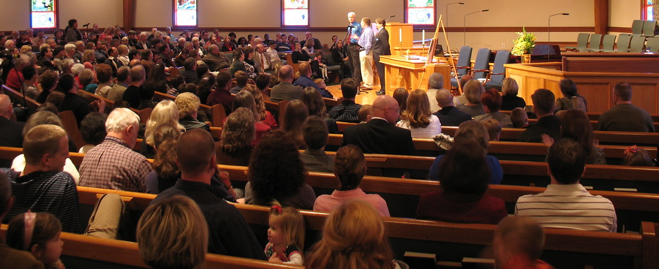
d
How To Make Public Appeals
Are they just for evangelistic meetings?
Notes:
1. We had been looking at personal appeals.
2. Now we turn to public appeals. Appeals made while speaking. Sermons, etc.
3. Are public appeals just for evangelistic meetings?

Slide 174
Public Appeals For Sabbath Worship
Why not on Sabbath mornings?
Creates an atmosphere of evangelism
Gives people a chance to respond to the sermon
Keeps people from being a spectator
Gives you interests to work with
Increases baptisms
Gives the Holy Spirit opportunity to move
Notes:
1. We should make appeals in our sermons. A sermon without an appeal is only a lecture giving information. We are asking people to decide and act.
2. Sabbath morning can be a evangelistic meeting.
3. Many creative ways to invite people to act. Altar calls. Raising hands. Standing. Silent prayer. Decision cards. Writing things on paper.

Slide 175
Flavel Yeakly Study
Types of Appeals For Getting Decisions
Raising Hands or Standing
Silent Prayer
Altar Call
Decision Cards
Notes:
There are different ways to appeal in a simple way. Find one that works best for you.

Slide 176

Raising Hands or Standing
This is a very general appeal
Helps people become comfortable with responding
Good appeal to start with if you’re not used to making appeals
Most people respond to this
Notes:
1. You can raise hands while speaking or while praying.

Slide 177
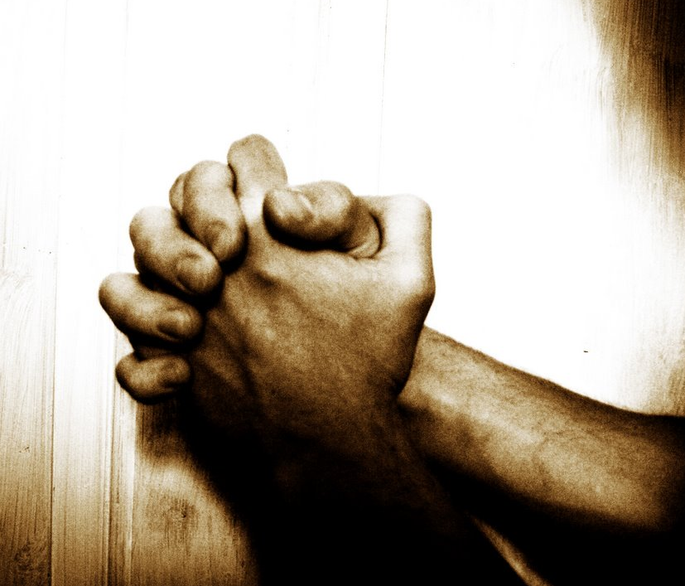
Silent Prayer
More of a private decision. Requires little action.
Could be used for sensitive subjects. Ex. Unforgiveness, sexual purity, etc.
Music could be playing softly during this time
Notes:
1. You may not want to ask people to come forward about harboring anger, withholding tithe, struggling with lust, struggling in marriage, etc.

Slide 178

Altar Call
Requires a major step of action
This really deepens the decision
Encourages others to respond when they see people coming forward
Don’t worry if no one comes forward
People can come forward during closing song
Notes:
1. Altar calls are not just for accepting Christ. These can be used so much more.
2. I usually do it during closing song because people are already standing so it is easier to come forward. If I have them come forward while I'm speaking, I have to think of more things to say. Rather let the Spirit speak.

Slide 179

Decision Cards
This requires a major step of action
This really deepens the impression
Gives people who wouldn’t go forward a chance to respond
A little more private
Gives you a chance to respond with a personal visit. This is key.
Go over the card with them
Notes:
1. Decision cards can be placed in pews or in bulletins.
2. Great reason to make a personal visit.
3. Make sure you have a simple way to collect the cards.

Slide 180
1st Line: Is it clear (intellectual)
2nd Line: Half Step in the Decision
3rd Line: Ask for commitment
4th Line: Request material or visit or ask a question
Notes:
1. Some people like to design their own cards. Here is a format that I thought was really helpful. You may develop your own style.

Slide 181
Sabbath Decision Card
It is clear to me that the seventh-day Sabbath is an important Bible truth.
I want to follow Jesus in my life.
I choose to follow Jesus by honoring His seventh-day Sabbath.
I have some questions and would like a visit.
Notes:
Here is an example of a Sabbath decision card. You could use this format with any subject.

Slide 182
General Decision Card
The subject we studied today is clear to me.
I am choosing to follow Jesus in this matter.
I would like prayer concerning this matter
There are some obstacles in my life and I would like to talk to someone.
I would like to prepare for baptism.
Notes:
This is a generic card you could have printed and put in the pews. It can be used for any subject.

Slide 183
Language of the Appeal
Be specific in your appeal. What is the decision you are asking them to make?
Be positive, not negative.
Make sure they understand what you are asking them to do.
If they come forward, when and where?
Repeat the appeal.
Notes:
1. Be specific. Don't assume people know what you want them to do. Don't just say "raise your hand if you want to follow Jesus." Be more specific.
2. Appeal to the positive blessings. Not "Lord, help me not to be a money grubbing Scrooge and a hypocrite and who won't return their tithe to you."
"Lord, I want to recieve your blessings. I want to submit all of my life to you. Incuding the financial side. I am choosing to trust you."
3. You will need to repeat appeal so people understand. Gives them time to respond.

Slide 184



Language of the Appeal
Minimize the Negative
Maximize the Positive
DON’T focus on:
  Challenges
  Obstacles
  Bad things that could happen
DO focus on:
  Blessings of making that decision
  Good things that will result from that choice
Notes:
1. Be specific. Don't assume people know what you want them to do. Don't just say "raise your hand if you want to follow Jesus." Be more specific.
2. Appeal to the positive blessings. Not "Lord, help me not to be a money grubbing Scrooge and a hypocrite and who won't return their tithe to you."
"Lord, I want to recieve your blessings. I want to submit all of my life to you. Incuding the financial side. I am choosing to trust you."
3. You will need to repeat appeal so people understand. Gives them time to respond.

Slide 185
Faithful Tithe/Stewardship
Minimize the Negative
Maximize the Positive
DON’T focus on:
  Not having enough to pay the bills
  How people will think you’re crazy
  How tight the budget is
DO focus on:
  The blessings of following Jesus
  The promise of the windows of heaven being open
  God’s promise to provide when we put Him first
Notes:
1. Be specific. Don't assume people know what you want them to do. Don't just say "raise your hand if you want to follow Jesus." Be more specific.
2. Appeal to the positive blessings. Not "Lord, help me not to be a money grubbing Scrooge and a hypocrite and who won't return their tithe to you."
"Lord, I want to recieve your blessings. I want to submit all of my life to you. Incuding the financial side. I am choosing to trust you."
3. You will need to repeat appeal so people understand. Gives them time to respond.

Slide 186
Baptism
Minimize the Negative
Maximize the Positive
DON’T focus on:
  What you may have to give up
  How people will think you’re crazy
DO focus on:
  The blessings of following Jesus
  The blessings of being at peace with God
  The joy of being right with God and having your sins washed away
Notes:
1. Be specific. Don't assume people know what you want them to do. Don't just say "raise your hand if you want to follow Jesus." Be more specific.
2. Appeal to the positive blessings. Not "Lord, help me not to be a money grubbing Scrooge and a hypocrite and who won't return their tithe to you."
"Lord, I want to recieve your blessings. I want to submit all of my life to you. Incuding the financial side. I am choosing to trust you."
3. You will need to repeat appeal so people understand. Gives them time to respond.

Slide 187
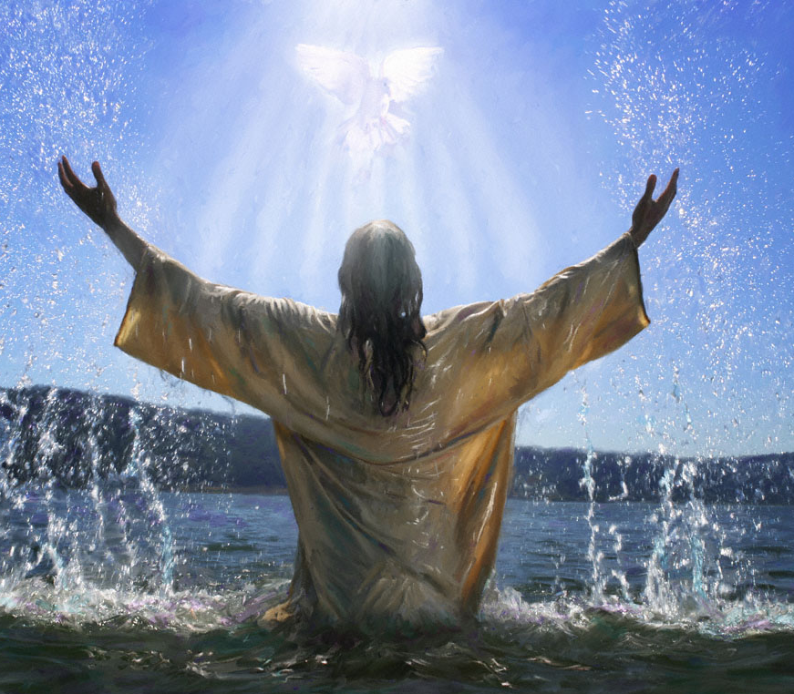
Example of Appeal for Character of Jesus
Would you like others to see the character of Jesus in you? Would you like to have the fruit of the spirit in your life?
This morning are you willing to say, “Lord, make me more like You. Create in me a loving heart. Come into my life and form the fruit of the spirit in me”?
Notes:
Example of an appeal for wanting the character of Jesus in your life.

Slide 188
Example of Appeal for Character of Jesus
If you would like Jesus to do this in your life, then I invite you to come forward when we sing the closing song and stand with me here at the altar.
By coming forward you are saying, “Lord, make me more like You.” You may start coming forward when we begin singing the first verse of the closing song.

Slide 189
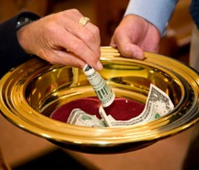
Example of Appeal for Tithing
God is asking you to submit the financial side of your life to Him. He is asking you to step out and trust Him. Would you like to ask Him to help you do this?
Today, if you would like to say, “Lord, I want to be a faithful steward. I want to submit all my life to you. I choose to return a faithful tithe and trust you to take care of me…”
Notes:
Example of appeal for wanting to be a faithful steward.

Slide 190
Example of Appeal for Tithing
Then I invite you to come forward as we sing our closing song. You may come forward as we sing the first verse.
Or…Then I invite you to raise your hand as we pray.
Begin praying. During the prayer repeat the appeal and ask for raised hands.

Slide 191

Example of Appeal to be a Witness
God is looking for people who will say, “Here I am Lord, you can use me.” Would you like to be used by Jesus this week to touch someone’s heart? Would you like to tell God that you’re available for service? Would you like to experience the joy of making a difference in someone’s life?
Are you willing to say, “Lord, if there’s someone who needs to feel the love of Jesus this week, then bring them across my path. I’m available if you want to use me this week”?
Notes:
Example of appeal for wanting to God to use me as a witness.

Slide 192
Example of Appeal to be a Witness
It might be someone in your family, someone at work, someone at school, someone in your neighborhood. It might even be a total stranger.
But if you want to say, “Lord Jesus, if someone needs your love this week, then I give you permission to use me…”
Then I invite you to come forward as we sing our closing song.

Slide 193

Example of Appeal with Decision Card
Today, we’ve heard God’s Word to us. Perhaps the Holy Spirit is speaking to your heart. Perhaps there are some decisions you need to make.
I’d like to give you the opportunity to respond to Jesus today. Please take out the yellow card in your pew…
Review the card and tell them where to put it.

Slide 194
Altar Call and Group Prayer
Make an altar call and have people come forward
Invite people to join you in a corner of the sanctuary or another room after the service
Have special prayer with those who came forward. Invite others to pray.
Let anyone who wants share a testimony.
Notes:
1. Example of Nigeria.
2. Example of coming forward for wanting the character of Christ--- or wanting to forgive.
3. After closing prayer, dismiss congregatons but spend time with those who came forward.

Slide 195
Have a Special Prayer Room
Make a public appeal (ex raising of hands)
But let people know there is a special prayer room where they can go for someone to pray with them
This gives them opportunity for personal interaction

Slide 196
REMEMBER THE MAIN POINT
To Get Decisions,
You Must ASK For Them

Slide 197
Seminar Info
Notes:
1. Evangelism doesn't start with the first night of a meeting. It starts by mingling with people.
2. This is how you prepare the soil. Not just by hanging literature on door knobs.
3. It starts with personal work and personal friendships.

Slide 198
WEBSITES
DiscoverBibleProphecy.org
Ccosda.org/pastorevangelistsbootcamp
Ccosda.org/evangelismtraining
MomentsWithJesus.org
Ccosda.org/forecastinghope
Notes:
We need to pray for this intensity. This passion.
Maybe it needs to be re-ignited in us.
Ask God to place it in your heart.

Slide 199
Forecasting Hope
Evangelism Kit
www.evangelismmarketing.com/forecastinghope
omagana@ohioadventist.org
Notes:
We need to pray for this intensity. This passion.
Maybe it needs to be re-ignited in us.
Ask God to place it in your heart.

Slide 200
Pastor David M. Klinedinst
Church Growth & Evangelism Director
Chesapeake Conference of SDA dklinedinst@ccosda.org DiscoverBibleProphecy.org
402-304-5603 855-744-HOPE davidklinedinst.org
Notes:
1. Evangelism doesn't start with the first night of a meeting. It starts by mingling with people.
2. This is how you prepare the soil. Not just by hanging literature on door knobs.
3. It starts with personal work and personal friendships.

