Slide 1

The Importance of Evangelistic Visitation

Slide 2

The Importance of Evangelistic Visitation
Allows you to see where the Holy Spirit is working
Allows you to see if conviction is present

Slide 3
The Importance of Evangelistic Visitation
It builds relationships and creates personal connections.
Establishes trust.

Slide 4
The Importance of Evangelistic Visitation
Allows for discussion that can’t happen during the meetings
Opportunity to ask questions and get clarity.

Slide 5
The Importance of Evangelistic Visitation
Decisions are solidified in one on one interactions.
Opportunity to help people move forward in their decisions.

Slide 6
The Importance of Evangelistic Visitation
15 minutes in the home is worth more than a 60 minute sermon.

Slide 7
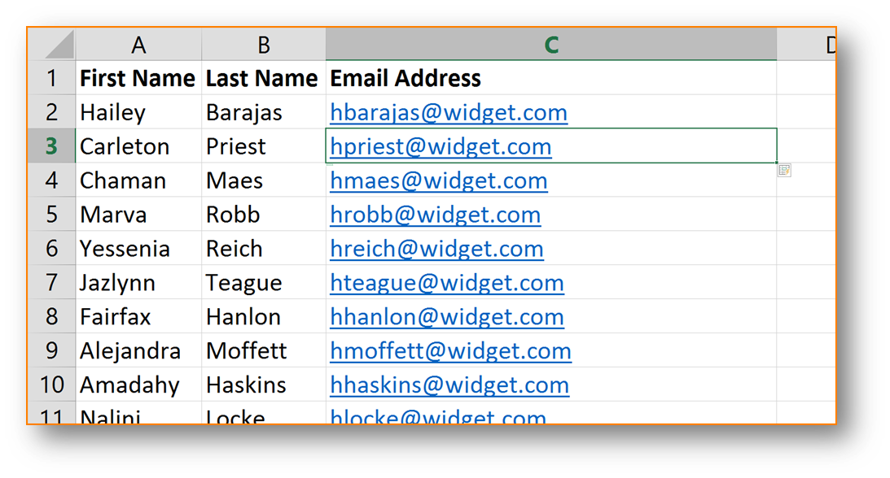
Having a Church Interest List
A church without an interest list is not serious about soul-winning.
An interest list is an organized way to keep track of those who have had contact with your church.
Notes:
In this session, I want to share the importance of developing relationships in evangelism.
We will look at three principles of soul winning-- of reaching people's hearts. You can apply these principles to your life. If you ignore, you will not reach people.

Slide 8
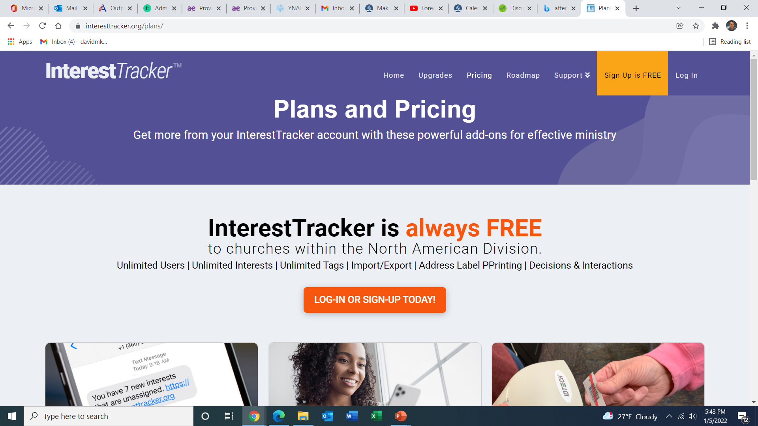
Having a Church Interest List
A church without an interest list is not serious about soul-winning.
An interest list is an organized way to keep track of those who have had contact with your church.
Notes:
In this session, I want to share the importance of developing relationships in evangelism.
We will look at three principles of soul winning-- of reaching people's hearts. You can apply these principles to your life. If you ignore, you will not reach people.

Slide 9
Tracking Attendance
Keeping track of attendance is absolutely essential.
It helps you to know who is the most interested and how to prioritize your visits.
Notes:
In this session, I want to share the importance of developing relationships in evangelism.
We will look at three principles of soul winning-- of reaching people's hearts. You can apply these principles to your life. If you ignore, you will not reach people.

Slide 10
Tracking Attendance
It holds your membership accountable.
These names get added to your church interest list.
Notes:
In this session, I want to share the importance of developing relationships in evangelism.
We will look at three principles of soul winning-- of reaching people's hearts. You can apply these principles to your life. If you ignore, you will not reach people.

Slide 11
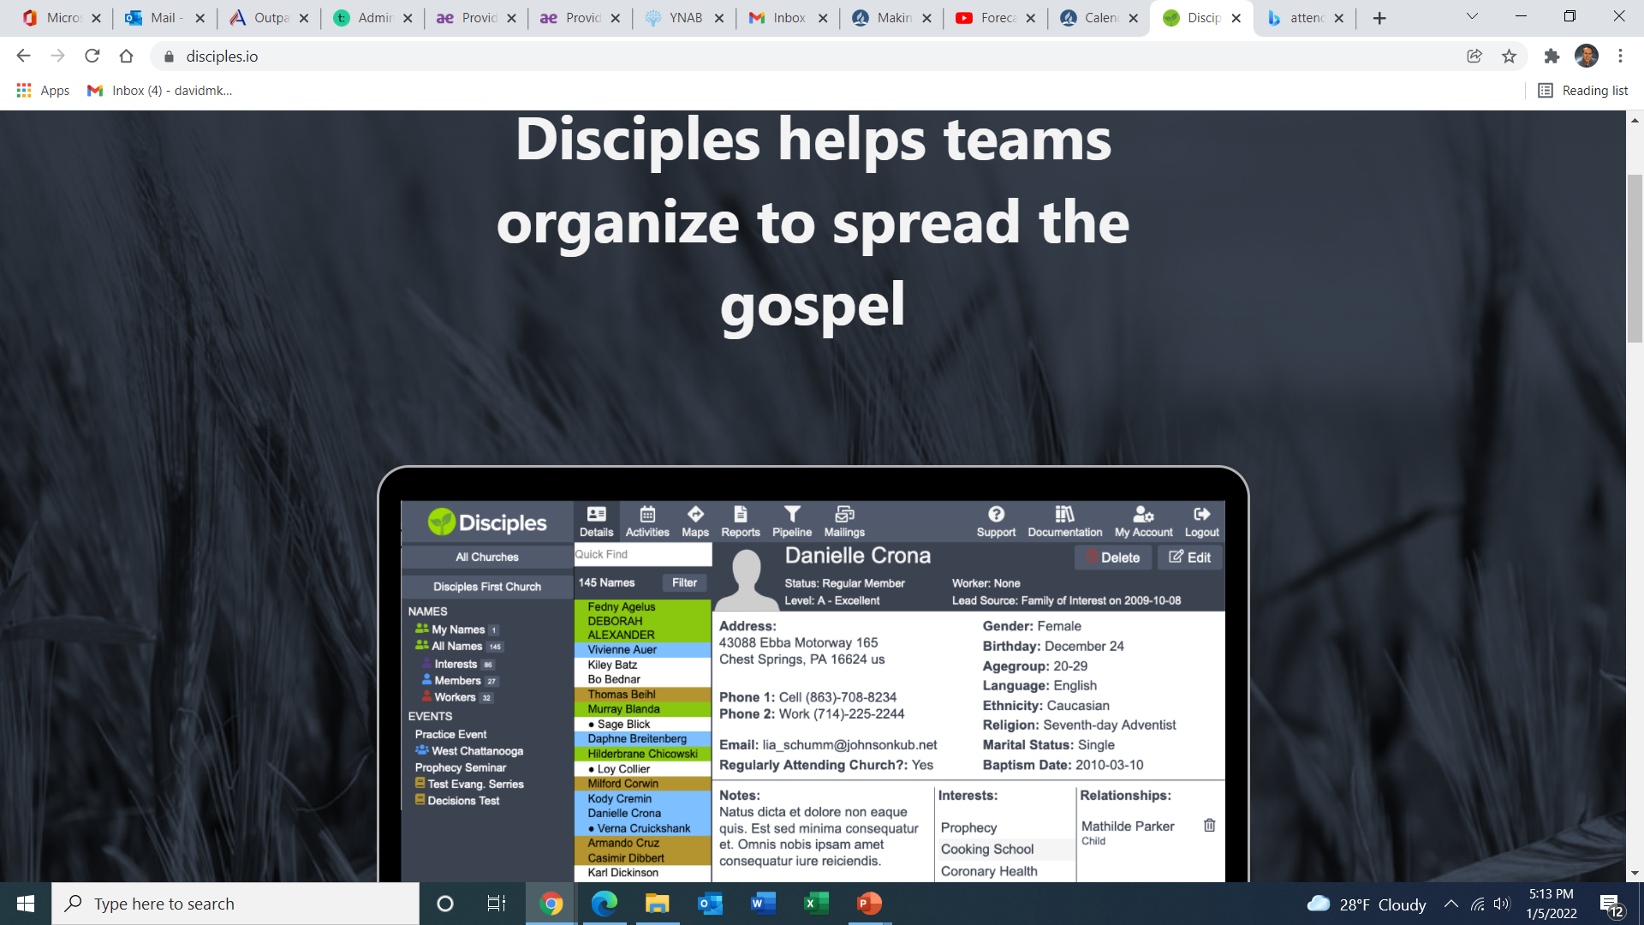
GetDisciples.com
Keeping track of attendance is absolutely essential.
It helps you to know who is the most interested and how to prioritize your visits.
GetDisciples.com
Notes:
In this session, I want to share the importance of developing relationships in evangelism.
We will look at three principles of soul winning-- of reaching people's hearts. You can apply these principles to your life. If you ignore, you will not reach people.

Slide 12
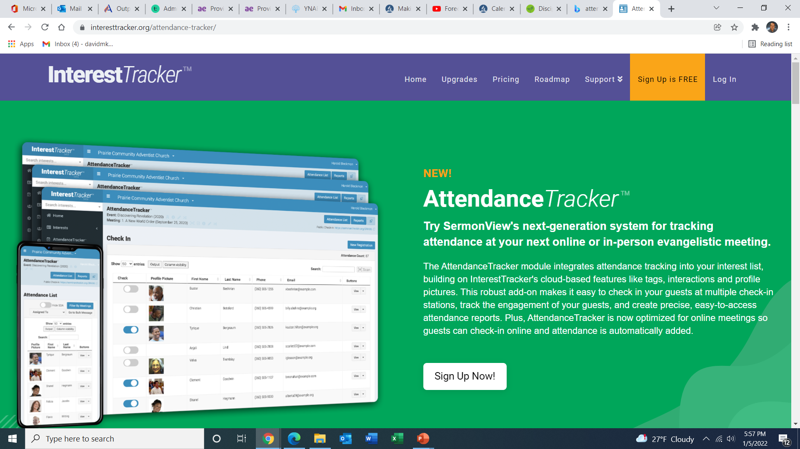
GetDisciples.com
Keeping track of attendance is absolutely essential.
It helps you to know who is the most interested and how to prioritize your visits.
GetDisciples.com
Notes:
In this session, I want to share the importance of developing relationships in evangelism.
We will look at three principles of soul winning-- of reaching people's hearts. You can apply these principles to your life. If you ignore, you will not reach people.

Slide 13
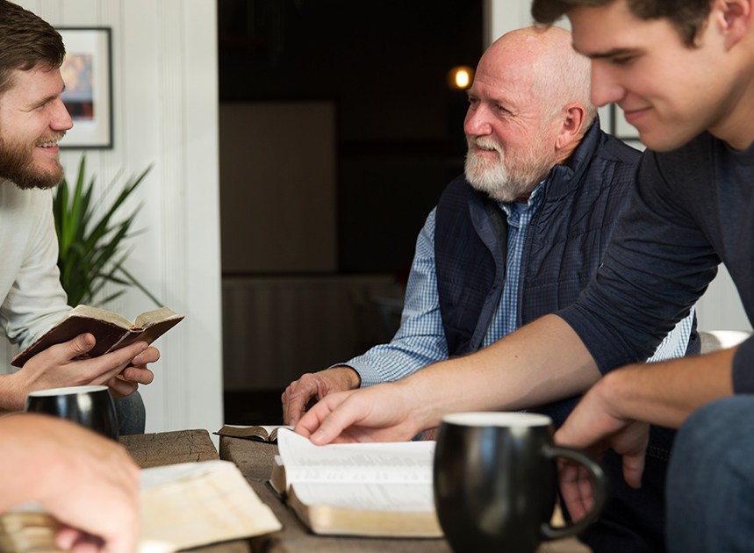
Visitation Before the Meetings Begin
1-2 weeks before the meetings, you should visit your best interests and give them a personal invitation with a professional looking flyer.
This can be done by the pastor, elders, or the church visitation team.
Notes:
In this session, I want to share the importance of developing relationships in evangelism.
We will look at three principles of soul winning-- of reaching people's hearts. You can apply these principles to your life. If you ignore, you will not reach people.

Slide 14

Early Visitation During the Meetings The first 7-10 days
Visit them at the meetings and give them the gift book.
This means you are intentionally connecting with people before and after the evening program.
Notes:
In this session, I want to share the importance of developing relationships in evangelism.
We will look at three principles of soul winning-- of reaching people's hearts. You can apply these principles to your life. If you ignore, you will not reach people.

Slide 15

Early Visitation During the Meetings The first 7-10 days
Another option is to have food and refreshments after each meeting.
It creates a great atmosphere for visitation.
Notes:
In this session, I want to share the importance of developing relationships in evangelism.
We will look at three principles of soul winning-- of reaching people's hearts. You can apply these principles to your life. If you ignore, you will not reach people.

Slide 16

What do you talk about?
FORT
F – Family
O – Occupation
R – Recreation
T - Testimony
Notes:
1- Take an interest in their life. Learn what makes them tick.
2- Find out what's important to them.
3- I have used FORT many times to learn about people.
You're never at a lost what to talk about.
4. FORT -- Each letter represents a subject you can talk about with people.

Slide 17

Questions to Ask
How did you find out about the meetings?
Why did you decide to attend?
Tell me your story. How did you become a Christian?
How did you become interested in spiritual things?
Notes:
In this session, I want to share the importance of developing relationships in evangelism.
We will look at three principles of soul winning-- of reaching people's hearts. You can apply these principles to your life. If you ignore, you will not reach people.

Slide 18

Listening vs. Talking
Listening is a big part of soul winning
Listening is more important than talking.
Notes:
In this session, I want to share the importance of developing relationships in evangelism.
We will look at three principles of soul winning-- of reaching people's hearts. You can apply these principles to your life. If you ignore, you will not reach people.

Slide 19
Accepting Jesus Visit
This visit happens when they fill out a card accepting Jesus as their Savior
Visit them immediately.
Encourage them, pray with them. Listen to their story.
Explain the Gospel and answer any questions.
Notes:
In this session, I want to share the importance of developing relationships in evangelism.
We will look at three principles of soul winning-- of reaching people's hearts. You can apply these principles to your life. If you ignore, you will not reach people.

Slide 20
Accepting Jesus Visit
How did you find out about the meetings?
Why did you decide to attend?
Tell me your story.
Why did mark your card to accept Jesus? What was going on in your heart?
Notes:
In this session, I want to share the importance of developing relationships in evangelism.
We will look at three principles of soul winning-- of reaching people's hearts. You can apply these principles to your life. If you ignore, you will not reach people.

Slide 21
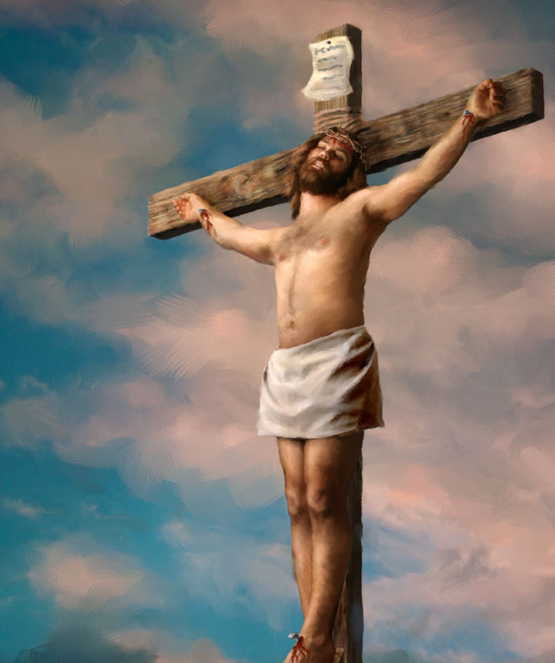
Making a Gospel Presentation
We are born with sin. It’s easy to do wrong. Everyone has made mistakes. Romans 3:23
The penalty of sin is death. Romans 6:23
Jesus paid the penalty. He lived a perfect life in our place. When He becomes your Savior, His perfect life counts for you. John 3:16
We must invite Him. Revelation 3:20
Notes:
Here is a simple way to make a gospel presentation. Just go over these four points.
People don't need big theological words. Make it simple. In the beginning, they just need to understand they are a sinner who needs Jesus and to ask Jesus into their lives. It's that simple.
EXAMPLE-- Do a role play with someone and illustrate how to explain the gospel to someone using these four steps. Invite them to accept Jesus. Have prayer with them.

Slide 22
Making a Gospel Presentation
We are born with sin. It’s easy to do wrong. Everyone has made mistakes. Romans 3:23
The penalty of sin is death. Romans 6:23
Jesus paid the penalty. He lived a perfect life in our place. When He becomes your Savior, His perfect life counts for you. John 3:16
We must invite Him. Revelation 3:20
Notes:
Here is a simple way to make a gospel presentation. Just go over these four points.
People don't need big theological words. Make it simple. In the beginning, they just need to understand they are a sinner who needs Jesus and to ask Jesus into their lives. It's that simple.
EXAMPLE-- Do a role play with someone and illustrate how to explain the gospel to someone using these four steps. Invite them to accept Jesus. Have prayer with them.

Slide 23

Taking action with the person
“Would you like to invite Jesus into your life?”
Invite them to pray in their own words
You pray in confirmation
Disciple them to know Jesus better
Get them to church
Start a Bible study
Notes:
When they say yes, pray with them. Invite them to church or to a personal Bible study immediately.

Slide 24
“The one work more precious than any other is the work of soul-saving. The same intensity of desire for the saving of souls that marked the life of the Savior marks the life of His true followers.”
-Australian Union Conference Record Aug. 15, 1902
Notes:
We need to pray for this intensity. This passion.
Maybe it needs to be re-ignited in us.
Ask God to place it in your heart.

Slide 25

Visitation After the Sabbath is Presented
When you cover the Sabbath, have a free book offer.
Deliver the book personally over the next few days.
Notes:
In this session, I want to share the importance of developing relationships in evangelism.
We will look at three principles of soul winning-- of reaching people's hearts. You can apply these principles to your life. If you ignore, you will not reach people.

Slide 26
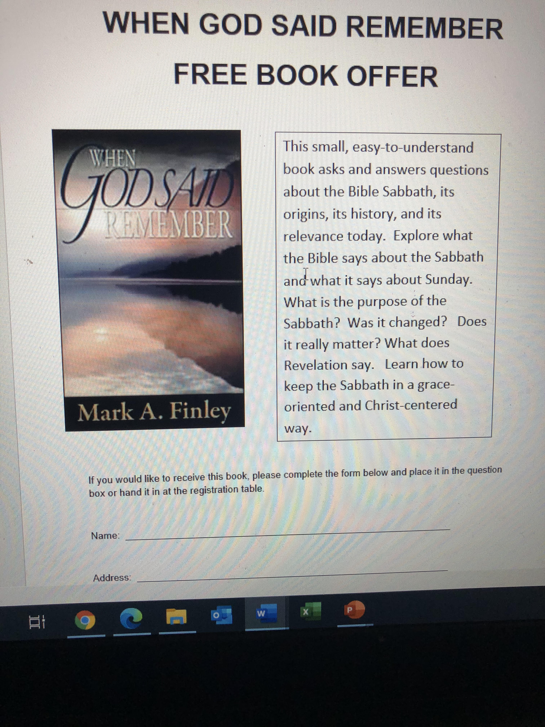
Visitation After the Sabbath is Presented
Create a nice looking flyer promoting the book.
Invite them to hand it in at the registration table.
Notes:
In this session, I want to share the importance of developing relationships in evangelism.
We will look at three principles of soul winning-- of reaching people's hearts. You can apply these principles to your life. If you ignore, you will not reach people.

Slide 27
What to Say. . . by Phone
“Hi Mary! This is David from the Forecasting Hope seminar. The reason I’m calling is because I saw that you requested the book When God Said Remember. I was going to be out visiting some people later this evening, would you mind if I stopped by for a moment and dropped off the book to you?”
Notes:
In this session, I want to share the importance of developing relationships in evangelism.
We will look at three principles of soul winning-- of reaching people's hearts. You can apply these principles to your life. If you ignore, you will not reach people.

Slide 28
What to Say…… in person
“Hi Mary! This is David from the Forecasting Hope Seminar. I just stopped by for a minute to drop off the book you requested. You had requested the book When God Said Remember.”
Notes:
In this session, I want to share the importance of developing relationships in evangelism.
We will look at three principles of soul winning-- of reaching people's hearts. You can apply these principles to your life. If you ignore, you will not reach people.

Slide 29
What do you talk about?
FORT
F – Family
O – Occupation
R – Recreation
T - Testimony
Notes:
1- Take an interest in their life. Learn what makes them tick.
2- Find out what's important to them.
3- I have used FORT many times to learn about people.
You're never at a lost what to talk about.
4. FORT -- Each letter represents a subject you can talk about with people.

Slide 30
Questions to Ask
How did you find out about the meetings?
Why did you decide to attend?
Tell me your story. How did you become a Christian?
How did you become interested in spiritual things?
Notes:
In this session, I want to share the importance of developing relationships in evangelism.
We will look at three principles of soul winning-- of reaching people's hearts. You can apply these principles to your life. If you ignore, you will not reach people.

Slide 31
Questions to Ask
I see you requested the book on the Sabbath? Was that new to you?
If they say it was not new, ask them where they heard it before.
Does it make sense to you?
Do you have any questions about it?
Have you ever thought about making the Sabbath a part of your life?
Notes:
In this session, I want to share the importance of developing relationships in evangelism.
We will look at three principles of soul winning-- of reaching people's hearts. You can apply these principles to your life. If you ignore, you will not reach people.

Slide 32
Ending the Visit
Encourage them to read the book. It will answer their questions
If the visit is positive, invite them to visit the church and experience a Sabbath worship.
Have a prayer of blessing with the family.
Notes:
In this session, I want to share the importance of developing relationships in evangelism.
We will look at three principles of soul winning-- of reaching people's hearts. You can apply these principles to your life. If you ignore, you will not reach people.

Slide 33
Under Conviction
If they appear under conviction, you might ask: What do you think Jesus would want you to do?
What do you sense God leading you to do?
Have you ever thought of making the Sabbath a part of your life and experiencing the blessing God has for you?
Notes:
In this session, I want to share the importance of developing relationships in evangelism.
We will look at three principles of soul winning-- of reaching people's hearts. You can apply these principles to your life. If you ignore, you will not reach people.

Slide 34
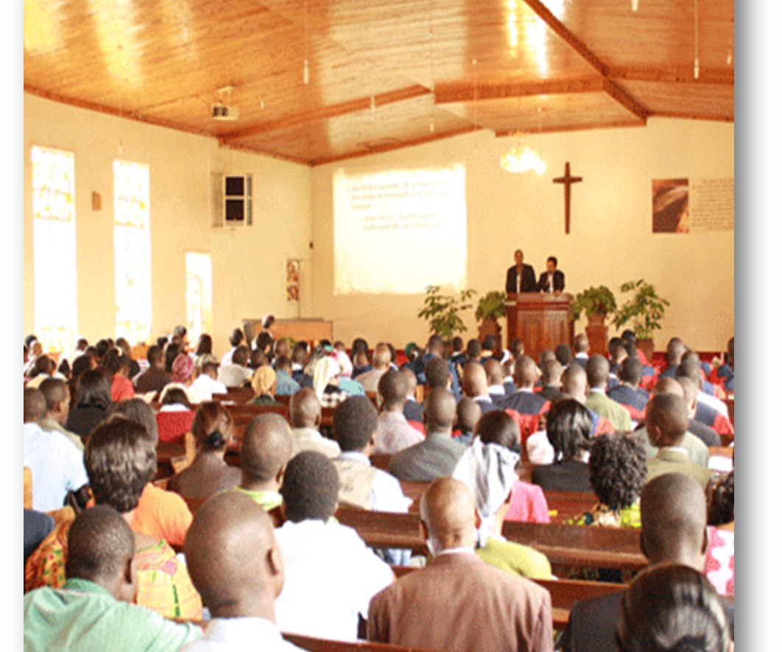
A Special Sabbath Worship
The next Sabbath, have a special Sabbath worship and invite the guests from the meetings.
Pick a special topic and advertise it as part of the meetings.
Those who come will be your key interests.
Notes:
In this session, I want to share the importance of developing relationships in evangelism.
We will look at three principles of soul winning-- of reaching people's hearts. You can apply these principles to your life. If you ignore, you will not reach people.

Slide 35
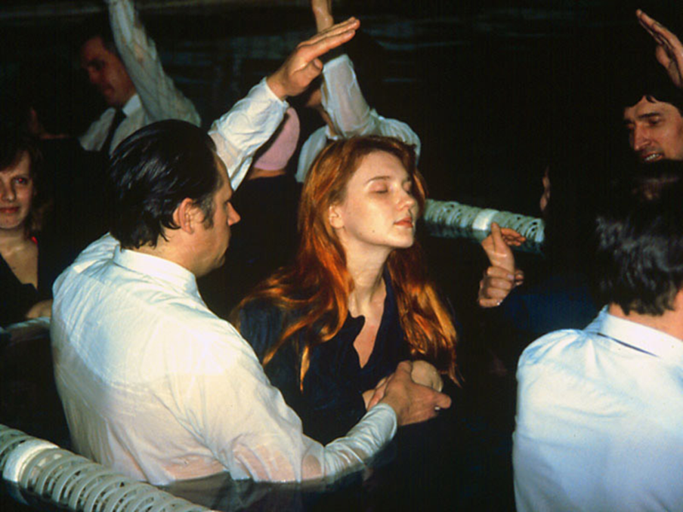
Visiting After Presenting Baptism
Use a decision card on this night and make a strong call for baptism.
Be clear on how to collect the cards.
Notes:
In this session, I want to share the importance of developing relationships in evangelism.
We will look at three principles of soul winning-- of reaching people's hearts. You can apply these principles to your life. If you ignore, you will not reach people.

Slide 36
Options For Collecting Decision Cards
Ushers stand at the door and collect the cards at the end.
Ushers collect the cards in the aisle and bring them to the speaker for a special prayer.
Have buckets in each row.
Notes:
In this session, I want to share the importance of developing relationships in evangelism.
We will look at three principles of soul winning-- of reaching people's hearts. You can apply these principles to your life. If you ignore, you will not reach people.

Slide 37
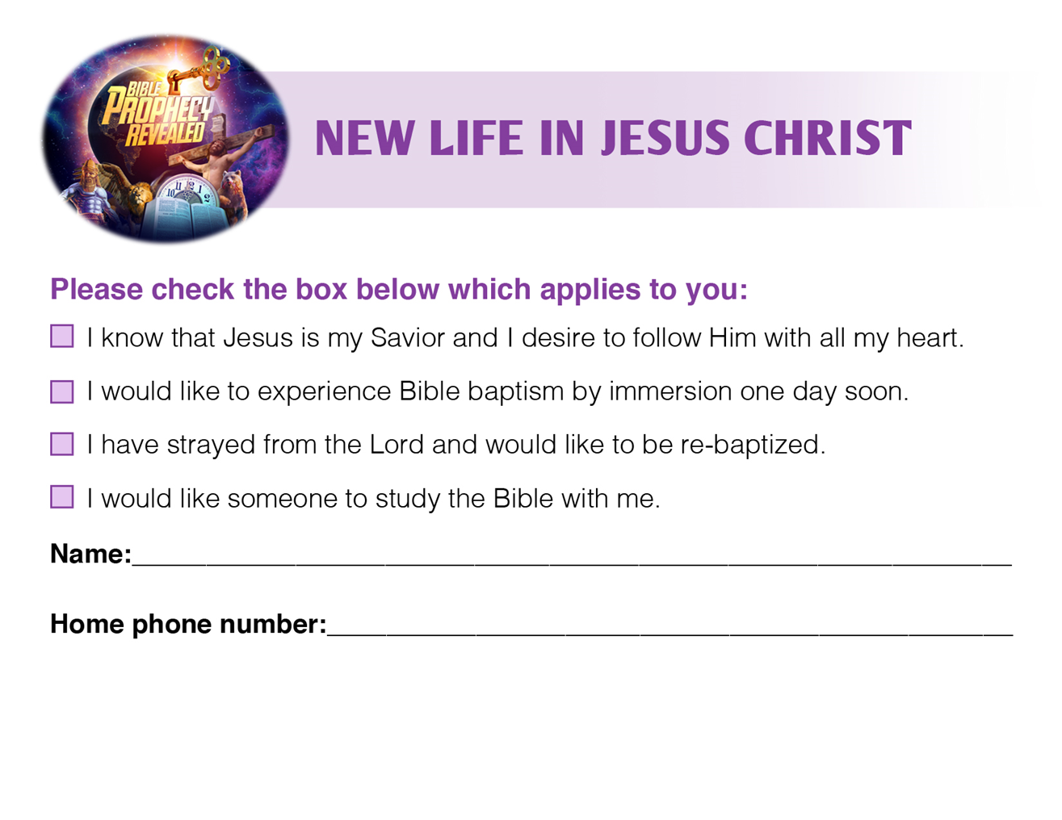
Notes:
In this session, I want to share the importance of developing relationships in evangelism.
We will look at three principles of soul winning-- of reaching people's hearts. You can apply these principles to your life. If you ignore, you will not reach people.

Slide 38
Visiting After Presenting Baptism
All who indicate a desire for baptism should be visited immediately.
Notes:
In this session, I want to share the importance of developing relationships in evangelism.
We will look at three principles of soul winning-- of reaching people's hearts. You can apply these principles to your life. If you ignore, you will not reach people.

Slide 39
Visiting After Presenting Baptism
Purpose to acknowledge, affirm, and encourage their decision.
Set up an appointment to visit.
The visit can take place at the hall, church, or in the home
Notes:
In this session, I want to share the importance of developing relationships in evangelism.
We will look at three principles of soul winning-- of reaching people's hearts. You can apply these principles to your life. If you ignore, you will not reach people.

Slide 40
What to Say. . .
“Hi Mary! This is David from the Forecasting Hope seminar. I was just going through the response cards from the other night. I noticed you were thinking about being baptized.
That’s wonderful. I’d love to talk with you for a few minutes and hear your story. Could we set up a time to do that?”
Notes:
In this session, I want to share the importance of developing relationships in evangelism.
We will look at three principles of soul winning-- of reaching people's hearts. You can apply these principles to your life. If you ignore, you will not reach people.

Slide 41
Engaging the Heart During the Visit
Tell me your story. Why did you decide to check for baptism?
What was going on in your heart?
How soon were you thinking of doing this?
Notes:
In this session, I want to share the importance of developing relationships in evangelism.
We will look at three principles of soul winning-- of reaching people's hearts. You can apply these principles to your life. If you ignore, you will not reach people.

Slide 42
Visiting After Presenting Baptism
Affirm them in their decision and have prayer.
If they are wanting to move forward soon, set up a separate time to review the baptismal statements
Notes:
In this session, I want to share the importance of developing relationships in evangelism.
We will look at three principles of soul winning-- of reaching people's hearts. You can apply these principles to your life. If you ignore, you will not reach people.

Slide 43
Visiting After Presenting Baptism
If it’s clear they need more study, offer to start personal Bible studies right away.
This is why it’s important to have members trained and ready to give Bible studies.
Notes:
In this session, I want to share the importance of developing relationships in evangelism.
We will look at three principles of soul winning-- of reaching people's hearts. You can apply these principles to your life. If you ignore, you will not reach people.

Slide 44
Reviewing the Baptismal Statements
Review the 13 statements and let them ask questions.
Set a date for baptism
Make that day special and have a gift for them.
Make sure the baptismal certificate looks nice or is framed.
Notes:
In this session, I want to share the importance of developing relationships in evangelism.
We will look at three principles of soul winning-- of reaching people's hearts. You can apply these principles to your life. If you ignore, you will not reach people.

Slide 45
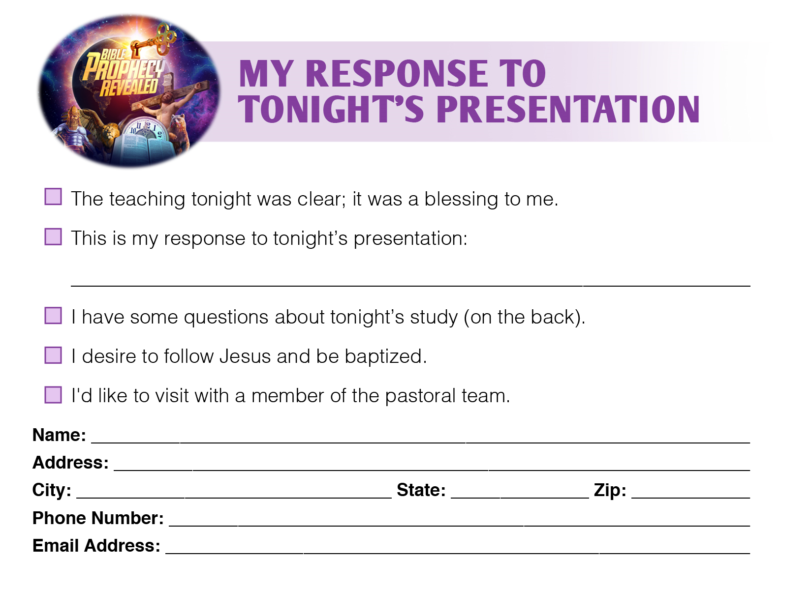
Notes:
In this session, I want to share the importance of developing relationships in evangelism.
We will look at three principles of soul winning-- of reaching people's hearts. You can apply these principles to your life. If you ignore, you will not reach people.

Slide 46

Include an Option to Submit Prayer Requests
Encourage attendees to write prayer requests on the card.
Then you or the prayer team can call them and pray with them.
The prayer team can even send a card in the mail.
This makes a deep connection in the heart.
Notes:
In this session, I want to share the importance of developing relationships in evangelism.
We will look at three principles of soul winning-- of reaching people's hearts. You can apply these principles to your life. If you ignore, you will not reach people.

Slide 47
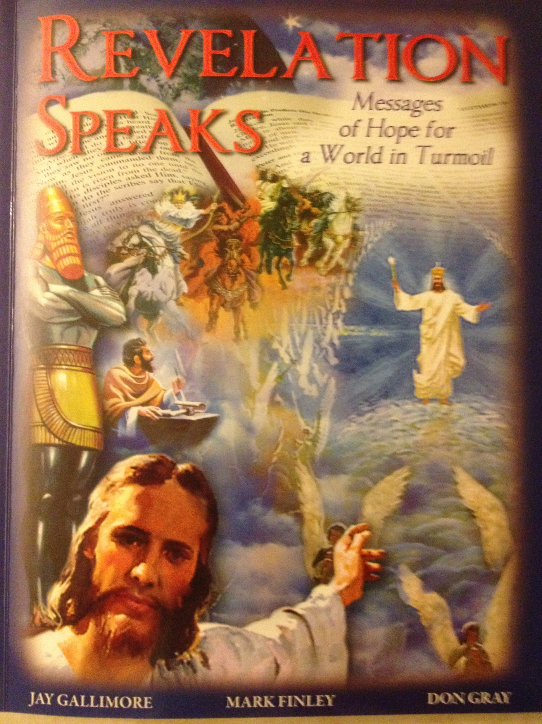
Follow Up Class
It is imperative to have a follow up class immediately after the series.
It should start 2-3 days after the main series concludes.
It enables you to build stronger, long term relationships with your interests.
Notes:
In this session, I want to share the importance of developing relationships in evangelism.
We will look at three principles of soul winning-- of reaching people's hearts. You can apply these principles to your life. If you ignore, you will not reach people.

Slide 48

Follow Up Class
Class should happen at least once a week.
Another option is twice a week, including a Sabbath School class.
Recommend Revelation Speaks workbook.
Notes:
In this session, I want to share the importance of developing relationships in evangelism.
We will look at three principles of soul winning-- of reaching people's hearts. You can apply these principles to your life. If you ignore, you will not reach people.

Slide 49
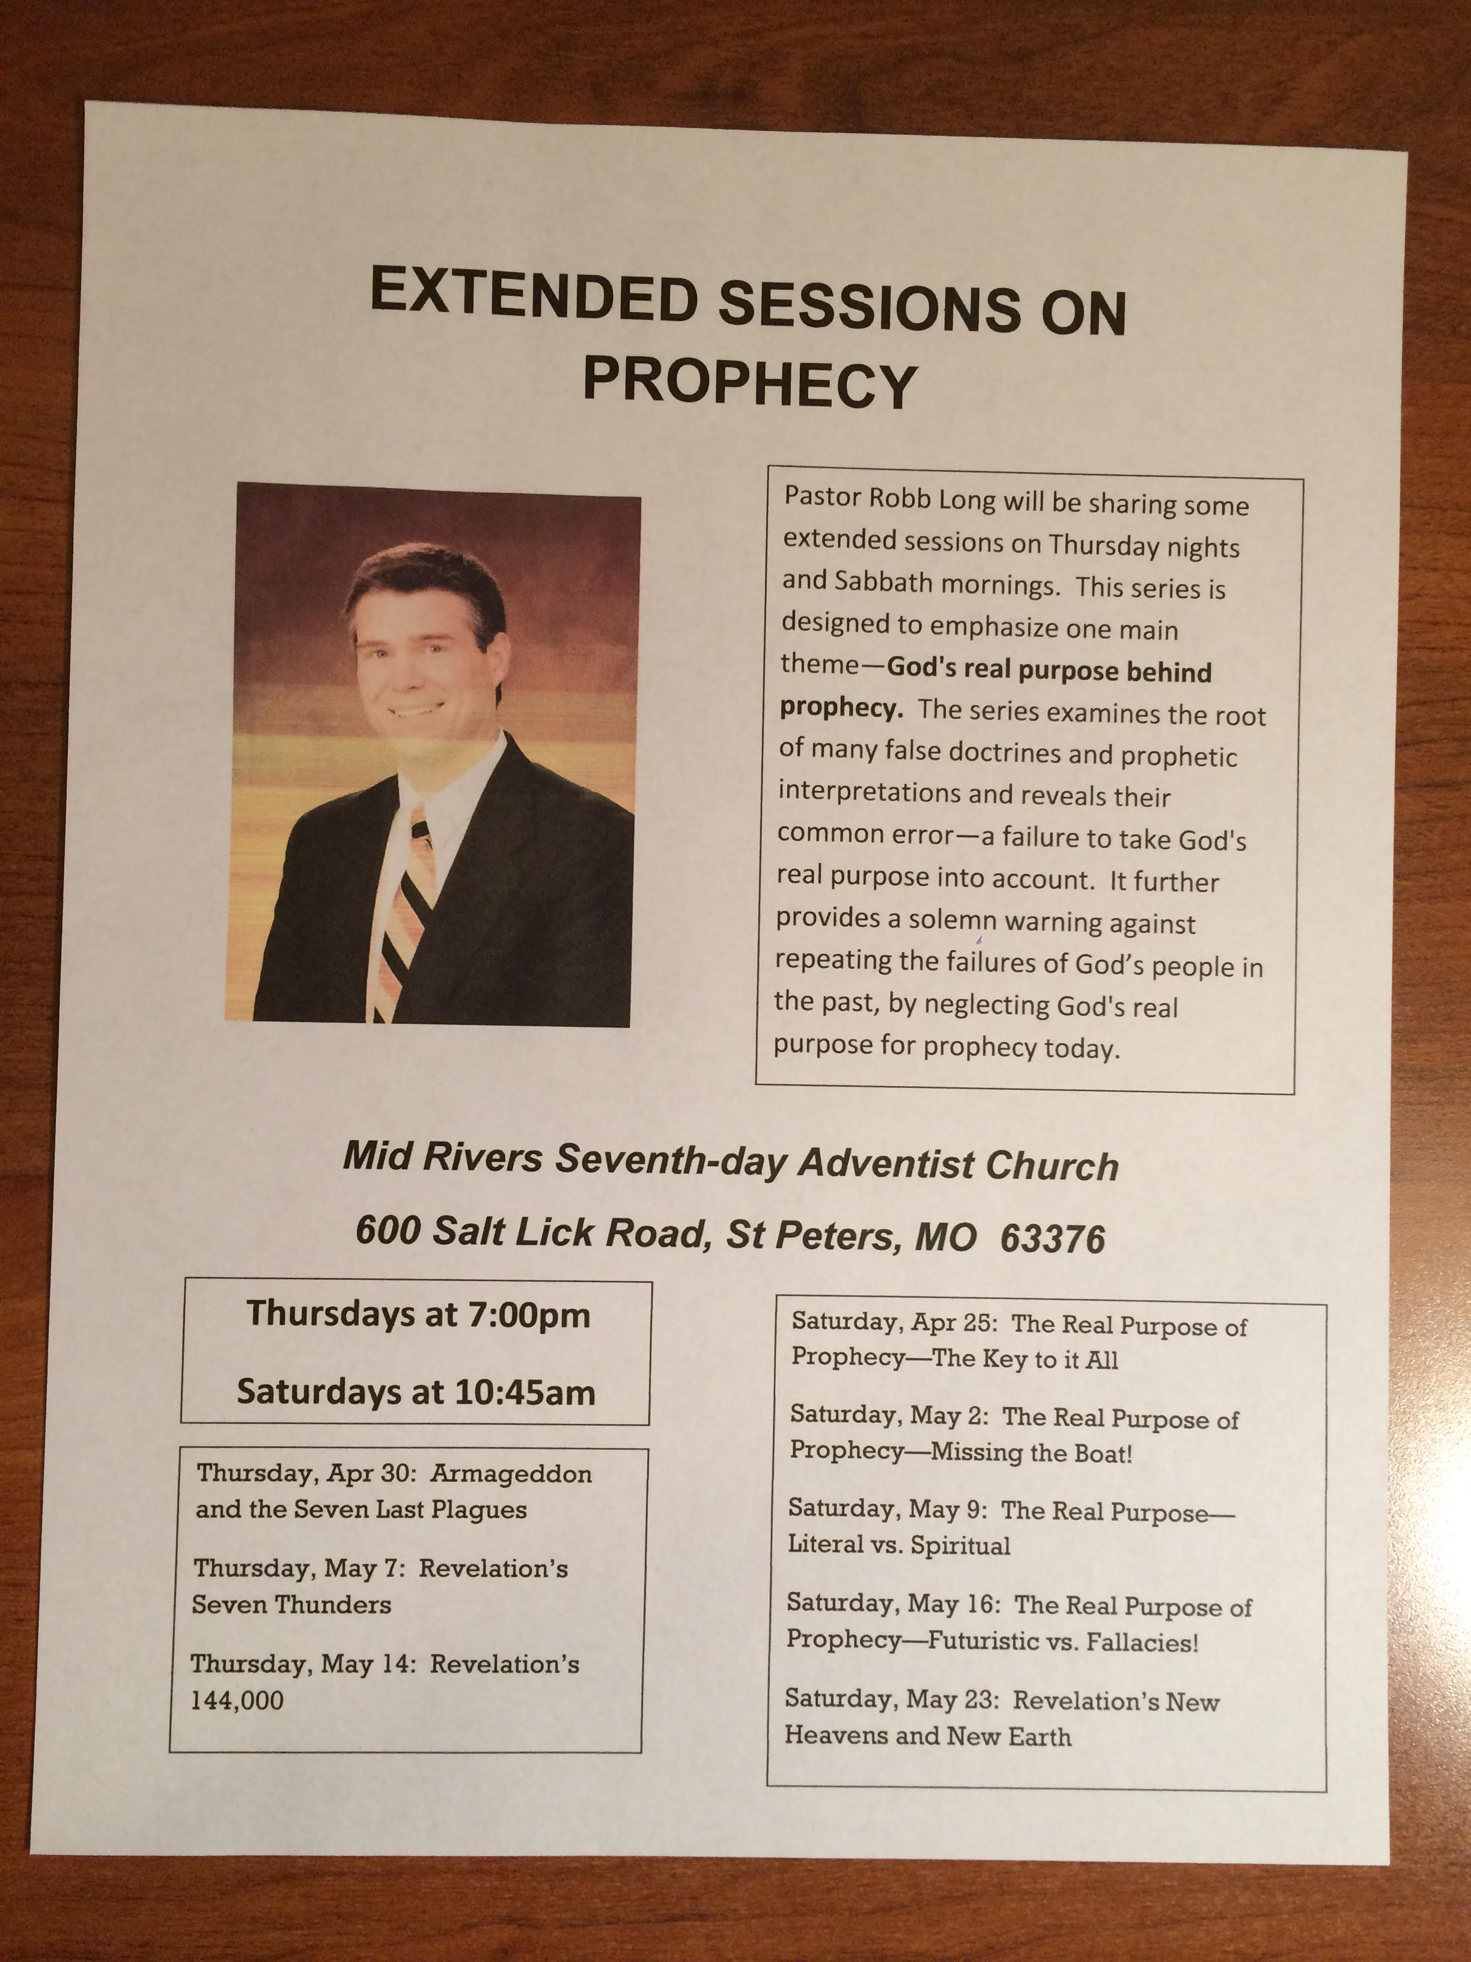
Sabbath Preaching Series
Start a Sabbath morning series on prophecy to encourage them to experience Sabbath worship.
Example: Seven churches, seven seals, or other topics not covered in the main series.
Notes:
In this session, I want to share the importance of developing relationships in evangelism.
We will look at three principles of soul winning-- of reaching people's hearts. You can apply these principles to your life. If you ignore, you will not reach people.

Slide 50
WEBSITES
DiscoverBibleProphecy.org
Cccosda.org/pastorevangelistsbootcamp
Ccosda.org/evangelismtraining
MomentsWithJesus.org
Notes:
We need to pray for this intensity. This passion.
Maybe it needs to be re-ignited in us.
Ask God to place it in your heart.

Slide 51
David Klinedinst
Evangelism and Church Growth Director
Chesapeake Conference of SDA
410-995-1910 office
402-304-5603 cell
dklinedinst@ccosda.org
DiscoverBibleProphecy.org
Davidklinedinst.org

