Slide 1


Slide 2
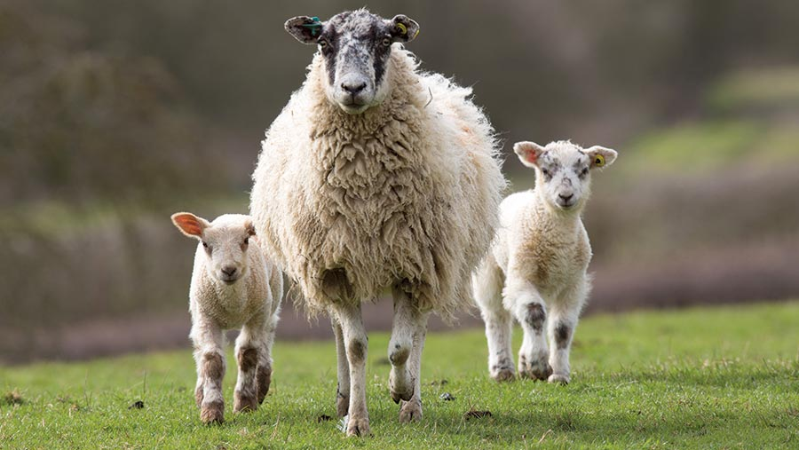

Slide 3

SHEEP

Slide 4
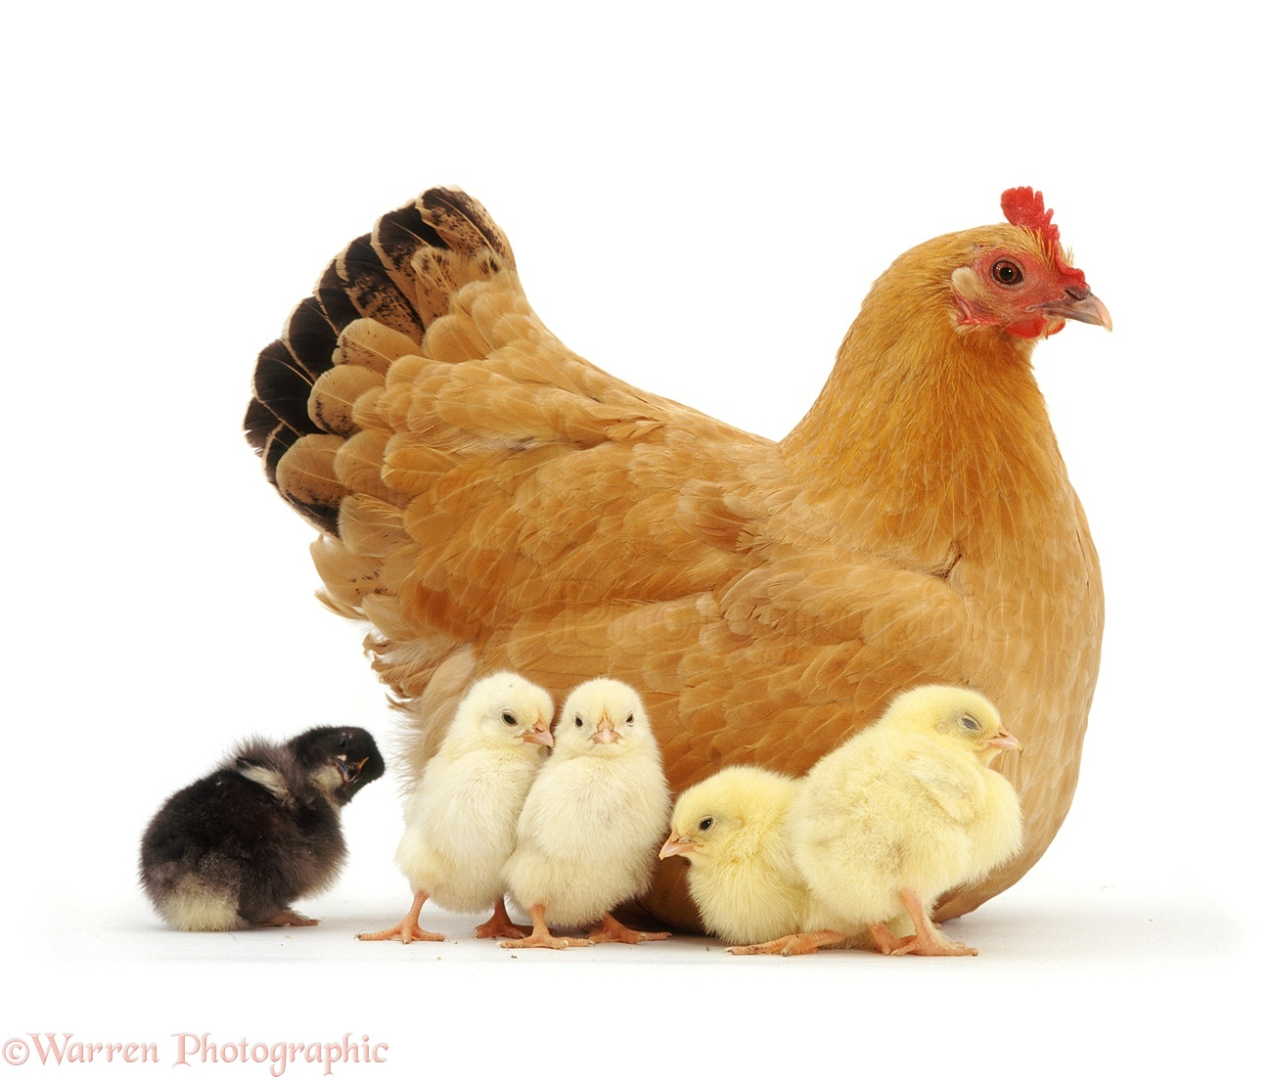

Slide 5
CHICKEN

Slide 6
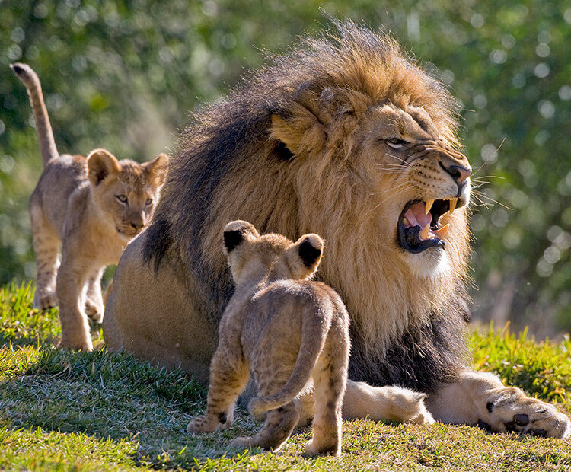

Slide 7
LION

Slide 8
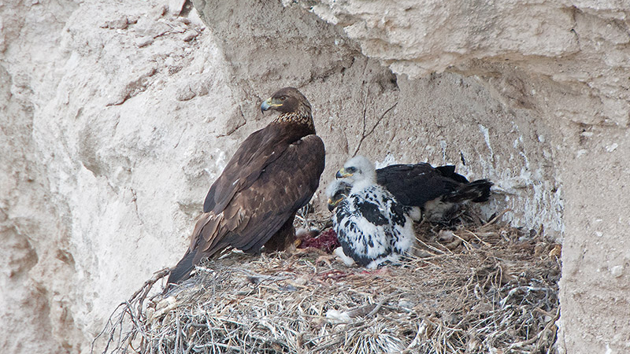

Slide 9
EAGLE

Slide 10
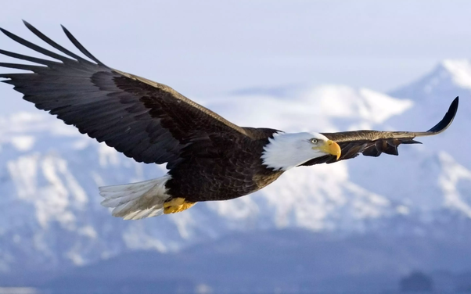
EAGLE
THE KING OF THE AIR

Slide 11
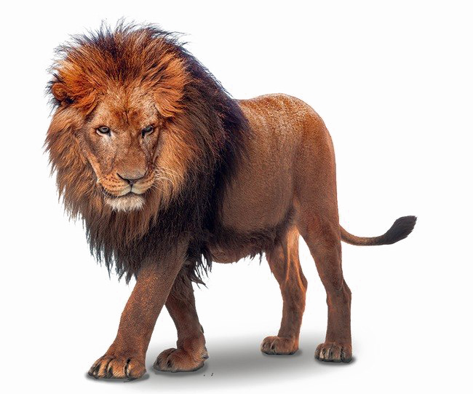
LION
THE KING OF THE JUNGLE

Slide 12
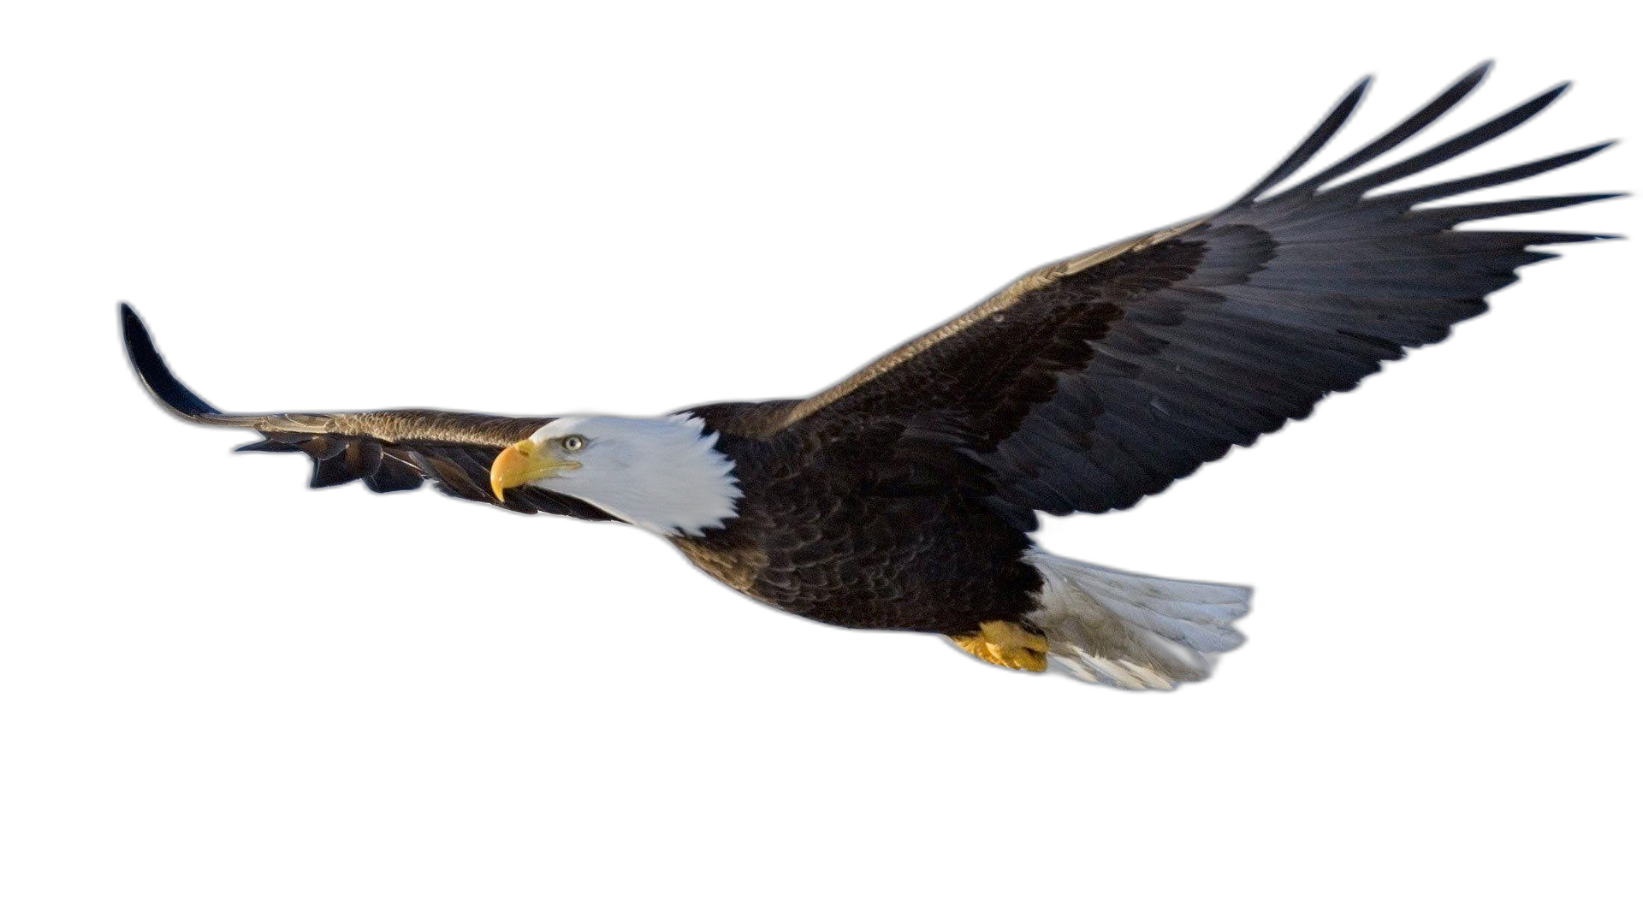
WHICH OF THE TWO
MOST POWERFUL ?
LION
EAGLE
KING OF THE AIR
KING OF THE JUNGLE

Slide 13

Deuteronomy 32:11-12 (NKJV))
¹¹ As an eagle stirs up its nest, Hovers over its young, Spreading out its wings, taking them up, Carrying them on its wings,
¹² So the Lord alone led him, And there was no foreign god with him.

Slide 14
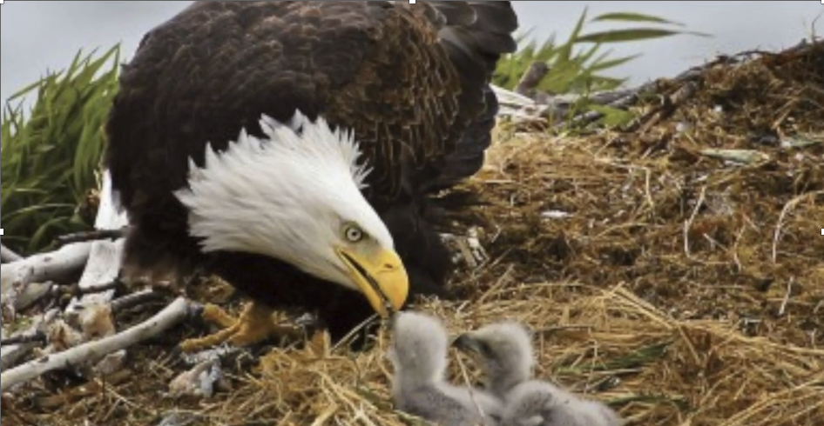

Slide 15
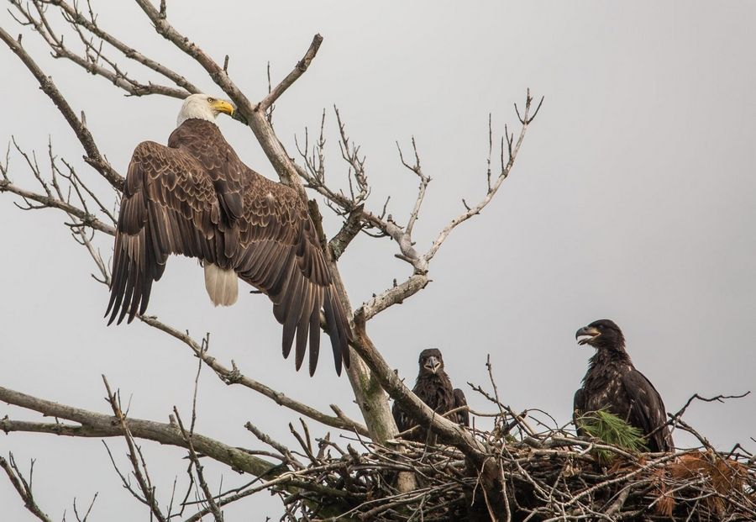
¹¹ As an eagle stirs up its nest, Hovers over its young, Spreading out its wings, taking them up, Carrying them on its wings,
¹² So the Lord alone led him, And there was no foreign god with him.
Deut. 32:11,12 (NKJV)

Slide 16
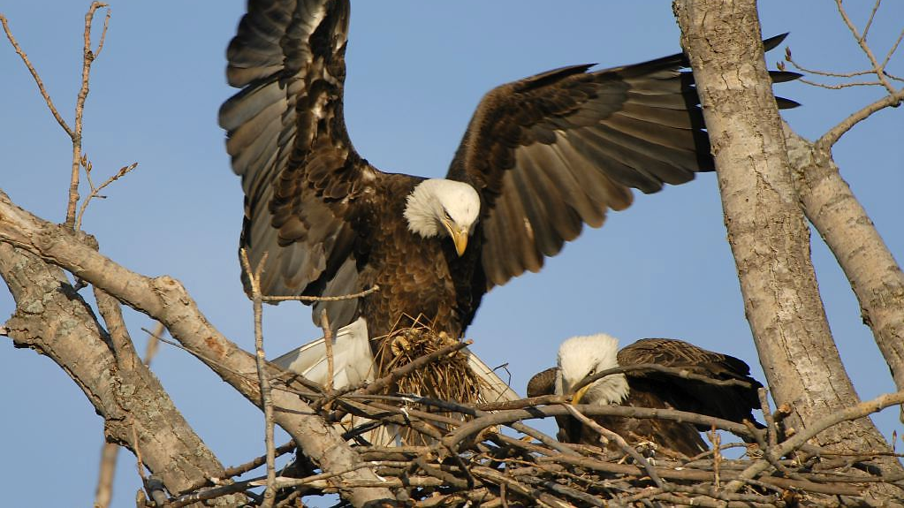
STIRRING

Slide 17
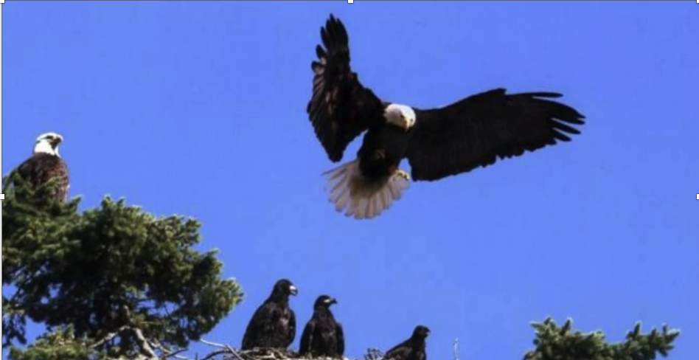
HOVERING

Slide 18
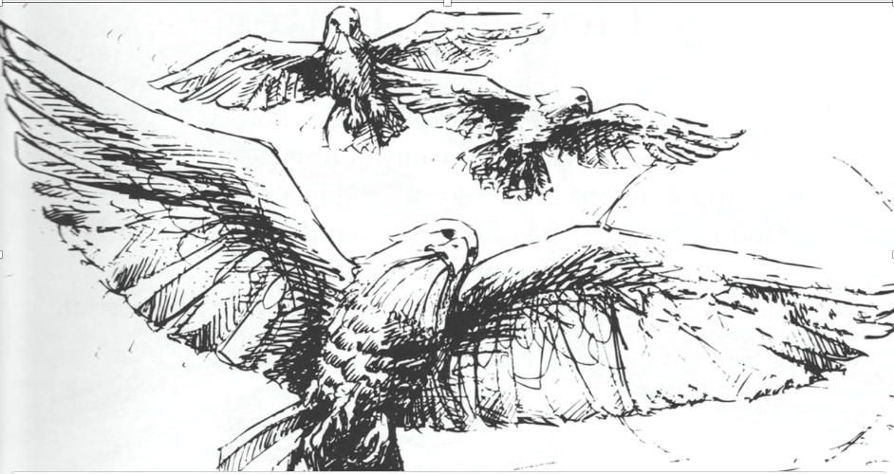
TAKING

Slide 19
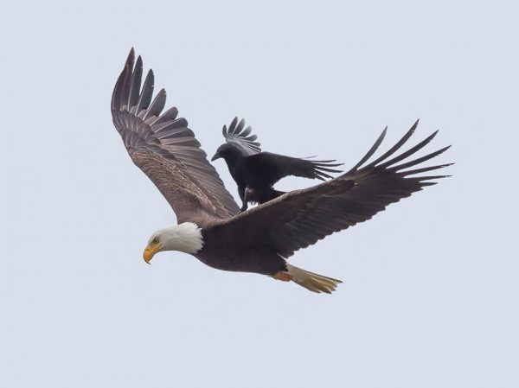
CARRYING

Slide 20
Exodus 19:4
You have seen what I did to the Egyptians, and how I carried you on eagles’ wings, and brought you to Myself.

Slide 21
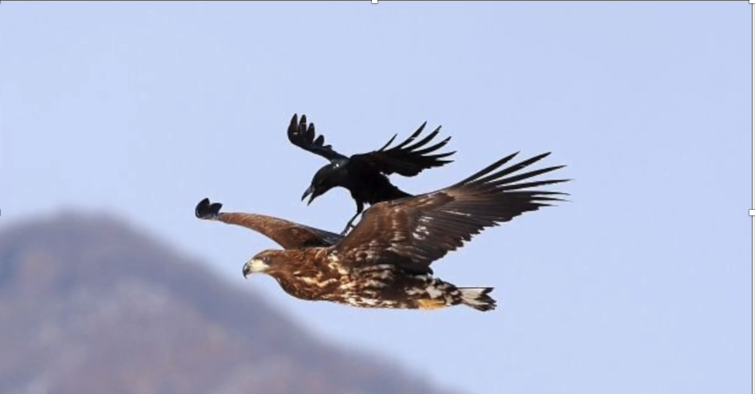
The path where God leads the way may lie through the desert or the sea, but it is a safe path.
Source: Ellen G. White Patriarchs and Prophets, 290.

Slide 22
As An ‘Eagle’ Teach Us Also
Religious Liberty

