Slide 1




Slide 2

UK Parliament
House of Commons:
Terminally ill Adults (End Of Life) Bill
16 October 2024, a Private Members’ Bill
was introduced, sponsored by Kim Leadbeater, Labour MP (Spen Valley)

Slide 3
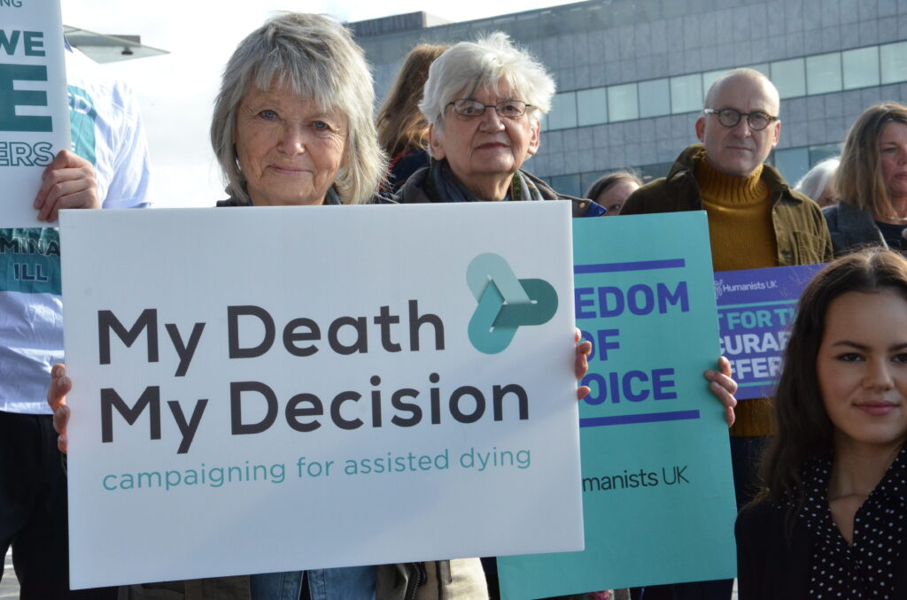


LEGALISING
ASSISTED DYING / ASSISTED SUICIDE
WHICH OF THESE TWO TAKES
PRECEDENCE
LEGISLATIVE
PERSPECTIVE
PERSONAL AUTONOMY
BIBLICAL
GUIDANCE
SANCTITY OF LIFE

Slide 4
GC PARL AIM STATES:
‘We work to position the Seventh-day Adventist Church and its services to a standing of credibility, trust, and relevance in the public realm’
(https://www.adventistliberty.org/quick-overview)

Slide 5
Why?
‘So the Adventist Church can be more effective in its mission…’
What Does PARL Do?
‘For this reason, PARL has a wide mandate. PARL works in cooperation with other church departments to advocate public policy positions on issues in areas as diverse as health, education, peace issues, environmental protection, women’s issues, children’s issues, the rights of prisoners, aid and development.’
https://www.adventistliberty.org/quick-overview

Slide 6
ROLE OF PARL
IN THE LOCAL CHURCH
AND THE PUBLIC SQUARE
Following the Church Ambassador Biblical Model, a PARL leader is encouraged to serve God and represent the Seventh-day Adventist Church to Governments, International Organizations, Non-Governmental Associations, Religious Bodies and the Public Square

Slide 7

BIBLICAL PRINCIPLE
FOOTMEN AND HORSES
If you have run with the footmen, and they have wearied you, Then how can you contend with horses? And if in the land of peace, In which you trusted, they wearied you, Then how will you do in the floodplain of the Jordan?
Jeremiah 12:5 (NKJV)
Footmen of Assisted Dying Bill
Horses of Assisted Dying Law

Slide 8
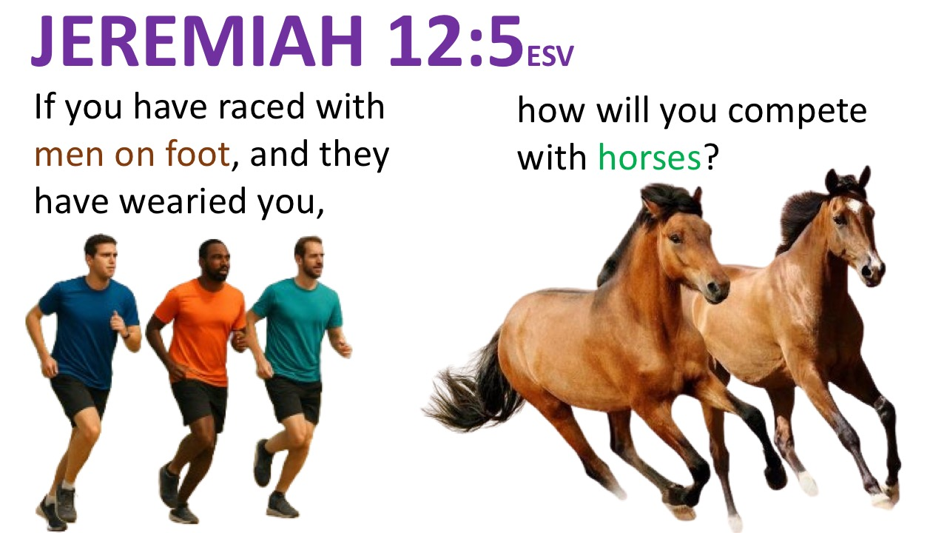
Footmen of Assisted Dying Bill Horses of Assisted Dying Law

Slide 9
FOOTMEN ARE A FORERUNNER TO HORSES
Footmen of Assisted Dying Bill Horses of Assisted Dying Law

Slide 10
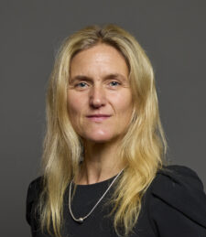
Kim Leadbeater’s Assisted Dying Bill Published
The Terminally Ill Adults (End of Life) Bill
Terminally Ill Adults (End of Life) Act 2024

Slide 11
Key elements of the Bill are:
The right to ask for help to die will be limited to people who have six months or fewer left to live;
Two independent doctors must be satisfied that the person is eligible and must, if necessary, consult a specialist in their condition and receive an assessment from an expert in mental capacity;
The application then goes before a High Court judge who must hear from at least one of the doctors and may hear from and question the person making the application and anybody else they consider appropriate;
No doctor will be under any obligation to participate in any part of the process;
If all the above safeguards and protections are met and the person still wishes to proceed, the medication must be self-administered.
With its six months time criterion the Bill will follow the format adopted by all of the states in the USA and several in Australia that allow assisted dying, and so will exclude most people with conditions like Parkinson’s, Huntington’s and Multiple Sclerosis from having the option of an assisted death. Debate of these cases will no doubt arise as the Bill progresses through the different stages of scrutiny. Age group - 18 years or older, and must be a mentally capable patient

Slide 12
LEGALISING
ASSISTED DYING / ASSISTED SUICIDE
WHICH OF THESE TWO TAKES
PRECEDENCE
LEGISLATIVE
PERSPECTIVE
PERSONAL AUTONOMY
BIBLICAL
GUIDANCE
SANCTITY OF LIFE

Slide 13
1 Peter 3:15
BIBLICAL PRINCIPLE
FOR
GUIDANCE
“But sanctify the Lord God in your hearts, and always be ready to give a defence to everyone who asks you a reason for the hope that is in you, with meekness and fear” (NKJV)
“But in your hearts set Christ apart as holy [and acknowledge Him] as Lord. Always be ready to give a logical defence to anyone who asks you to account for the hope that is in you, but do it courteously and respectfully” (AMP)

Slide 14

Homicide Act 1957
1957 CHAPTER 11
An Act to make for England and Wales (and for courts-martial wherever sitting) amendments of the law relating to homicide and the trial and punishment of murder, and for Scotland amendments of the law relating to the trial and punishment of murder and attempts to murder.
[21st March, 1957]
4 Suicide pacts
(1)It shall be manslaughter, and shall not be murder, for a person acting in pursuance of a suicide pact between him and another to kill the other or be a party to the other killing himself or being killed by a third person.
(2)Where it is shown that a person charged with the murder of another killed the other or was a party to his killing himself or being killed, it shall be for the defence to prove that the person charged was acting in pursuance of a suicide pact between him and the other.

Slide 15
Suicide Act 1961
1961 CHAPTER 60 9 and 10 Eliz 2
An Act to amend the law of England and Wales relating to suicide, and for purposes connected therewith.
[3rd August 1961]
1 Suicide to cease to be a crime.
The rule of law whereby it is a crime for a person to commit suicide is hereby abrogated.
2 Criminal liability for complicity in another’s suicide.
[F1(1)A person (“D”) commits an offence if—
(a) D does an act capable of encouraging or assisting the suicide or attempted suicide of another
person, and
(b) D's act was intended to encourage or assist suicide or an attempt at suicide.

Slide 17

Human Rights Act 1998
Article 8
Right to respect for private and family life
1 Everyone has the right to respect for his private and family life, his home and his correspondence.
There shall be no interference by a public authority with the exercise of this right except such as is in accordance with the law and is necessary in a democratic society in the interests of national security, public safety or the economic well-being of the country, for the prevention of disorder or crime, for the protection of health or morals, or for the protection of the rights and freedoms of others.

Slide 18
Suicide Act 1961
1961 CHAPTER 60 9 and 10 Eliz 2
An Act to amend the law of England and Wales relating to suicide, and for purposes connected therewith.
[3rd August 1961]
1 Suicide to cease to be a crime.
The rule of law whereby it is a crime for a person to commit suicide is hereby abrogated.
2 Criminal liability for complicity in another’s suicide.
[F1(1)A person (“D”) commits an offence if—
(a) D does an act capable of encouraging or assisting the suicide or attempted suicide of another
person, and
(b) D's act was intended to encourage or assist suicide or an attempt at suicide.

Slide 19
Lord Neuberger - President of the Supreme Court on the premise whether the court should declare that section 2 is incompatible with Article 8, he noted whether “the provisions of section 2 should be modified to him raised a difficult, controversial and sensitive issue, with moral and religious dimensions, which undoubtedly justifies a relatively cautious approach from the courts.”
Source: https://supremecourt.uk/uploads/uksc_2013_0235_judgment_5eb5de2114.pdf

Slide 20
The Sanctity of Life was duly acknowledged in English Common Law.
“It perceived suicide as an immoral, criminal offence against God and also against the Crown”.
Source: S M Canick (1997) constitutional aspects of physician - assisted suicide after Lee V Oregon am.jl &

Slide 21
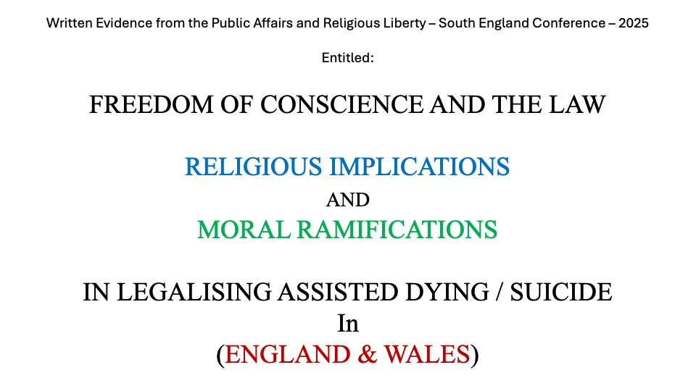
FREEDOM OF CONSCIENCE AND THE LAW
RELIGIOUS IMPLICATIONS
AND
MORAL RAMIFICATIONS
IN LEGALISING ASSISTED DYING / SUICIDE
In
(ENGLAND & WALES)

Slide 22
tiabilltiabill@parliament.uk
To:​You​
Fri 07/02/2025 13:53
Dear Brighton Gresham Kavaloh PhD,
Thank you for your email, which will be circulated to Members of the Committee.
Further information on the progress of the bill is available on:
https://bills.parliament.uk/bills/3774/publications
Kind regards,
Susan
Susan Ramsay | Team and External Support Manager
Scrutiny Unit | Select Committee Team | House of Commons
SCRUTINY UNIT
Strengthening scrutiny through specialist support

Slide 23
Divine Revelation (God’s Design)
¹ In the beginning God created the heaven and the earth.
²⁷ So God created man in His own image, in the image of God created He him; male and female created He them.
And God blessed the seventh day, and sanctified it: because that in it He had rested from all His work which God created and made.
Genesis 1:1 (KJV)
Genesis 1:27 (KJV)
Genesis 2:3 (KJV)

Slide 24
GOD’S CREATION OF HUMAN LIFE
Genesis 1:27
²⁷ So God created man in his own image, in the image of God created he him; male and female created he them.
Genesis 2:7
⁷ And the Lord God formed man of the dust of the ground, and breathed into his nostrils the breath of life; and man became a living soul.

Slide 25


Slide 26
SEVENTH-DAY ADVENTISTS DO NOT PRACTICE
“MERCY KILLING” OR ASSIST IN DYING / ASSIST IN SUICIDE
Exodus 20:13
¹³ Thou shalt not kill. (KJV)
¹³ You shall not murder. (ESV)

Slide 27


Slide 28
5. While Christian love may lead to the withholding or withdrawing of medical interventions that only increase suffering or prolong dying, Seventh-day Adventists do not practice “mercy killing” or assist in suicide (Genesis 9:5- 6; Exodus 20:13; 23:7). They are opposed to the intentional taking of the life of a suffering or dying person.

Slide 29
It has become common to discuss such questions under the heading of euthanasia. Much confusion exists with regard to this expression. The original and literal meaning of this term was “good death.” Today the term “euthanasia” is associated with “mercy killing,” or intentionally taking the life of a patient in order to avoid painful dying or in order to alleviate burdens for a patient’s family or society. Seventh-day Adventists believe that allowing a patient to die by foregoing medical interventions that only prolong suffering and postpone the moment of death is morally different from actions that have as their primary intention the direct taking of a life.

Slide 30
6. Christian compassion calls for the alleviation of suffering (Matthew 25:34-40; Luke 10:29-37). In caring for the dying, it is a Christian responsibility to relieve pain and suffering, to the fullest extent possible. When it is clear that medical intervention will not cure a patient, the primary goal of care should shift to relief from suffering. [Equivalent to palliative care]

Slide 31
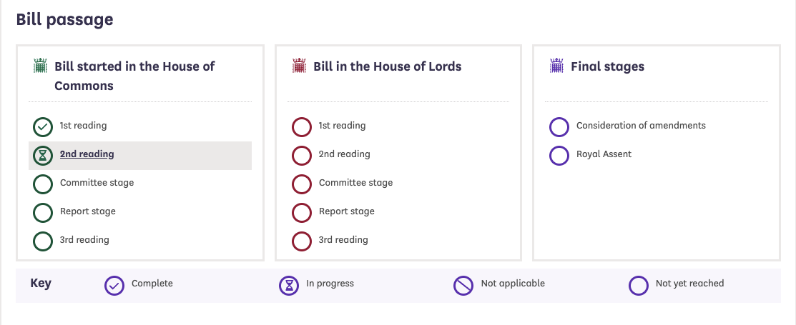

Slide 32
