Slide 1
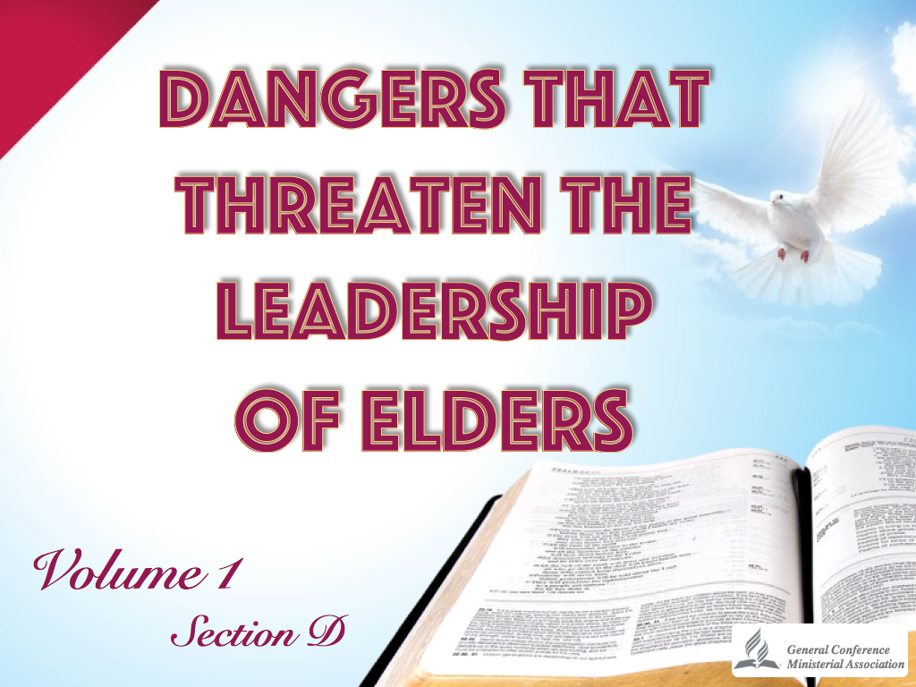

Slide 2

“Do not neglect your gift, which was given you through prophecy when the body of elders laid their hands on you. Be diligent in these matters; give yourself wholly to them, so that everyone may see your progress. Watch your life and doctrine closely. Persevere in them, because if you do, you will save both yourself and your hearers.”
1 Timothy 4:14-16

Slide 3
The fact of having been called by God, does not make us immune to sin and does not put us in a place where evil cannot reach us. The only thing that guarantees our immunity, is the constant presence of God in our lives and our close relationship with Jesus through prayer and Bible study.

Slide 4
  What things could destroy the leadership of church elders?

Slide 5
1. Feeling that they are the owners and masters of the church
Believing that they can decide for themselves some issues of the church.
Making decisions that do not pertain to them, but to the board, to the church, or to the pastor.
Thinking that only their opinions are to be taken into account.

Slide 6
Feeling bad and out of place if their counsel is not sought.
Jealously seeking power.
Not delegating responsibilities.
Turning into authoritarian leaders.
Making others think that they are the boss.

Slide 7
“…not lording it over those entrusted to you, but being examples to the flock.”
1 Peter 5:3

Slide 8
2. Competing or being rivals to the other leaders
Developing a spirit of competition.
Considering themselves as the best of all the leaders in the church.
Acting motivated by the feeling of being superior to the other leaders.

Slide 9
Trying to gain the sympathy of the brethren at the expense of damaging the image of the other leaders.
Criticizing other leaders and trying to reduce the influence they have on the brethren.

Slide 10
“Brothers and sisters, think of what you were when you were called. Not many of you were wise by human standards; not many were influential; not many were of noble birth. But God chose the foolish things of the world to shame the wise…so that no one may boast before him.”
1 Corinthians 1:26-27, 29

Slide 11
3. Becoming very sensitive to criticism
Being depressed if anyone criticizes or disagrees with their opinions.
Always being ready to confront whoever criticizes them.
Not analyzing judgments passed on them to learn if there is any validity in them, then correcting their errors promptly.

Slide 12
Always being on the defensive thinking that others are out to get them.
Differentiating between one criticism and another.
Getting to the point of not accepting counsel.
Thinking that only they are in the right and that they cannot err.

Slide 13
The case may be that they aim to pay back with the same coin those who criticize them.
Everyone who criticizes them is considered an enemy.

Slide 14
“If you can’t stand the heat, get out of the kitchen.”
Anonymous
“The only way to get the best of an argument is to avoid it.”
Dale Carnegie

Slide 15
4. Believing that their mission is to contradict the pastor
If the pastor is younger than they are, they think the pastor should not rule over them and, therefore, they will not support their pastor.
Schedule church board meetings without previously arranging them with the pastor.

Slide 16
Are not a shield for their pastor, but rather are ever ready to attack the pastor.
Do not have a good rapport with the pastor.
“Do not entertain an accusation against an elder unless it is brought by two or three witnesses.”
1 Timothy 5:19

Slide 17
5. Holding on to their position and thinking that they could never be replaced
Thinking that they should be elders all of their lives.
Refusing to accept another position decided by the church, and criticizing the new appointed elders.
Believing that the only important position there is, is being a church elder, and not understanding that: “It is people who make a position important and not positions that make people important.”

Slide 18
“Whoever believes he is too important to do small things, is too small to do the most important things.”
Anonymous

Slide 19
6. Male elders having too much familiarity with the opposite sex
Male elders openly confiding too much in the women of the church, which is an indiscretion that lends itself to misinterpretation.
Regularly greet and say goodbye to the ladies using expressions that denote too much familiarity.
When interacting with the brethren, it is evident that they physically get closer to the ladies than to the men.
Rubbing their bodies against the ladies, touching them inappropriately, or holding their hand too long when greeting them.

Slide 20
Male elders going out to do missionary work accompanied by sisters from the church, without their wives.
Thinking they will never fall into temptation.

Slide 21
“He must also have a good reputation with outsiders, so that he will not fall into disgrace and into the devil’s trap.”
1 Timothy 3:7

Slide 22
7. Ceasing to be leaders and turning into bosses
Leaders are an example of how things are to be done.
Bosses give orders for others to do them.
Leaders persuade, convince.
Bosses demand, intimidate.

Slide 23
Leaders are interested in the overall development of the group.
Bosses are only interested is their good name.
Leaders want to be followed by conviction.
Bosses are only interested in being obeyed.
Leaders promote the work as a team.
Bosses want everyone to revolve around them.

Slide 24
Leaders attribute all success to the team.
Bosses attribute all success to their own great endeavors.
Leaders delegate responsibilities and share the privileges.
Bosses try to hoard all the attention.

Slide 25
8. Being indifferent and tough with the children and youth of the church
Consider that the activities of the Adventurer Club are a waste of time.
Are ever ready to maximize the mistakes of the Adventurer Club.

Slide 26
Reprimand the children so severely as to give them the impression that they are the elders of terror.
Could care less for the children’s classes and are not a friend of the youth of the church.
“A great man shows his greatness by the way he treats little men.”
Thomas Carlyle

Slide 27
9. Turning into extremists and legislators
Believing that they are the ones that have to decide what is good or evil to do in the church.
Making extreme decisions without considering the consequences that this may bring to the church in the future.

Slide 28
Drawing from some personally formulated rules and committing them as denominational regulations.
Thinking that the church has to decide, reason and act according to their way of doing so.

Slide 29
“Watch your life and doctrine closely. Persevere in them, because if you do, you will save both yourself and your hearers.”
1 Timothy 4:16

Slide 30
10. Confiding more in their own experience than in their daily study of the Bible
Start to neglect the preparation of sermons.
Do not constantly review the Church Manual.
Are not too concerned about their personal, daily devotional time.

Slide 31
Believe that because of their experience, they can handle and solve anything.
Do not plan church programs and leave everything to the spur of the moment.
By browsing the internet they effect all necessary requirements for preaching.

Slide 32
“Until I come, devote yourself to the public reading of Scripture, to preaching and to teaching. Do not neglect your gift, which was given you through prophecy when the body of elders laid their hands on you.”
1 Timothy 4:13-14

Slide 33
11. Neglecting their families in favor of keeping their commitments to the church
Elders must render to their families the time and care that they require.
They must organize their time and activities, without neglecting their families or church.
No argument justifies being neglectful of either family or church

Slide 34
The first church the elders should commit to is their home as a church.
Their spouse, their children and their immediate family are the first and foremost flock that the elders have to tend.
If they neglect the discipline in their homes, they will ultimately lose all influence inside and outside of the church.

Slide 35
“He must manage his own family well and see that his children obey him, and he must do so in a manner worthy of full respect. (If anyone does not know how to manage his own family, how can he take care of God’s church?)”
1 Timothy 3:4-5

Slide 36
“God designs that in his home life the teacher of the Bible shall be an exemplification of the truths that he teaches. What a man is has greater influence than what he says.”
AH 353

Slide 37
“You have entrusted to you a little plot of ground; but your own dooryard is left to grow up with brambles and thorns, while you are engaged in weeding others’ gardens… You are preaching the gospel to others; practice it yourself at home.”
AH 356

Slide 38
12. Not delegating responsibilities
Some do not delegate because they believe they should do everything. They are wrong.
Some do not delegate because they do not trust the abilities of other leaders. This is wrong.
Others do not delegate because they do not want to share the honor. This is regretful.

Slide 39
Still others go to the extreme of delegating everything so that they do not feel responsible.
One must know when, to whom, and what things are to be delegated. One has to trust other leaders.
Before delegating, the person to receive the task must be made ready and able to carry on the responsibility.

Slide 40
“Men in responsible positions should credit others with some sense, with some ability of judgment and foresight, and look upon them as capable of doing the work committed to their hands.”
TM 302

Slide 41
“We want every responsible man to drop responsibilities upon others. Set others at work that will require them to plan, and to use judgment.”
TM 302

Slide 42
13. Thinking that every problem can be solved the same way
Each problem has its own solution.
It is possible that what worked to solve one problem will not work in other circumstances.

Slide 43
Keep in mind that people are different from one another.
Churches do not react in the same manner to the same problems.
A solution that solves the problem without causing another one must be found.

Slide 44
14. Allowing their relationship with Christ to grow weak
Do not trust your life experience. Trust Jesus.
Do not think that knowledge will help you go forward without Jesus.

Slide 45
Do not believe that personal charisma or being articulate will lead you to triumph at the end.
Do not trust the good name and image you have before the church.
Do not trust what is inside of you. Trust only Jesus. He will indeed help you triumph.

Slide 46
“If you point these things out to the brothers and sisters, you will be a good minister of Christ Jesus, nourished on the truths of the faith and of the good teaching that you have followed. Have nothing to do with godless myths and old wives’ tales; rather, train yourself to be godly.”
1 Timothy 4:6-7

Slide 47
Recapitulating what we studied

Slide 48
Point out eight traits which could destroy the influence of church elders
Feeling that they are the owners and masters of the church.
Competing with other leaders.
Being too sensitive when criticized.
Trusting more their life experience than their daily study of the Bible.

Slide 49
Becoming extremists and legislators.
Believing that all problems can be solved in the same manner.
Not delegating responsibilities.
Allowing their relationship with Jesus to grow weak.

