Slide 1
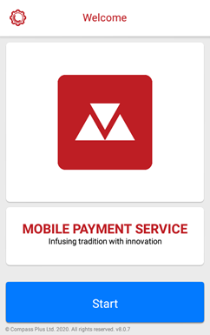
An introduction to using MobiCash
for the first time
for members of the Seventh Day Adventist Church congregation

Slide 2
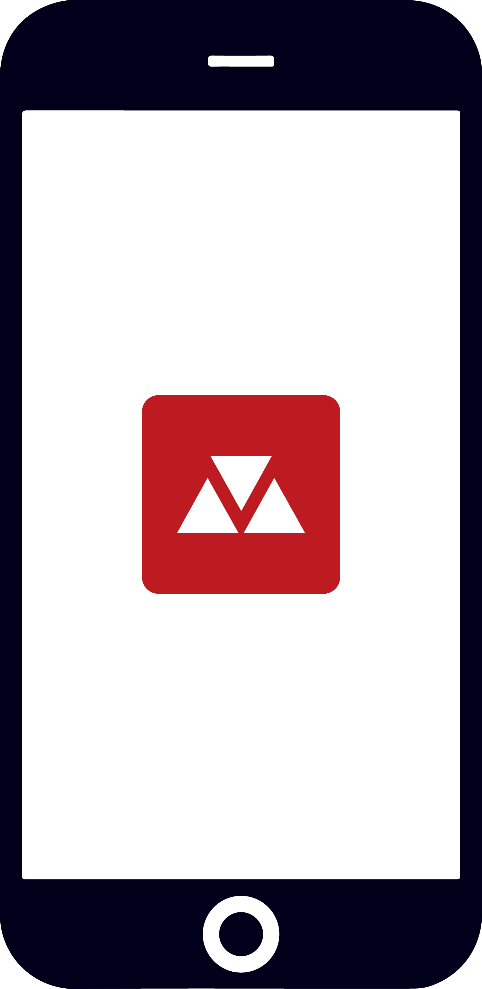
Introduction
People are carrying less and less cash on them
Almost everyone has a mobile phone
We want to make it easier for you to donate
We have worked with an established payments companies that have 30+ years experience in payments and is trusted by customers worldwide to give you a secure and convenient way to donate using your mobile phone - MobiCash

Slide 3
Why use MobiCash?
For you
No cash is no problem
Once your details are entered & the first payment made, then future payments are:
Easy
Secure
Quick
Include Gift Aid
For your church
Accounting is easier
Gift Aid is collected

Slide 4
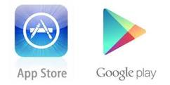
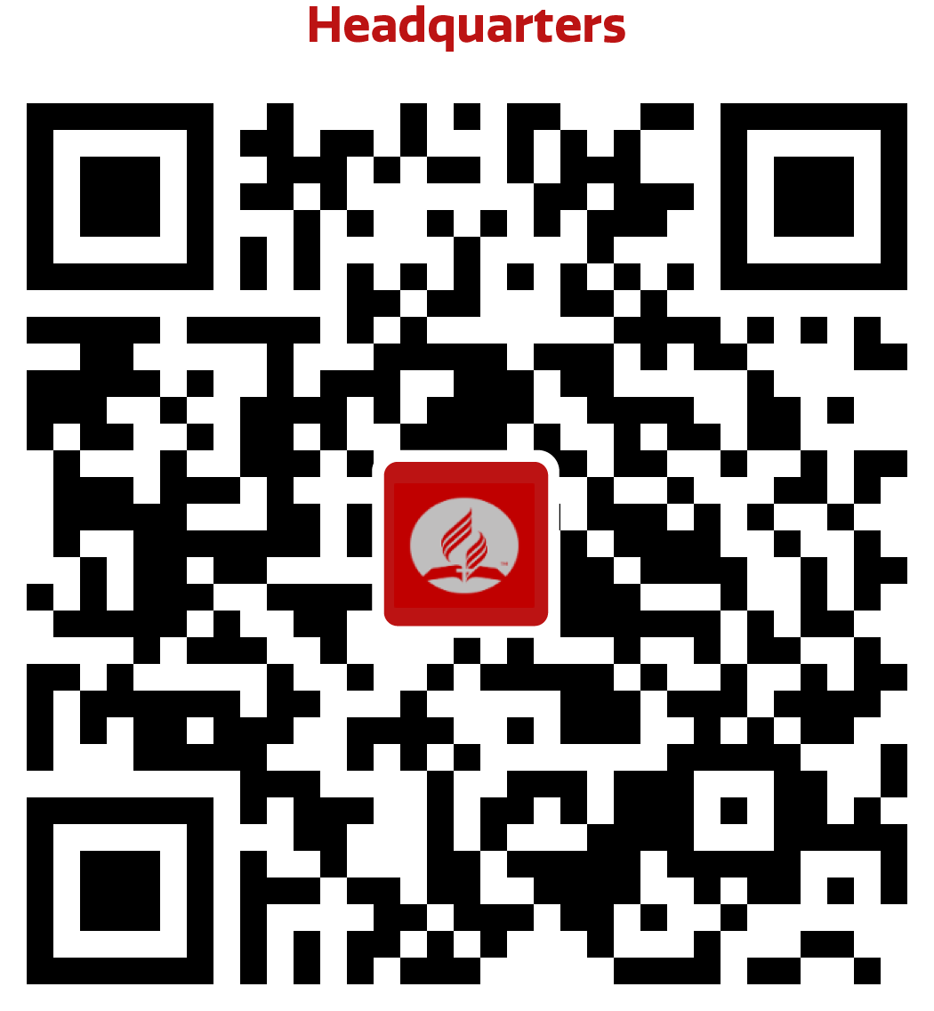
How to get started
Scan this QR code to download now!
Or text MOBICASH to 70500
Download the app
Follow the simple registration process
Add a bank card or Apple Pay/Google Pay to MobiCash
You will be able to make donations anytime, anywhere!

Slide 5
Opening MobiCash for the first time
Click Start

Slide 6
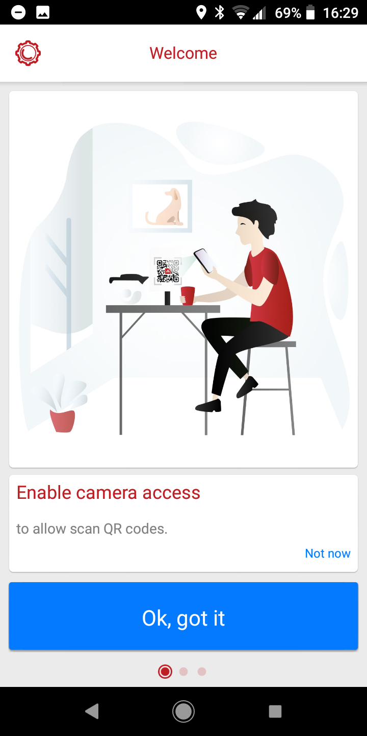
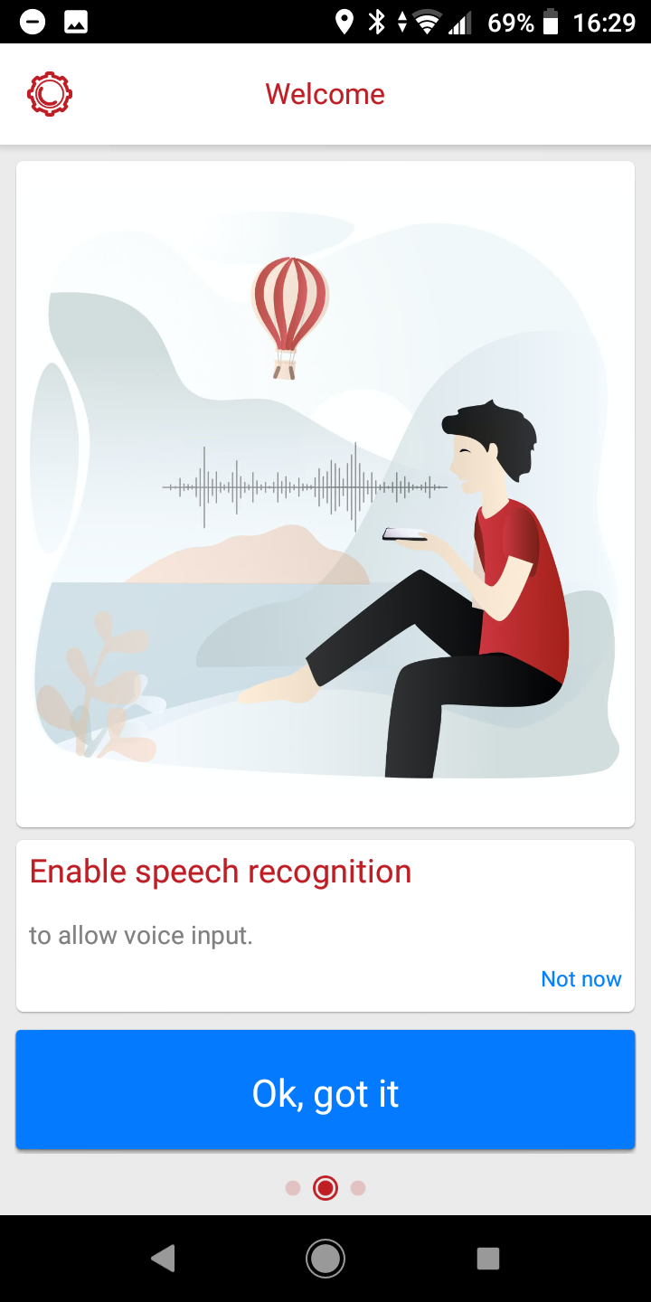
Allow access
Give MobiCash permission to access your:
Camera – to view QR codes
Gallery – to store receipts
Giving permission to access speech recognition is optional

Slide 7
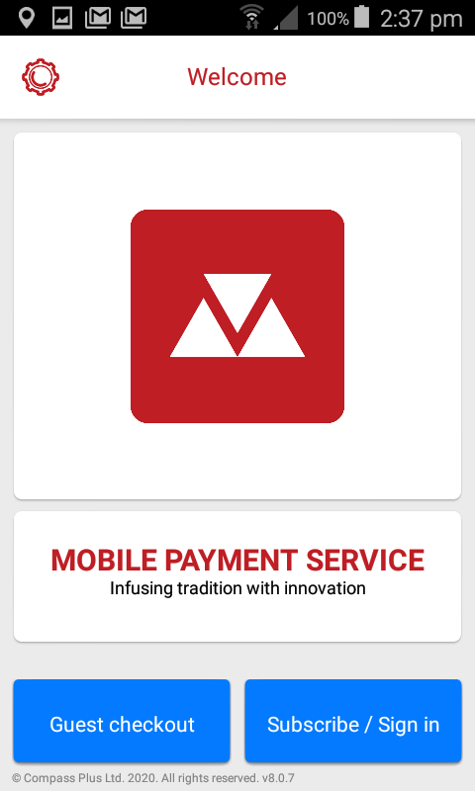
Subscribing to MobiCash
Click Subscribe/Sign in
If you use Guest mode, your payment and Gift Aid information will not be saved for future use
Don’t worry, the service is completely free to use

Slide 8
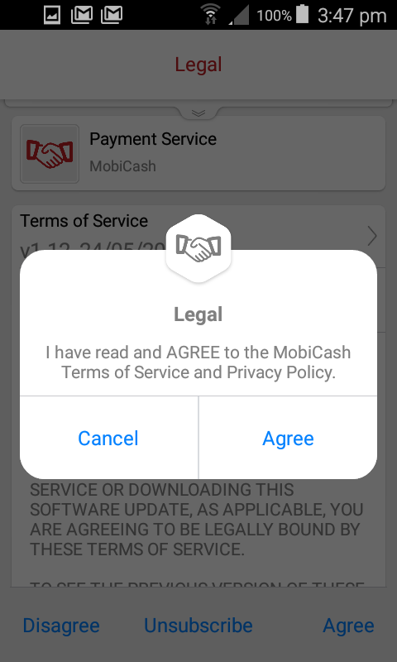
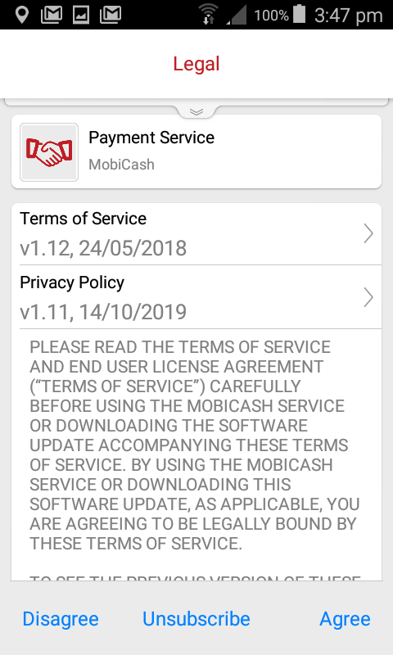
Subscribing to MobiCash
Read the service Terms & Conditions and click Agree

Slide 9
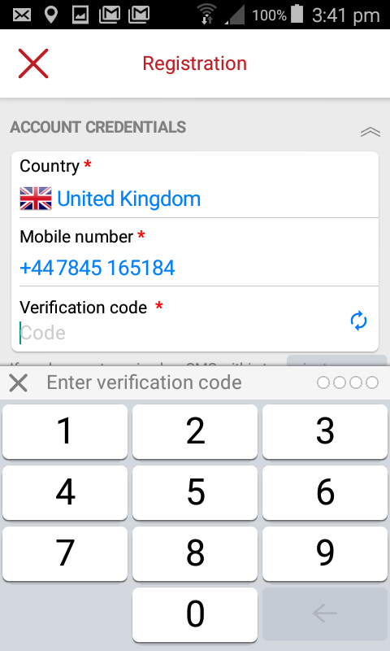
Subscribing to MobiCash
Enter your mobile number followed by the 4-digit verification code you will receive by SMS

Slide 10
Create your PIN
You will then be asked to enter a 4-digit PIN. This PIN will secure your access to MobiCash app
Please DO NOT use your bank card PIN

Slide 11
Set up your security
There are 3 ways of accessing the service:
DigiPad (a traditional keyboard) will require you to enter your PIN to access the service
MemPad (a mosaic keyboard) will also require you to enter your PIN
Biometric authentication
Choose the method you are the most comfortable with
Click Subscribe to finish the registration process

Slide 12
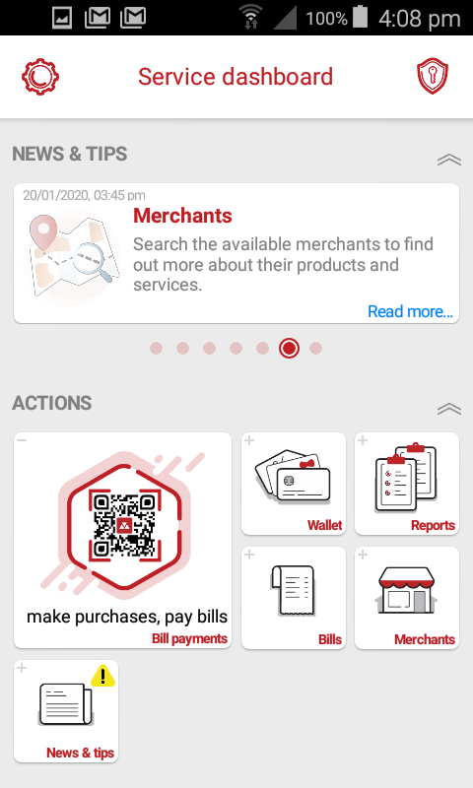
The main dashboard
Welcome to the main dashboard
Let’s have a look around...

Slide 13
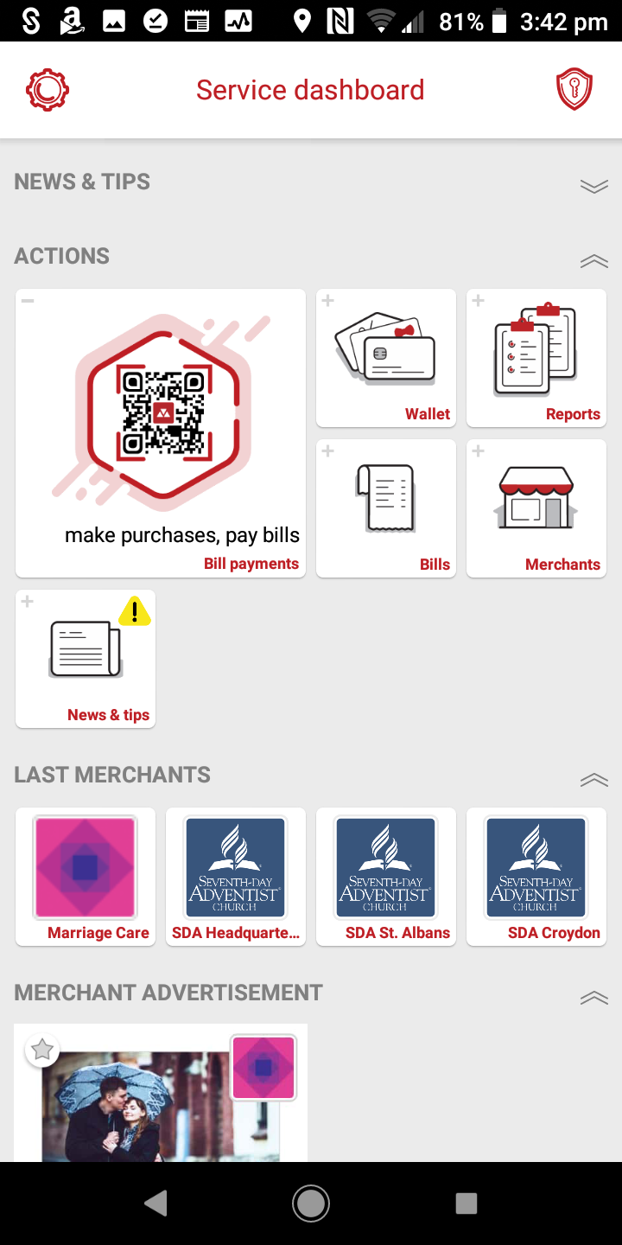
MobiCash dashboard overview
Manage your account
Manage your settings
Manage your wallet
View your spending reports
Scan QR codes
View where you can use MobiCash
View your bill payment history and pending bills
Access your recent donations
See what promotions are available

Slide 14
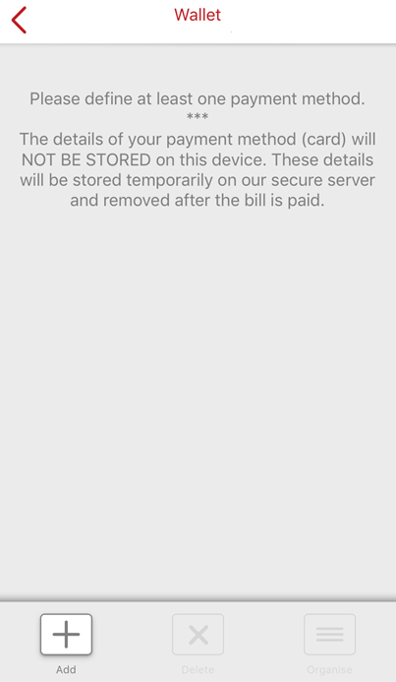
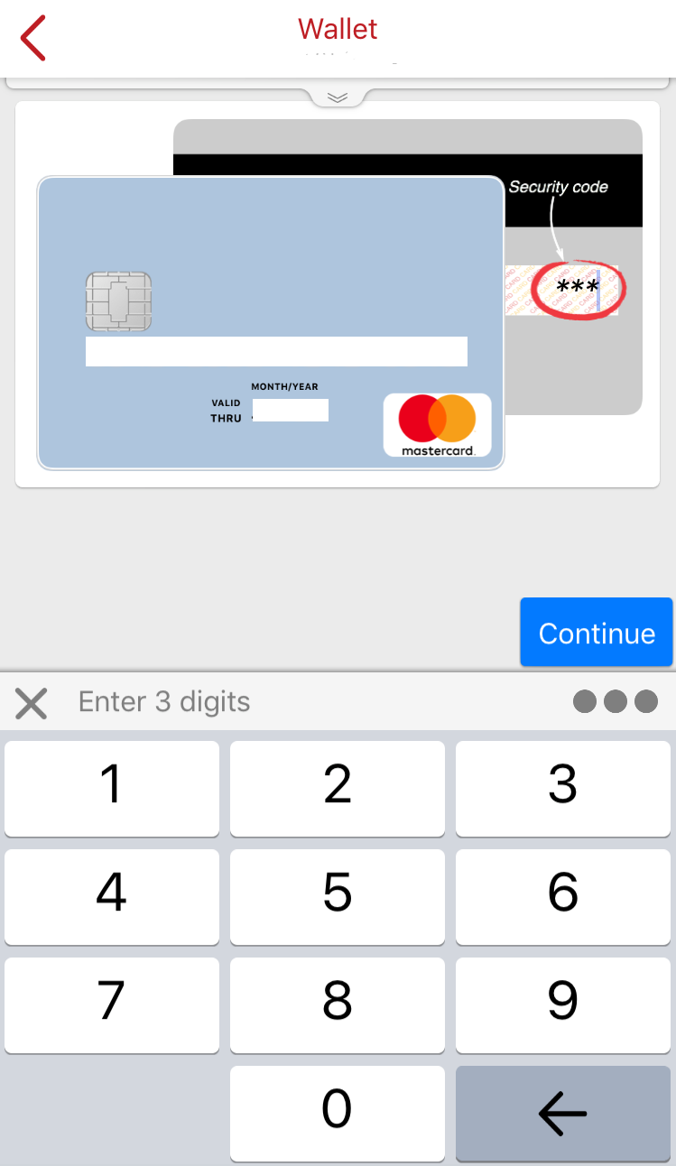
Add a payment card to the MobiCash Wallet
Go to the Wallet from the main dashboard
Click Add
Enter your card details (photo or manually) and confirm when prompted

Slide 15
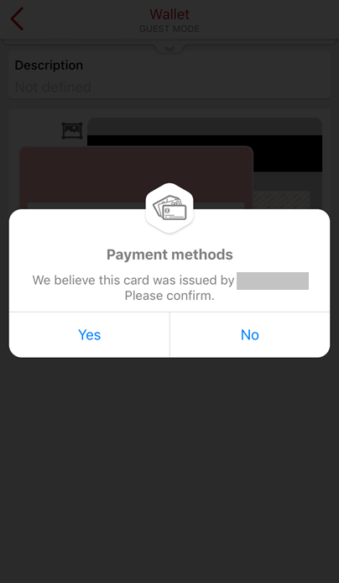
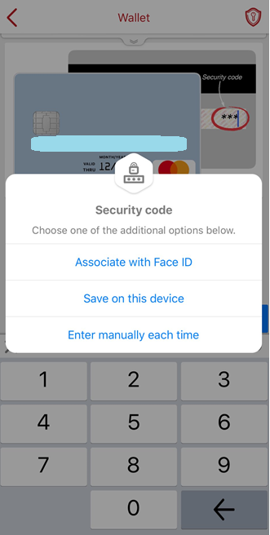
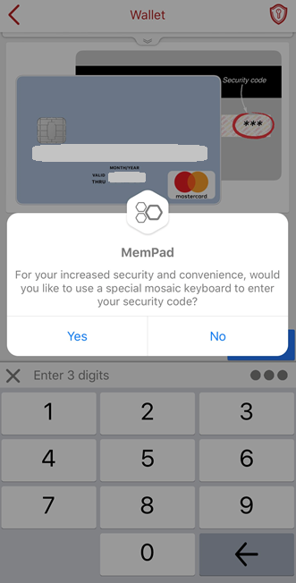
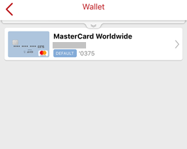
Your card details are now linked to your MobiCash account, and you are ready to make a payment!
You can delete, change or add payment methods to your Wallet at any time
Confirm your bank when prompted
Additional security may be offered depending on your device
MemPad is an advanced security keyboard in MobiCash that you can enable if and when you choose

Slide 16
Using QR codes in MobiCash to donate
MobiCash can help you make a donation faster. Scanning an SDA QR code in MobiCash will take you directly to your church’s page to complete your donation
Click Make purchases, pay bills on the main dashboard to open a QR code scanner

Slide 17
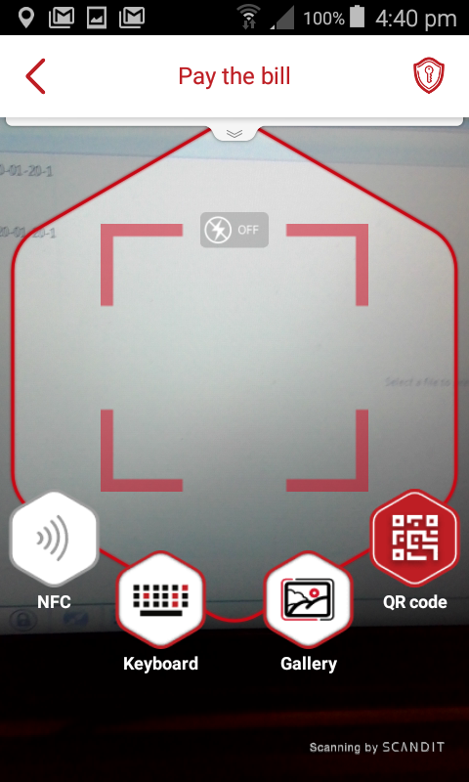
Scanning a QR code
Scanning a QR code is like taking a photo. Point the camera at your church’s MobiCash QR code to donate
Each church and ministry (e.g. Youth) has a unique QR code.

Slide 18
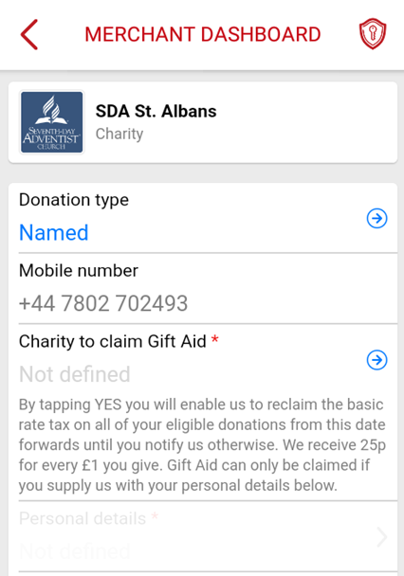
Example: donate to SDA St Albans Donation type
Choose the donation type:
Named
Anonymous
If you want to add Gift Aid, your donation has to be Named
Gift Aid allows the church to receive an additional 25% of the value of your donation

Slide 19
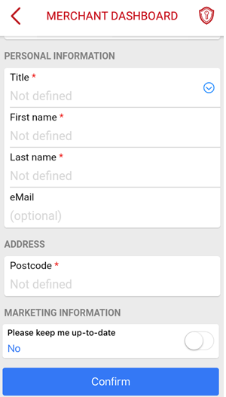
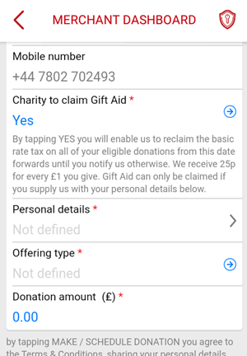
Example: donate to SDA St Albans
Adding Gift Aid
Click Yes for Gift Aid, then you will be required to enter some personal details
You only need to do this once. Your personal details will be securely stored for future donations

Slide 20
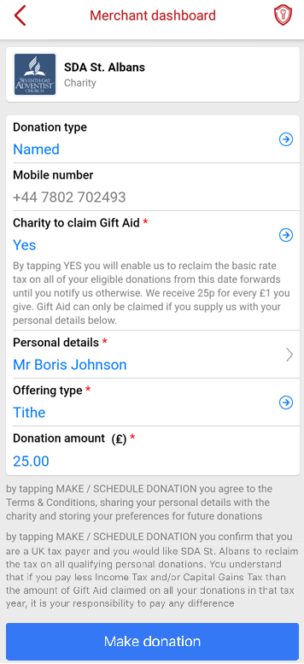
Example: donate to SDA St Albans
Next steps
Select the offering type and donation amount*
Scroll down and click Make Donation
You have successfully made a donation!
* Some QR codes are for fixed amount donations. This will be clearly stated by the church

Slide 21
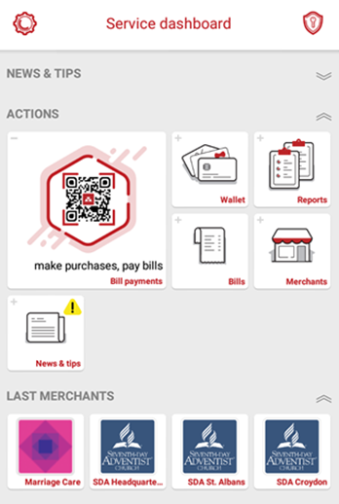
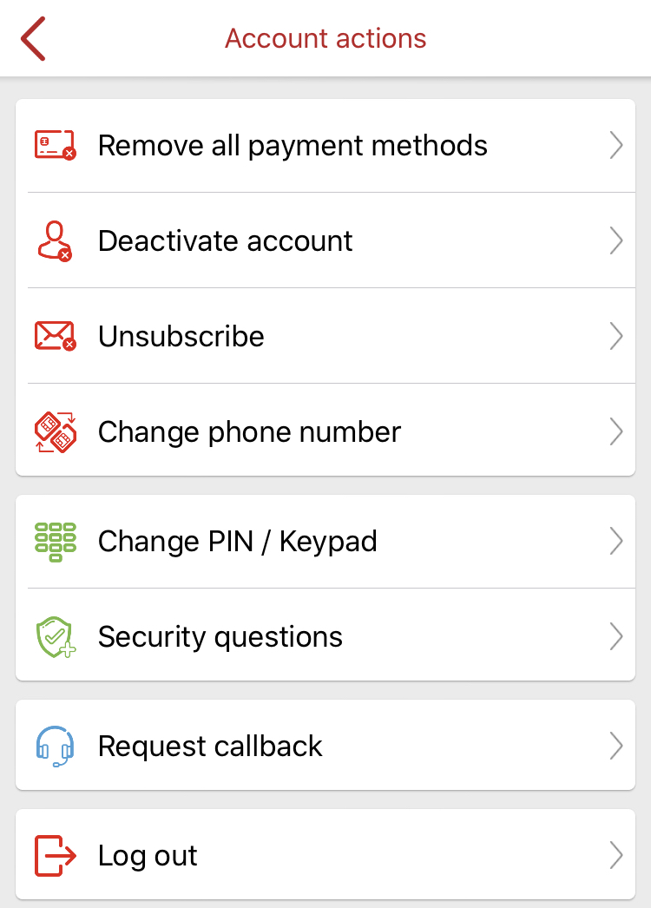
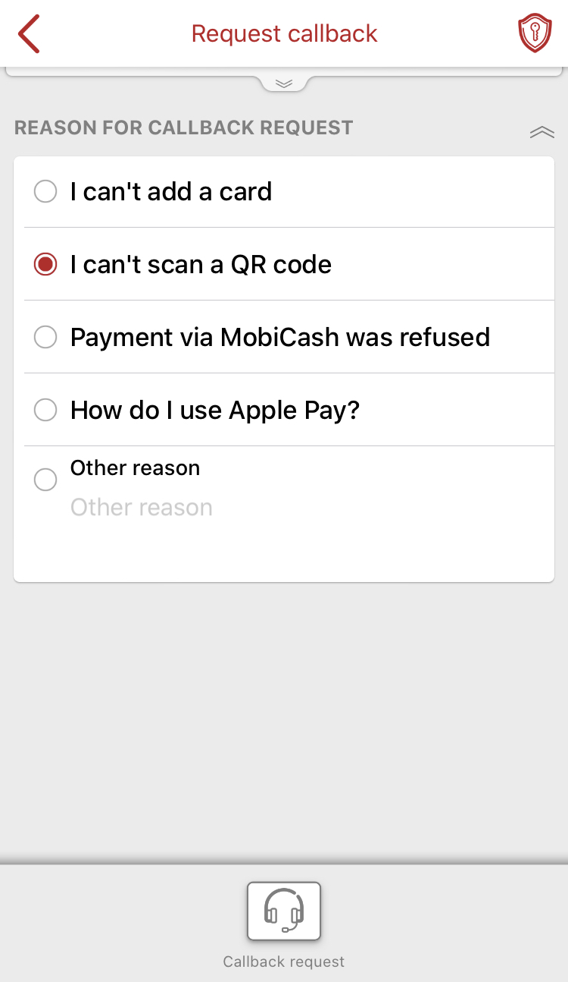
Support
If you are having problems with a payment or the app itself, request a callback and the MobiCash Support team will contact you:
Go to Account actions
Click Request callback
Choose a reason for your request, then submit

